Slide 1
2018-19 Financial Aid Night at (fill-in) High School
October 2017

Slide 2
Presented By
Cathy Mueller
Executive Director
Mapping Your Future

Slide 3
Agenda
Planning for college
Resources
Paying for college
Free Application for Federal Student Aid (FAFSA)
South Dakota programs
Choosing a career
Selecting a school

Slide 4
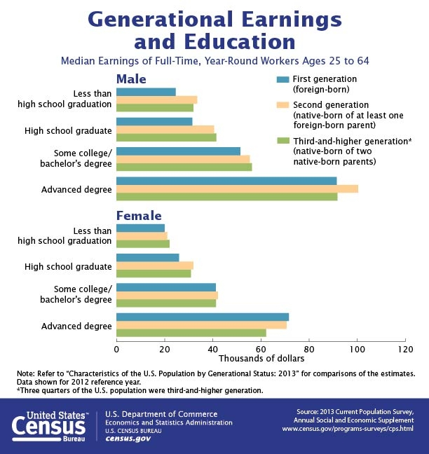
https://www.census.gov/library/visualizations/2016/comm/cb16-203_earnings_education.html

Slide 5
Three major decisions
Choosing a career
Selecting a school
Paying for education

Slide 6
Choosing a Career
Develop a career plan
Assess your skills and interests
Research careers and requirements
Determine which schools have the needed programs
Decide which school to attend

Slide 7
Selecting a School
Program of study
Type of school
Cost of attendance
Other factors
Size of school
Location
Activities

Slide 8
Types of schools
Public vs. private
2-year vs. 4-year
Professional and technical
Theological
Proprietary
Notes:
Public schools
•Schools which use public funds as a major source of support
•4-year public schools
◦Offer bachelor’s degree programs
◦May offer master’s, doctoral, and professional degrees
•2-year public schools
◦Offer associate’s degree programs
◦May offer certificate programs or contract training
◦Most are community colleges
Independent/private schools
•Mainly supported by private funds
•4-year private schools
◦Offer bachelor’s degree programs
◦May offer master’s, doctoral, and professional degrees
•2-year private schools
◦Offer associate’s degree programs
◦May offer certificate programs or contract training
◦Most are junior colleges
Professional and technical schools
Degree and non-degree-granting institutions that prepare students for direct entry into the workforce in a specific occupational field
Theological schools
Private schools that incorporate religion or focus on religious occupations and are supported by a church body or congregation
Proprietary/private career schools
•Privately owned and controlled schools or out-of-state institutions offering courses and programs in your state
•Many offer degrees or less than degree level programs, and prepare students for direct entry into an occupation or profession

Slide 9
Paying for education
Savings
Financial aid
Cash/earnings
Tax credits and deductions
Notes:
These are some of the large categories that you can use to pay for college.

Slide 10
Saving money
It’s never too early or too late to start!
Set short-term goal for summer earnings
Pay yourself first
Notes:
I can’t emphasize enough that it’s not too early or too late to start saving for college. Maybe you will have a summer job and you can set a goal to save enough for your first semester’s books. Don’t forget to see if you can come back to that job during Christmas break! I was fortunate to work for the Missouri Dept. of Transportation in the summers and Christmas breaks. In the late 80’s, $5-6 an hour went further than it does today and with my scholarships I was able to save enough to pay my tuition, room & board for all four years of my education. Today’s tuition prices are a lot different, but don’t let that discourage you from saving.

Slide 11
Sources and types of financial aid
Sources
Types
School-based (colleges and universities)
Private
Community and civic organizations
Employers
State
Federal
Need-based
Non-need based

Slide 12
Types of financial aid
Grants
Pell Grant
Scholarships
State
School-specific
Local
Work-study programs
Loans
Direct Loans
Direct PLUS Loans
Private/alternative
Notes:
There is a variety of types of financial aid. The sources include federal, state, institutional, and private. Grants, scholarships and work-study funds generally don’t have to be repaid. Students loans should be a last resort

Slide 13
Sample maximum financial aid amounts
Pell Grant: $5,920*
Direct Loan: $5,500
Up to $3,500 Subsidized
Remaining $5,500 can be Unsubsidized
PLUS Loan: Parents can borrow up to the cost of attendance less financial aid
*For the 2017-18 academic year
**For the 2016-17 academic year
Notes:
Access Missouri:
Bright Flight $3,000--ACT Score:
31 or above
OR
SAT Critical Reading and Math Scores:
800 and 800
$1,000
ACT Score:
30
OR
SAT Critical Reading and Math Scores:
760-799 and 770-799
The table below displays the minimum and maximum annual awards for each school type as established by the statute. Award amounts may be less than those shown in the table depending on the amount of funding that is available for the program. Award amounts may vary depending on your total financial aid package.
Public 2-Year Public 4-Year, State Technical College of Missouri, and Private Maximum Minimum Maximum Minimum
$1,300 $300 $2,850 $1,500

Slide 14
Financial aid process
Complete the Free Application for Federal Student Aid (FAFSA)
Receive Student Aid Report
Receive award letter from the school
Decide which aid to accept and return award letter
Notes:
It’s early for you to think about filing a FAFSA—explain the FAFSA.
Each year you will need to complete a renewal FAFSA and go through the SAR and award letter processes again.

Slide 15
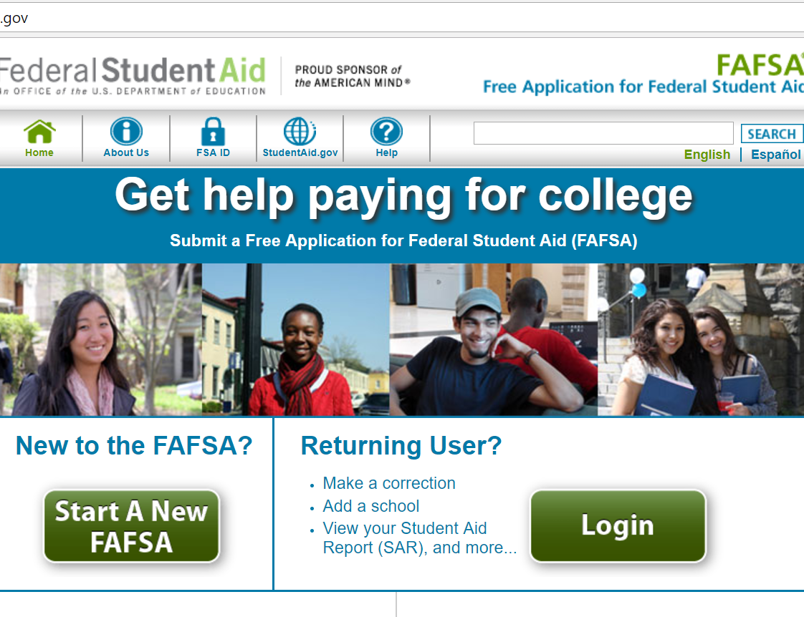
What is the FAFSA?
Free Application for Federal Student Aid
Base application for various forms of financial aid (need based and non-need based)
Federal
State
Institutional
Private
Available October 1, 2017 for 2018-19 academic year
Notes:
First, let’s answer the question, what is the FAFSA? The FAFSA is the Free Application for Federal Student Aid that is the base application for various forms of financial aid (both need-based and non-need-based).
Federal aid—such as Pell Grants and subsidized and unsubsidized Direct Loans, as well as
State, institutional, and private grants and scholarships.
You should watch filing deadlines for the various aid programs, especially college financial aid application deadlines. Also, keep in mind that colleges may have another grant or scholarship application as well, but the FAFSA is likely a part of the process. The state application deadlines are listed on the FOTW worksheets and FAFSA website.

Slide 16
Completing the FAFSA
Creating an FSA ID
Gathering the Documents Needed to Apply
Getting Help
Starting Your FAFSA® Form at FAFSA.gov and Providing Your Basic Personal Information
Listing Colleges and/or Career Schools

Slide 17
Completing the FAFSA
Determining Your Dependency Status
Reporting Parents’ Information
Providing Financial Information
Automatically Transferring Your Tax Information Using the IRS Data Retrieval Tool
Signing and Submitting the FAFSA® Form
Taking the Next Steps

Slide 18
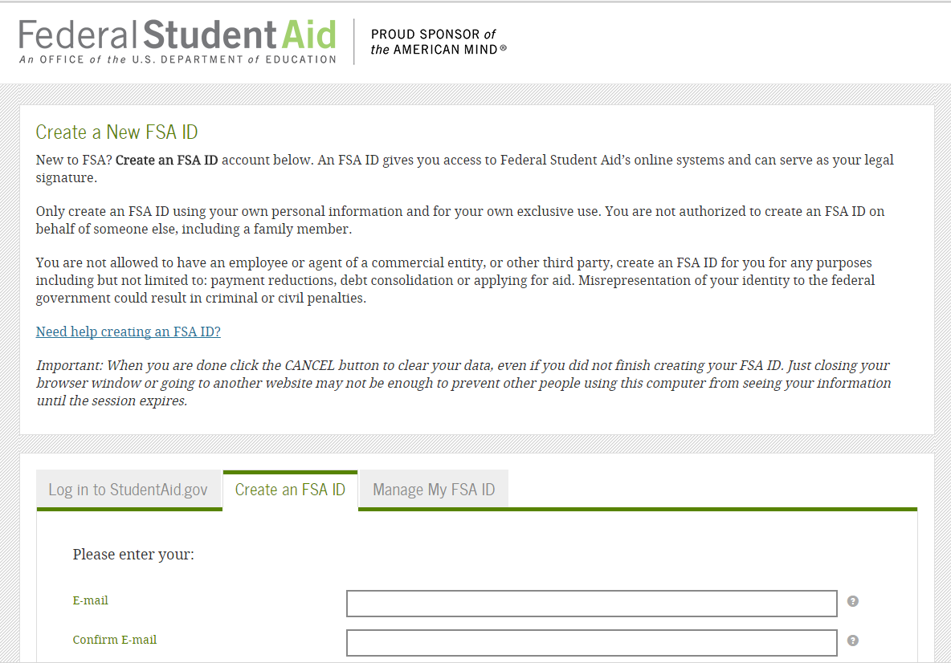
Obtain an FSA ID
Go to https://fsaid.ed.gov/
Enter your log-in information
Enter your personal information
Submit your information.
18

Slide 19
Who needs an FSA ID?
Student
To retrieve tax information, if applicable
To sign the FAFSA
To apply for Direct Loans
To sign in to the FAFSA
Parent
To retrieve tax information, if applicable
To obtain a Direct PLUS (Parent) Loan
One parent must sign the FAFSA for a dependent student
Notes:
Who needs an FSA ID? The answer is that both the student and the parent (if the student is a dependent student—which we will define a little later) need one. We recommend setting up the FSA ID before sitting down to complete the FAFSA, as it can help speed up the FAFSA completion process.
Students and parents use their FSA ID in the FAFSA itself. . .students can use theirs to log into the FAFSA and both students and parents can use the FSA ID to access their tax information and to sign the FAFSA electronically.
Your FSA ID can be used electronically to sign the Master Promissory Note for Direct Loans and to access your Federal Student Aid records online.
Be sure to keep your FSA ID a safe place, as it serves as your electronic signature and provides access to your personal records, so you should never give your FSA ID to anyone, including commercial services that may offer to help you complete your FAFSA. We do recommend using free resources to get help completing the FAFSA.

Slide 20
FAFSA on the Web Worksheet
20

Slide 21
Gathering documents needed
Your Social Security number
Your parents’ Social Security numbers
Your driver’s license number
Your Alien Registration number (if not a U.S. citizen)
Federal tax information or tax returns including IRS W-2 information, for you and for your parents
Records of your untaxed income
Information on cash, savings and checking account balances, investments
21

Slide 22
What are the FAFSA sections?
Student demographics
School selection
Dependency status
Parent demographics
Financial information
Sign and submit
Notes:
As outlined in the gray bar in this screenshot, there are different sections of the FAFSA that you are required to complete, including:
Student demographics
School selection
Dependency status
Parent demographics
Financial information
Sign & submit
Confirmation
The FAFSA will walk you through each section in the order identified above. If you would like to return to a prior section, you can click on the section header or click previous. Don’t use the back button on your browser, instead use the Previous and Next buttons that you will see at the bottom of each page.
On this screen, there are a few frequently asked questions. If we were to click on the “how long will it take to complete?” question, it would expand to show the answer—The FAFSA should take less than one hour to complete depending on your answers and whether or not you have the necessary information available.

Slide 23
What does the FAFSA ask about the student?
Student information
Enrollment plans
High school information
Citizenship status
Selective Service registration (if applicable)
Drug conviction questions(only if received federal student aid before)
Degree plans
Parents’ educational level
Colleges to receive FAFSA information
Housing plans
Notes:
Students must enter their information in this section. Keep an eye on the banner on the left of the screen so the parent information is not inadvertently entered.
The Student demographic section includes:
Student information as shown above
Enrollment plans and
High School information
Some information will be prefilled if the student logged in with his FSA ID.
A common question is why the FAFSA asks about state residency. This question is used to gather information for state and institutional scholarship programs.

Slide 24
Are you a dependent or an independent student?
24
Notes:
The dependency questions listed on this slide are key to the FAFSA process, as the answers help determine whether the student is considered a dependent or an independent student.
Examples of the questions include:
Were you born before 1/1/1993?
Are you married?
Will you be working on a graduate or professional degree in the 2016-17 academic year?
Do you have a child (or other individual) for whom you provide more than half of their support?
Are you a veteran or are you currently serving in the US Armed Forces?
At any time since you were 13, were both your parents deceased, were you in foster care, or were you a dependent or ward of the court?
Are you or were you an emancipated minor?
Are you or were you in a legal guardianship?
On or after 7/1/15, were you homeless or were you self-supporting and at risk of being homeless?
On the next slide, we are going to go into more detail about the topic of unaccompanied homeless youth.
Here are the 2014-15 questions that determine your dependency status:
http://studentaid.ed.gov/fafsa/filling-out/dependency#dependent-or-independent

Slide 25
Who is the parent for FAFSA purposes?
Your biological and/or adoptive parents are considered your legal parents.
Student must report information for both biological or adoptive parents if they are married or unmarried and living together
Grandparents, foster parents, legal guardians, older brothers or sisters, and aunts and uncles are not considered parents unless they have legally adopted you.
Notes:
Bullet taken off slide: Use the table on an upcoming slide to determine whose information to provide on the FAFSA based on your parents' marital status.
The definition of parent for FAFSA purposes can generate a lot of discussion and questions. The definition of parents changed a little for the 2014-15 FAFSA processing year, such as the:
Definition of married
Parental information changes
Revised responses for parent marital status
Revised labels for many parent questions, i.e., Parent 1 and Parent 2
Your biological and/or adoptive parents are considered your legal parents. Grandparents, foster parents, legal guardians, older brothers or sisters, and aunts and uncles are not considered parents unless they have legally adopted you.
Use the table on the next page to determine whose information to provide on the FAFSA based on your parents' marital status.
From Jennifer’s notes: See Dear Colleague Letter GEN-13-25
Change due to Supreme Court’s decision in United States v. Windsor
For federal financial aid purposes, a student or a parent is considered married if he or she was legally married in any domestic or foreign jurisdiction that recognizes the relationship as a valid marriage, regardless of where the couple resides

Slide 26
Who is the parent?
Parents' marital status: | Provide information for:
Married | Both of your parents
Unmarried and both parents living together | Both of your parents
Remarried (after being widowed or divorced) | Parent and Stepparent
Never married and not living together | The parent that you lived with most during the last 12 months. If you did not live with one parent more than the other, provide information about the parent who provided more financial support during the last 12 months, or during the most recent year that you actually received support from a parent.
Divorced or Separated | The parent that you lived with most during the last 12 months. If you did not live with one parent more than the other, provide information about the parent who provided more financial support during the last 12 months, or during the most recent year that you actually received support from a parent.
Widowed | Your parent

Slide 27
What information is asked about the parent(s)?
Marital status and date
Social security numbers
First initial, last name
Date of birth
E-mail address
Lived in state at least 5 years?
Household size
Number in college
Notes:
We just established who the parent(s) are for the purpose of the FAFSA, so listed on this slide are the first fields to be completed by the parent.
Purpose: Your parents must provide financial information for parents if you are a dependent student. The EFC calculation, determined by congressional formula, uses information from this part to determine what portion of your parents’ income and assets should be available to contribute to your educational cost of attendance.

Slide 28
Who is included in the household?
Student
Parent(s)
Children: Other than the student, regardless if they live in the household*
Other people: Such as a grandparent, who live with the parents*
*Must receive more than half of their support from the parent(s), and will continue to receive more than half of their support from the parent(s) between July 1, 2018 and June 30, 2019
Notes:
Number in parents’ household. The following persons are included in your parents’ household size:
• You (the student), even if you do not live with your parents.
• Your parents (the ones whose information is reported on the FAFSA).
• Your parents’ other children, if your parents will provide more than half of their support from July 1, 2014 through June 30, 2015 or if the other children could answer “No” to every question in Questions 46–58.
• Your parents’ unborn child, if that child will be born before July 1, 2014 and your parents will provide more than half of the child’s support from the projected date of birth through the end of the 2014–15 award year (June 30, 2015). (If there is a medical determination of a multiple birth, then all expected children can be included.)
• Other people (including your children and/or your unborn child due before July 1, 2015), if they live with and receive more than half of their support from your parents at the time of application and will continue to receive that support from July 1, 2014 through June 30, 2015.
To determine whether to include children in the household size, the “support” test is used (rather than a residency requirement) because there may be situations in which a parent supports a child who does not live with the parent, especially in cases where the parent is divorced or separated. In such cases, the parent who provides more than half of the child’s support may claim the child in his or her household size. It does not matter which parent claims the child as a dependent for tax purposes. If your parent receives benefits (such as Social Security or Temporary Assistance for Needy Families [TANF] payments) in the child’s name, these benefits must be counted as parental support to the child.
Support includes money, gifts, loans, housing, food, clothes, car payments or expenses, medical and dental care, and payment of school costs.

Slide 29
Who is included in the number in college? Dependent student
Student
NOT the parent(s)
Others attending at least half time in an approved program during 2018-19 that leads to a degree or certificate at a postsecondary school eligible to participate in any of the federal student aid programs
Do not include students enrolled at military academies
Notes:
Enter the number of people from the parents’ household (in question 73) who are or will be enrolled in a postsecondary school in 2014–2015. Count yourself as a college student. Include others only if they will be attending at least half time in an approved program during 2014–2015 that leads to a degree or certificate at a postsecondary school eligible to participate in any of the federal student aid programs.
Do not include your parents. Also do not include a student at a U.S. military academy because the family is not expected to contribute to that student’s postsecondary educational cost at the academy.

Slide 30
What financial information is needed?
Adjusted gross income (AGI)-income earned from work
Tax paid
Untaxed income
Education credits
Child support paid
Taxable earnings from need-based employment programs
Taxable grant and scholarship aid
Combat pay or special combat pay
Earnings from a coop program
Notes:
Education credits. Enter the total amount of American Opportunity, Hope, or Lifetime Learning credits you (or your spouse) received from Form 1040—line 49 or 1040A—line 31. The American Opportunity, Hope, or Lifetime Learning tax credits benefit students or parents who pay tuition and related expenses for attendance at least half time in a degree-granting program. These tax credits are subtracted directly from the total federal tax on a tax return. For more information about these tax credits, visit the IRS website at
www.irs.gov/pub/irs-pdf/p970.pdf.
b. Child support payments. Enter any child support payments paid by you (or your spouse) because of divorce, separation, or as a result of a legal requirement. Do 43
not include support for children in your household, as reported in the “number in household” question on the FAFSA (Question 93 for independent students). For purposes of the FAFSA, a child is a member of your household if you provide more than half of the child’s support, whether the child lives with you or not.
c. Taxable earnings from need-based employment programs. Enter earnings from any need-based work programs including Federal Work-Study and need-based employment portions of fellowships and assistantships.
d. Student grants and other awards. Enter any student grant and scholarship aid reported to the IRS in your AGI. This includes AmeriCorps benefits (awards, living allowances, and interest accrual payments), as well as grant and scholarship portions of fellowships and assistantships.
e. Combat Pay or Special Combat Pay. Enter only the amount that was taxable and included in your adjusted gross income. Don’t include untaxed combat pay reported on the W-2 (Box 12, Code Q).
f. Earnings from work under a cooperative education program. Enter here any amounts you earned from work under a cooperative education program offered by an institution of higher education.

Slide 31
What are the asset questions?

Slide 32
Determining the value of assets
Market value
Debt owed
Net value

Slide 33
What is untaxed income?
Payments to tax-deferred pension and savings plans
IRA deductions and payments to self-employed SEP, SIMPLE, Keogh
Child support received
Tax exempt interest income
Untaxed portions of IRA distributions
Untaxed portions of pensions
Housing, food or other living allowances to military, clergy, others
Veterans non-education benefits
Other untaxed income
Exclusions are also listed
Notes:
Payments to tax-deferred pension and savings plans. Enter amounts paid into tax-sheltered or deferred annuities (whether paid directly or withheld from earnings). You must include untaxed portions of 401(k) and 403(b) plans. Note that employer contributions to tax-deferred pension and savings plans should not be reported on the FAFSA as an untaxed benefit.
b. IRA and other plans. Enter the amount of IRA deductions and payments to self-employed Simplified Employee Pension (SEP), Savings Incentive Match Plan for Employees (SIMPLE) and Keogh and other qualified plans.
c. Child support received. Enter the amount of child support you received for any children during 2011. Do not include foster care or adoption payments.
d. Tax-exempt interest income. Enter the total amount of tax-exempt interest income you (and your spouse) earned in 2011
e. Untaxed portions of IRA distributions. Enter the untaxed portions of your IRA distributions. If the result is a negative number, enter a zero here.
f. Untaxed portions of pensions. Enter the untaxed portions of your pension distributions. This amount can be calculated from IRS Form 1040 (line 16a minus 16b) or 1040A (line 12a minus 12b). Exclude rollovers. If the result is a negative number, enter a zero here.
g. Housing, food, and other living allowances. Enter the amount of housing, food and other living allowances provided to you or your spouse. These allowances must be reported when they are part of a compensation package that some people, particularly clergy and military personnel, receive for their jobs. Include cash payments and cash value of benefits. If you received free room and board for a job that was not awarded as federal student aid, you must report the value of the room and board as untaxed income. (This category, “housing allowances,” excludes rent subsidies for low-income housing.)
h. Veterans’ noneducation benefits. Enter the total amount of veterans’ noneducation benefits you received. Include Disability, Death Pension, Dependency and Indemnity Compensation (DIC), and/or VA Educational Work-Study allowances.
i. Other untaxed income and benefits. Enter untaxed income or benefits not reported in items 44a through 44h, such as worker’s compensation or disability benefits, interest income on educational IRAs, untaxed portions of railroad retirement benefits, black lung benefits, the untaxed portion of capital gains, and foreign income that wasn’t taxed by any government. Also include the first-time home buyer tax credit from IRS Form 1040—line 67. Don’t include student aid, earned income credit, additional child tax credit, welfare payments, untaxed Social Security benefits, Supplemental Security Income, Workforce Investment Act educational benefits, on-base military housing or a military housing allowance, combat pay, benefits from flexible spending arrangements (for example, cafeteria plans), foreign income exclusion, or credit for federal tax on special fuels.
j. Money received. Enter the amount of any cash support you received from a friend or relative (other than your parents, if you are a dependent student). Cash support includes payments made on your behalf. For instance, if your aunt pays your rent or utility bill that you would otherwise be obligated to pay yourself, you must report those payments here. 45
Certain income and benefits should not be reported in Questions 43 and 44:
• Student financial aid. Student aid received is already taken into account when a school packages your aid. However, work-study earnings must be reported as taxed income in the income questions of the Student’s Income and Assets section.
• Food stamps and other programs. Benefits received from federal, state, or local governments from the following programs are not counted as untaxed income: Supplemental Nutrition Assistance Program (SNAP) (formerly the Food Stamp Program); Special Supplemental Nutrition Program for Women, Infants and Children (WIC); Food Distribution Program; Commodity Supplemental Food
Program; National School Lunch and School Breakfast Programs; Summer Food Service Program; and Special Milk Program for Children.
• Dependent Assistance. You may be eligible to exclude a limited amount of benefits received for dependent care assistance if certain requirements are met. Generally, up to $5,000 of benefits may be excluded from an employee’s gross income, or $2,500 for a married employee who files a separate return from his or her spouse. This exclusion cannot exceed the employee’s (or his or her spouse’s) earned income. (Note: Some states provide reimbursement for childcare expenses incurred by welfare recipients through Temporary Assistance for Needy Families [TANF]. You must report this on the application because you bill the state for the amount of childcare costs incurred while on welfare and are reimbursed on that basis.)
• Per capita payments to Native Americans. You should not report individual per capita payments received in 2011 from the Per Capita Act or the Distribution of Judgment Funds Act unless any individual payment exceeds $2,000. Thus, if an individual payment were $1,500, you would not report it on your application. However, if a payment were $2,500, you would report the amount that exceeds $2,000: $500.
• Heating/fuel assistance. Exclude from consideration as income or resources any payments or allowances received under the Low-Income Home Energy Assistance Program (LIHEAP). (Note: Payments under the LIHEAP are made through state programs that may have different names.)

Slide 34
What is the IRS Data Retrieval Tool?
Must have a valid Social Security Number
Must have filed a 2016 federal tax return
Must have unchanged marital status since 12/31/2015

Slide 35
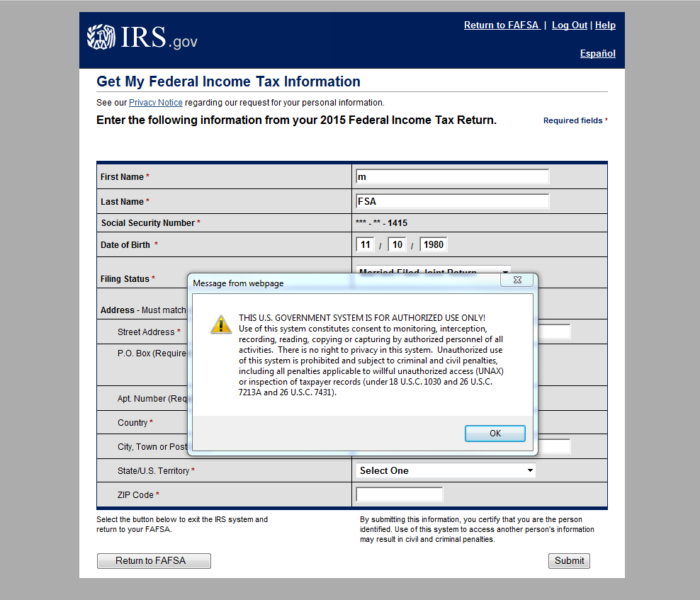
How do I use the Data Retrieval Tool?
Authorized user OK
Enter tax return filing status
Enter address information exactly as it appears on tax return

Slide 36
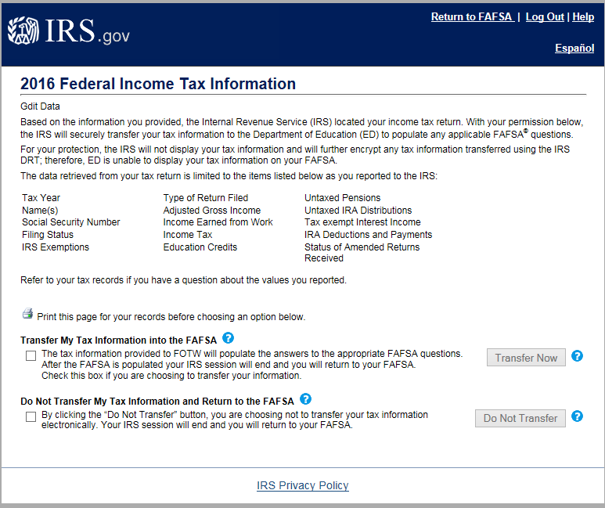
IRS DRT (Parent) Data Transfer Options
Notes:
2018-19 IRS Data Retrieval Tool, page 2, containing user-specific IRS data.
The IRS has revised this page to provide information about how the IRS data is being protected and will not display.
The user can check the “Transfer My Tax Information…” box and click “Transfer Now” to carry this data back into FOTW.
The user can check the “Do Not Transfer…” box and click “Do Not Transfer” to discontinue use of the IRS DRT and return to FOTW.
The user can click the “Print this page” icon in order to print the data that is displayed on this page.
The applicant or parent is also notified on the IRS page that the information will not display on the IRS page or on the fafsa.gov site.

Slide 37
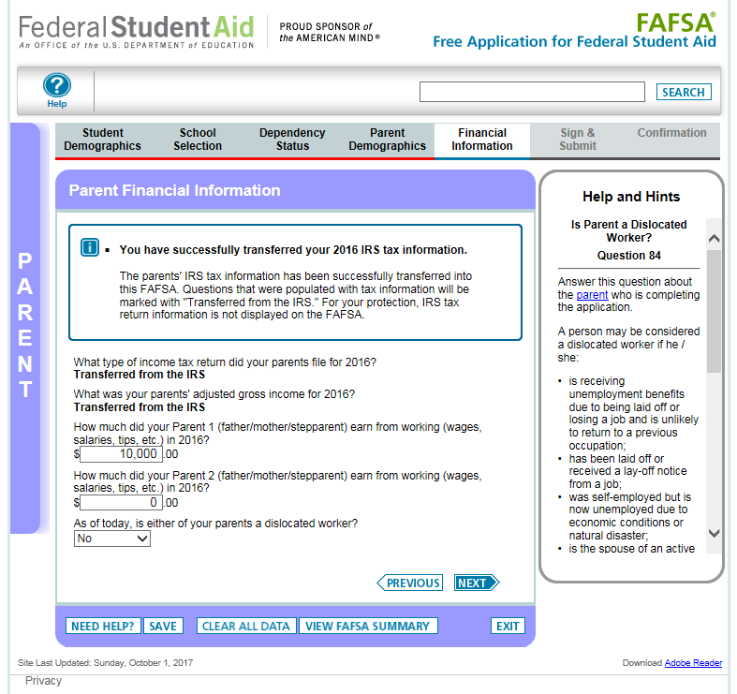
Parent Financial Information
Notes:
2018-19 “Parent Financial Information” page.
A new alert message has been added to indicate that the IRS Data was successfully transferred and will be identified as “Transferred from the IRS”.
The entry boxes that contain IRS Data have been replaced with the “Transferred from the IRS” label. This data cannot be changed.
For parents who are married, they will be required to manually enter their income earned from work.

Slide 38
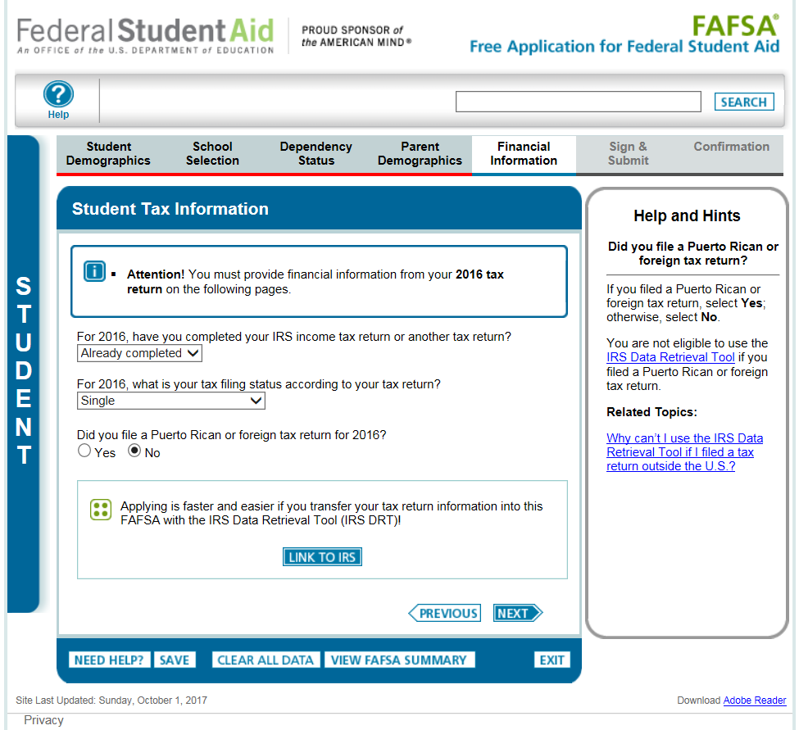
Independent Student, Student Tax Information
Notes:
2018-19 “Student Tax information” page.
Amended tax return filtering question was removed from this page. In addition, parents who filed amended tax returns will now be eligible to use the IRS DRT. However, because the IRS is unable to transmit amended tax information, data transferred from the IRS into fafsa.gov will be the original tax information.
The IRS is unable to transmit amended tax information into FOTW, therefore the data transferred will be original tax information.

Slide 39
Signing the FAFSA
Notes:
When you have completed the FAFSA, you will have a chance to view and print your responses before signing it.
103. Student and parent signatures. The student (and a parent of a dependent student) must either use his or her PIN to provide an electronic signature on FAFSA on the Web or print out, sign and submit a signature page. If applying on paper, the student (and a parent of a dependent student) must sign the FAFSA.
If the student submits a FAFSA on the Web application and indicates that he or she will print and mail in a signature page, the application will be held for 14 days awaiting the proper signature(s). If the processor does not receive the signature(s) within 14 days, it will reject the application and send the student a SAR indicating that the proper signatures are missing. Also, if a student mails in a PDF or paper FAFSA without the proper signatures, the application will be rejected immediately and the student will receive a SAR indicating that the proper signatures are missing. If the student (or parent, if applicable) signs the SAR and returns it, processing will continue.
You (and anyone else who signs the form) certify that all information on the form is correct and that those who signed are willing to provide documents to prove that the information is correct. This information may include U.S. or state income tax forms that you filed or are required to file. You also certify that
1. you will use federal and/or state student financial aid only to pay the cost of attending an institution of higher education,
2. you are not in default on a federal student loan or have made satisfactory arrangements to repay the loan,
3. you do not owe money back on a federal student grant or—if you do—you have made satisfactory arrangement to repay the grant or loan,
4. you will notify your school if you default on a federal student loan, and
5. you will not receive a Federal Pell Grant for attendance at more than one school for the same period of time.
Alternatives to a parental signature
Although parental information must be provided for a dependent student, a high school counselor or a postsecondary school’s financial aid administrator (FAA) may sign the application in place of your parents in the following limited cases:
• Your parents are not currently in the U.S. and cannot be contacted by normal means.
• Your parents’ current address is not known.
• Your parents have been determined physically or mentally incapable of providing a signature.
Your parents’ unwillingness to sign the FAFSA or provide financial information is not, in and of itself, a reason for the FAA to sign your FAFSA in place of them.
If your counselor or FAA signs the PDF or paper FAFSA in place of your parents, he or she should provide his or her title when signing and briefly state the reason (only one reason is needed) why he or she is signing for your parents. By signing your application, however, your counselor or FAA does not assume any responsibility or liability in this process. If a financial aid office finds any inaccuracies in the information reported, you will have to submit corrections on paper, on the Web or through the financial aid office.

Slide 40
Confirmation page

Slide 41
What is Expected Family Contribution?
Calculated using data from the FAFSA and federal formula
The amount a family can reasonably be expected to contribute.
Stays the same regardless of college
Two components
Parent contribution
Student contribution
41

Slide 42
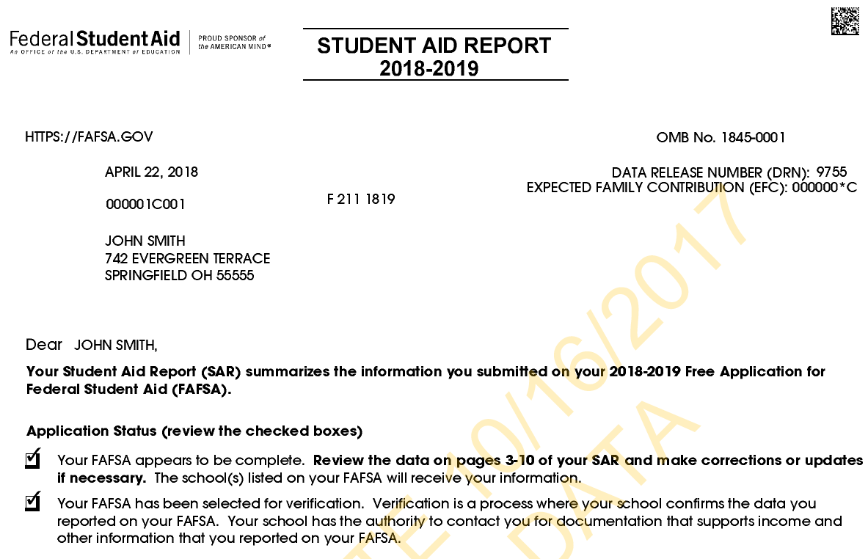
Student Aid Report (SAR)
Notes:
The Student Aid Report (SAR) is the FAFSA output document sent to the student to provide a summary of the FAFSA information and to provide the Expected Family Contribution (EFC) that was calculated based on the information provided. Colleges then use the EFC to help calculate the student’s financial aid eligibility.

Slide 43
My FAFSA page
http://fafsa.ed.gov
The My FAFSA® page is a navigation tool for the applicant when accessing the FAFSA on the Web site.
The page provides options and messaging based on the status of the student’s FAFSA:
Start a 2018-19 FAFSA
Complete and submit a Renewal FAFSA
Make FAFSA corrections
View the Student Aid Report
View correction history
Provide missing signatures
Notes:
You’ve already seen the “Start 2018-19” FAFSA page. On the next slide we’ll show you the “My FAFSA” page when a renewal FAFSA exists.

Slide 44
South Dakota scholarship programs*
South Dakota Opportunity Scholarship
Attend postsecondary school in SD
Dakota Corps Scholarship
Full tuition and applicable fees at participating SD schools
$1,300 for 3 years and $2,600 for final year
Must be SD resident
Eligibility requirements include minimum GPA, minimum ACT scores, curriculum requirements, etc.
Apply at https://sdos.sdbor.edu/ by Sept. 1
Requirements includes minimum grades and agreement to stay in state for work in specific areas
Apply at https://www.sdbor.edu/dakotacorps/Pages/welcome.aspx by Feb. 1. *Programs may change – check websites for the latest information

Slide 45
South Dakota scholarship programs*
Jump Start Scholarship
Students who graduate from a SD public high school in 3 years or less
South Dakota Needs Based Grant Program (SDNBGP)
Resident of SD
Enroll is a accredited institution located in SD within 1 year of high school graduation.
For first year only and dollar amount varies
For SD residents
Apply at https://www.sdbor.edu/student-information/Pages/Jump-Start-Scholarship.aspx by Sept. 1
Enrolled at least part time in an eligible program
Grade requirement and completed FAFSA
*Programs may change – check websites for the latest information
Information at https://www.sdbor.edu/student-information/Pages/Need-Based-Scholarship.aspx

Slide 46
South Dakota scholarship programs*
Build Dakota Scholarship
Full-ride scholarship
For students enrolled in a high-need workforce area program at one of the four technical institutes
Apply at www.builddakotascholarships.com
Work full-time in SD for a minimum of three years.
*Programs may change – check websites for the latest information
Enroll in a program determined to be a high-need workforce area.
Next application cycle will be Jan. 1, 2018 – March 31, 2018

Slide 47
Scholarship searches
The sooner you search, the better
Meet deadlines
Follow directions
Beware of scams
More information at:
http://mappingyourfuture.org/paying/scholarshipsearch.cfm

Slide 48
Education tax benefits
Tax credits
American Opportunity Credit
Lifetime Learning Tax Credit
Tax deductions
College Tuition and Fees Deduction
Student Loan Interest Deduction
Notes:
Tax credits and deductions can help your family get some taxes back, based on how much they paid in educational expenses the year before.
American Opportunity Credit: Families may receive a tax credit for expenses paid for the dependent student’s first four years of college.
Lifetime Learning Tax Credit: You may claim a tax credit for education expenses incurred after the first two years of postsecondary education.
Tax deductions
College Tuition and Fees Deduction: You can reduce your taxable income for higher education expenses.
Student Loan Interest Deduction:

Slide 49
South Dakota website
Comprehensive website for students, parents, counselors, and other professionals at https://SouthDakota.MappingYourFuture.org

Slide 50
Resources
SouthDakota.MappingYourFuture.org
MappingYourFuture.org
mappingyourfuture.org/services/webinararchive.cfm
fafsa.gov
FAFSA on the Web worksheet
Frequently asked questions
studentaid.ed.gov/sa/
Filling out the FAFSA
Estimate your aid

Slide 51
Counseling and customer service
1-800-374-4072
8 a.m. to 4 p.m. Central Time
feedback@mappingyourfuture.org

Slide 52
Questions

Slide 53
Cathy Mueller cathy@mappingyourfuture.org
Beth Ziehmer beth@mappingyourfuture.org
(800) 374-4072
feedback@mappingyourfuture.org MappingYourFuture.org

