Slide 1
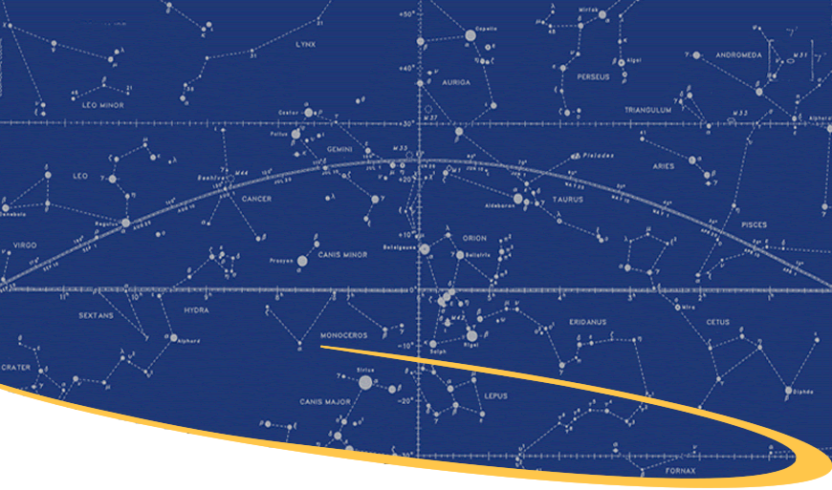
Direct Loan Entrance Counseling

Slide 2
Apply for a Direct Subsidized or Unsubsidized Loan
Topic 1 of 6
2
©2024 Mapping Your Future, Inc.

Slide 3
Types of Student Loans
There are several types of federal student loans.
This counseling session will focus on:
We will use the term “Direct Loans” throughout this presentation to mean both subsidized and unsubsidized loans.
Direct Subsidized Loans
Direct Unsubsidized Loans
3
©2024 Mapping Your Future, Inc.

Slide 4
Know Your Student Loans
Understand the types of loans available
Know the terms of your loans
Your responsibility to repay the loans
As a borrower, you should:
Direct Loans are borrowed under from the federal government via the Department of Education with your school certifying your eligibility for the loans.
4
©2024 Mapping Your Future, Inc.

Slide 5
Master Promissory Note
Once eligibility is certified, you must complete
a Master Promissory Note or MPN.
The MPN:
Is a binding legal agreement to indicate your commitment to repay your student loan(s)
May be used for multiple loans up to 10 years (depending on your school)
Makes the borrowing process easier for borrowers and schools
May be revoked
5
©2024 Mapping Your Future, Inc.

Slide 6
Fast Loan Facts
You may only use student loans for educational expenses.
You may decline a portion or all of a loan or reject a loan type if you do not want it.
You may receive your student loan funds in more than one disbursement throughout the loan period.
If you are a first-year undergraduate and a first-time borrower, there may be a waiting period before your loan funds can be released.
You must complete the renewal FAFSA each year if you want to receive federal financial aid.
6
©2024 Mapping Your Future, Inc.

Slide 7
Topic 2 of 6
Loan Types
7
©2024 Mapping Your Future, Inc.

Slide 8
Direct Subsidized Loan
Need-based
At least half-time enrollment to qualify
6.53% interest rate for loans disbursed 7/1/24-6/30/25
No interest accrues while in school and during deferment
Interest does accrue during grace period and forbearance
Repayment starts after six-month grace period
8
©2024 Mapping Your Future, Inc.

Slide 9
Direct Unsubsidized Loan
Not need-based
At least half-time enrollment to qualify
8.08% interest rate for graduate loans disbursed 7/1/24-6/30/25
Interest begins accruing immediately after loan is disbursed
Repayment begins six months no longer enrolled at least half time
6.53% interest rate for undergraduate loans disbursed 7/1/24-6/30/25
9
©2024 Mapping Your Future, Inc.

Slide 10
Annual Loan Limits
Dependent Undergraduates
1st year total $5,500 (maximum $3,500 subsidized)
2nd year total $6,500 (maximum $4,500 subsidized)
3rd year & beyond total (each year) $7,500 (maximum $5,500 subsidized)
10
©2024 Mapping Your Future, Inc.

Slide 11
Annual Loan Limits
Independent Undergraduates
1st year total $9,500 (maximum $3,500 subsidized)
2nd year total $10,500 (maximum $4,500 subsidized)
3rd year & beyond total (each year) $12,500 (maximum $5,500 subsidized)
These limits also apply to dependent undergraduates whose parents don’t qualify for a Direct PLUS loan.
11
©2024 Mapping Your Future, Inc.

Slide 12
Annual Loan Limits
Graduate and Professional Students
Total amount (each year) $20,500 (unsubsidized only)
12
©2024 Mapping Your Future, Inc.

Slide 13
Additional Loan Eligibility Information
Students in health professions programs may be eligible for higher unsubsidized limits
Coursework that is not part of an eligible program has different loan limits
You may have to pay loan fees, which will be deducted from the loan amount
13
©2024 Mapping Your Future, Inc.

Slide 14
Aggregate Loan Limits
Dependent undergraduates
Independent undergraduates/students whose parents are unable to borrow a PLUS loan
Graduate and professional students
$31,000 (maximum $23,000 subsidized)
$57,500 (maximum $23,000 subsidized)
$138,500 (maximum $65,500 subsidized; includes Stafford and Direct Loans received for undergraduate study)
14
©2024 Mapping Your Future, Inc.

Slide 15
Understanding Student Loan Borrowing
Topic 3 of 6
15
©2024 Mapping Your Future, Inc.

Slide 16
You Must Repay Your Loans
You must repay your loans, even if you:
Do not complete your education
Do not complete your program within the regular completion time for that program
Are not employed upon completion of your studies
Feel that the education you received did not meet your expectations
File bankruptcy. (Generally, student loans are not cancelled or discharged.)
16
©2024 Mapping Your Future, Inc.

Slide 17
Tips for Borrowers
Borrow conservatively
Maintain satisfactory academic progress
Understand withdrawals and refunds
Keep in contact with your servicer
17
©2024 Mapping Your Future, Inc.

Slide 18
Withdrawals and Refunds
Contact the ___ office at ______ if you decide to withdraw before completing your program of study.
Federal law specifies how financial assistance you earned and how much must be refunded.
You may have to repay aid received, if you earned less than you received.
The school will have to refund excess funds in a specific order.
18
©2024 Mapping Your Future, Inc.

Slide 19
Repayment
Topic 4 of 6
19
©2024 Mapping Your Future, Inc.

Slide 20
Beginning Repayment
You may prepay all or part of your loan at any time without penalty.
Try to pay the interest accruing on your loan.
20
©2024 Mapping Your Future, Inc.

Slide 21
Grace Period
Your loans will have one grace period of six months before you enter repayment.
If you were enrolled less than half-time or gone from school for six months or more, you already have used the grace period on the loans.
If you withdraw or drop below half-time status, but return to at least half-time status before the six month grace period elapses, then the grace period will not be considered as used.
21
©2024 Mapping Your Future, Inc.

Slide 22
Repayment Options
Standard repayment
Graduated repayment
Extended repayment
Income-contingent repayment
Pay as You Earn repayment
SAVE repayment (formerly Revised Pay as You Earn)
Income-based repayment
22
©2024 Mapping Your Future, Inc.

Slide 23
Loan Consolidation
Available if your loans are in grace period or in repayment
Enables you to pay your existing student loans in full with one loan, with one interest rate and repayment schedule
Typically extends your repayment period and lowers your monthly payments
May increase the interest rate and the total amount of interest you pay on the loan
23
©2024 Mapping Your Future, Inc.

Slide 24
Sample Payment Amounts
Amount borrowed | Monthly payments | Number of payments | Total amount paid
1,500 | 50 | 33 | 1,650
3,500 | 50 | 89 | 4,450
5,500 | 63.29 | 120 | 7,595.30
6,500 | 74.80 | 120 | 8,976.27
7,500 | 86.31 | 120 | 10,357.23
8,500 | 97.82 | 120 | 11,738.19
9,500 | 109.33 | 120 | 13,119.16
10,500 | 120.83 | 120 | 14,500.12
12,500 | 143.85 | 120 | 17,262.05
20,500 | 253.91 | 120 | 28,309.76
40,000 | 460.32 | 120 | 55,238.56
57,500 | 661.71 | 120 | 79,405.43
80,000 | 920.64 | 120 | 110,477.11
138,500 | 1,593.86 | 120 | 191,263.50
224,000 | 2,577.80 | 120 | 309,335.93
24
©2024 Mapping Your Future, Inc.

Slide 25
Solutions for Repayment Problems
Topic 5 of 6
25
©2024 Mapping Your Future, Inc.

Slide 26
Deferment
A deferment is a period of time when a loan payment is not required.
Types of deferments include:
Graduate fellowship program
Rehabilitation training program
Military service
Unemployment
Economic hardship
At least half-time enrollment at an eligible school
26
©2024 Mapping Your Future, Inc.

Slide 27
Forbearance
Available if you are unable to make your full payments and do not qualify for a deferment
A period of time during which you do not have to make full payments or make regular payments at all
You are responsible for the interest that accrues during any forbearance period
You must contact the Direct Loan Program or its servicer to apply for forbearance
27
©2024 Mapping Your Future, Inc.

Slide 28
Loan Discharge
Your loans may only be eligible for discharge if:
You become totally and permanently disabled and meet certain conditions
Your school fails to pay a refund if you withdraw
Your loan was falsely certified as a result of identity theft
Your school fraudulently certified or fraudulently completed a loan application in your name without your approval
You die
28
©2024 Mapping Your Future, Inc.

Slide 29
Loan Forgiveness and Repayment Programs
Teacher Loan Forgiveness
For teachers serving in designated low-income schools
Must teach in a low-income school for five consecutive years to qualify
Public Service Employee Forgiveness
For public service employees
Must have made 120 payments
AmeriCorps service program
For information, visit www.americorps.gov
Military repayment programs
Contact your recruiter for more information
29
©2024 Mapping Your Future, Inc.

Slide 30
Delinquency and Default
Topic 6 of 6
30
©2024 Mapping Your Future, Inc.

Slide 31
Delinquency and Default
Delinquency
When a student loan payment is missed
Default
When a student loan payments is not made for 270 days.
31
©2024 Mapping Your Future, Inc.

Slide 32
Consequences of Default
Damage to your credit rating
Referral to a collection agency
Collection costs
Garnishment of your wages
Withholding of your state or federal payments
Civil lawsuit, including court costs and legal fees
Loss of repayment options
Loss of eligibility for future financial aid
Suspension of your professional license
32
©2024 Mapping Your Future, Inc.

Slide 33
Avoid Delinquency and Default
Call your servicer or the Direct Loan Program if you are having trouble making payments
Read and keep all documents about your student loan
Inform your school and Direct Loan Program of any changes
33
©2024 Mapping Your Future, Inc.

Slide 34
StudentAid.gov
Log in with your FSA ID to access your FAFSA, loan application, and loan history information
(800) 433-3243
The loan history does not list your alternative or private loans
Manage your federal aid, including student loans:
34
©2024 Mapping Your Future, Inc.

Slide 35
Third-Party Student Debt Relief Companies
Use caution when dealing with third-party student loan debt relief companies.
Your loan servicer can provide the same services free of charge, such as:
Lowering your monthly payment
Changing your repayment plan
Consolidating your student loans
Postponing monthly payments while you are in school or are unemployed
Getting your loans out of default status
35
©2024 Mapping Your Future, Inc.

Slide 36
Federal Student Aid Ombudsman
Federal Student Aid (FSA) Ombudsman
Works with student loan borrowers informally to resolve loan disputes the borrower is unable to resolve
Goal is to find creative alternatives
https://studentaid.gov/help-center/answers/article/how-to-contact-ombudsman-group
(877) 557-2575
36
©2024 Mapping Your Future, Inc.

Slide 37
Education Tax Benefits
American Opportunity Credit
Lifetime Learning Credit
Student Loan Interest Deduction
37
©2024 Mapping Your Future, Inc.

Slide 38
Financial Literacy Topic
Important Steps to Being Financially Fit
38
©2024 Mapping Your Future, Inc.

Slide 39
Personal Finance
Open up checking and savings accounts
Make your monthly payments for loans and services on time each month
Make a list of your values and set your goals to help you maintain those values
Create a spending plan that meets your "wants" as well as your "needs"
Review your credit report once a year to make sure it is accurate
Contact your creditors if you are having trouble making payments
39
©2024 Mapping Your Future, Inc.

Slide 40
Savings
Pay yourself first
Use direct deposit, if possible
Start an emergency fund
Save 6 to 12 months of earnings
40
©2024 Mapping Your Future, Inc.

Slide 41
Private Student Loans
Private loans are credit based and may require a co-signer
The interest rate is often based on your credit rating
Fees vary among programs
There is no federal interest subsidy
Not all private loan programs have a grace period
41
©2024 Mapping Your Future, Inc.

Slide 42
Credit Cards
When selecting a credit card, look for:
A low annual percentage rate
The interest calculation method
Low or no annual fees
A grace period
The credit limit
Services and features
42
©2024 Mapping Your Future, Inc.

Slide 43
Credit Report
Credit reports contain personal information, credit record, and repayment history
Most negative information stays on your credit report for seven years, though some bankruptcies remain 10 years.
Positive information stays on indefinitely. Inquiries stay on for six months to two years, depending on the type of inquiry.
43
©2024 Mapping Your Future, Inc.

Slide 44
Free Credit Report
Visit www.AnnualCreditReport.com
View and print one or all credit reports. There are three major credit reporting agencies: Equifax, Trans Union, and Experian.
Know when fees may apply. You may be charged a fee if you request more than one copy from the same credit reporting agencies within a year or if you request your credit/FICO® score.
44
©2024 Mapping Your Future, Inc.

Slide 45
Contact
School contact
E-mail address
Phone number
Web address
45
©2024 Mapping Your Future, Inc.

