Slide 1
2025-26 Financial Aid Night
October 2024
Notes:
NOTE:
To change the image on this slide, select the picture and delete it. Then click the Pictures icon in the placeholder to insert your own image.

Slide 2
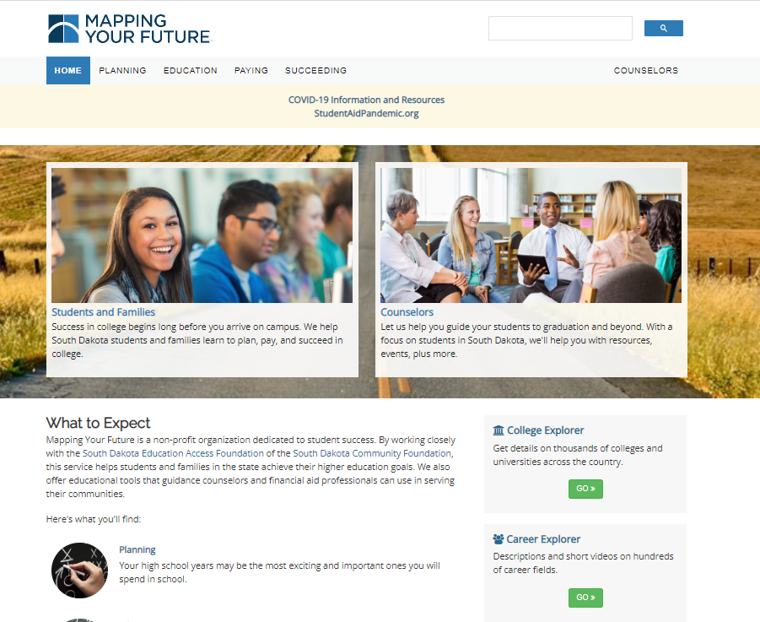
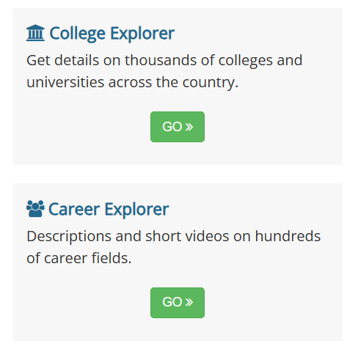
South Dakota Mapping Your Future website
Comprehensive website for students, parents, counselors, and other professionals at https://SouthDakota.MappingYourFuture.org
2

Slide 3
Agenda
Paying for college
Free Application for Federal Student Aid (FAFSA)
South Dakota programs
Resources

Slide 4
Paying for education
Savings
Earnings
Financial aid
Tax credits & deductions
4
Notes:
These are some of the large categories that you can use to pay for college.
Savings:
It’s never too early or too late to start!
Set short-term goal for summer earnings
Pay yourself first

Slide 5
Financial aid process
Complete
2
the Free Application for Federal Student Aid (FAFSA)
Receive
3
FAFSA Submission Summary
Receive
4
a financial aid offer from the school
Decide
5
which aid to accept and return the financial aid offer
Create
1
FSA ID on StudentAid.gov
5
Notes:
It’s early for you to think about filing a FAFSA—explain the FAFSA.
Each year you will need to complete a renewal FAFSA and go through the SAR and award letter processes again.

Slide 6
Complete the FAFSA
Student starts the FAFSA
Student invites the parent to do their part in the FAFSA
Parent completes their part of the FAFSA
Submit the FAFSA when complete
Student completes their part of the FAFSA
6

Slide 7
Types of financial aid
Grants
Scholarships
Work-study programs
Loans
7
7
Notes:
There is a variety of types of financial aid. The sources include federal, state, institutional, and private. Grants, scholarships and work-study funds generally don’t have to be repaid. Students loans should be a last resort.

Slide 8
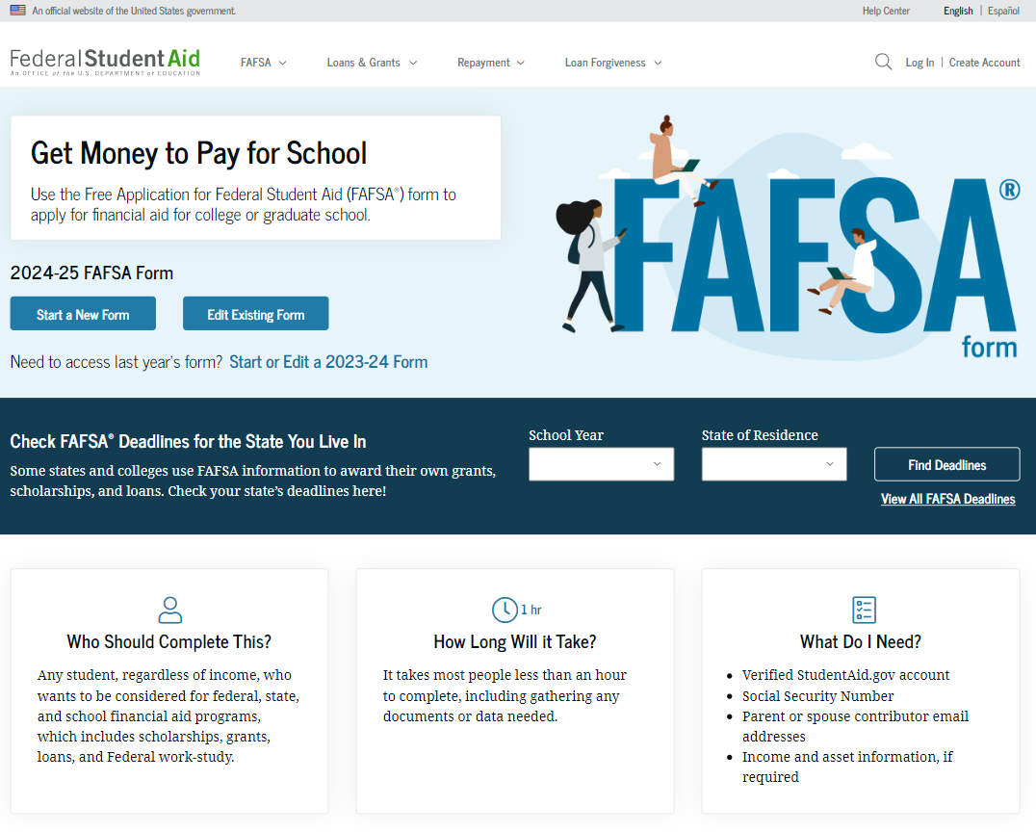
What is the FAFSA?
Free Application for Federal Student Aid
Base application for various forms of financial aid (need based and non-need based)
Federal
State
Institutional
Private
2025-26 FAFSA available in December 2024 (normally available October 1 for the following academic year)
8
Notes:
First, let’s answer the question, what is the FAFSA? The FAFSA is the Free Application for Federal Student Aid that is the base application for various forms of financial aid (both need-based and non-need-based).
Federal aid—such as Pell Grants and subsidized and unsubsidized Direct Loans, as well as
State, institutional, and private grants and scholarships.
You should watch filing deadlines for the various aid programs, especially college financial aid application deadlines. Also, keep in mind that colleges may have another grant or scholarship application as well, but the FAFSA is likely a part of the process. The state application deadlines are listed on the FOTW worksheets and FAFSA website.

Slide 9
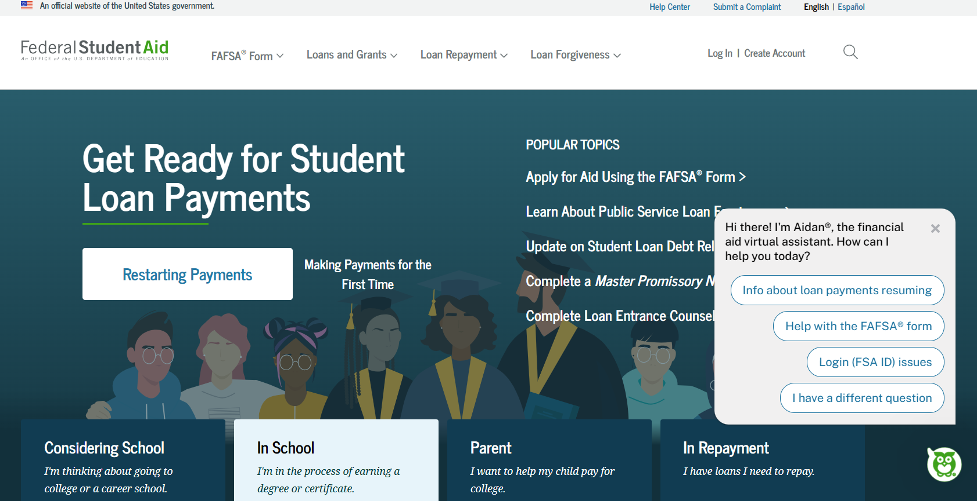
https://StudentAid.gov
Navigation tool for the applicant when accessing the FAFSA on the website
Includes Dashboard for the user
Provides options and messaging based on the status of the student’s FAFSA:
Start a 2025-26 FAFSA
View the FAFSA Submission Summary
Make FAFSA corrections
View correction history
Complete and submit a Renewal FAFSA
9

Slide 10
Dependent Student Identity Information
FAFSA terminology
Contributor
Approval/Consent
Personal circumstances
Parent
Unusual circumstances
Special circumstances
FAFSA Submission Summary
Student Aid Index (SAI)
10

Slide 11
Who is the parent for FAFSA purposes?
Your biological and/or adoptive parents are considered your legal parents.
Must report information for both biological or adoptive parents if they are married or unmarried and living together
Grandparents, foster parents, legal guardians, older brothers or sisters, and aunts and uncles are not considered parents unless they have legally adopted you.
Parent wizard tool in the FAFSA helps determine which parent’s or parents’ information to include.
Department of Education is considering making the parent wizard tool available outside of the FAFSA to help students and parents prepare to complete the form.
11
Notes:
Bullet taken off slide: Use the table on an upcoming slide to determine whose information to provide on the FAFSA based on your parents' marital status.
The definition of parent for FAFSA purposes can generate a lot of discussion and questions. The definition of parents changed a little for the 2014-15 FAFSA processing year, such as the:
Definition of married
Parental information changes
Revised responses for parent marital status
Revised labels for many parent questions, i.e., Parent 1 and Parent 2
Your biological and/or adoptive parents are considered your legal parents. Grandparents, foster parents, legal guardians, older brothers or sisters, and aunts and uncles are not considered parents unless they have legally adopted you.
Use the table on the next page to determine whose information to provide on the FAFSA based on your parents' marital status.
From Jennifer’s notes: See Dear Colleague Letter GEN-13-25
Change due to Supreme Court’s decision in United States v. Windsor
For federal financial aid purposes, a student or a parent is considered married if he or she was legally married in any domestic or foreign jurisdiction that recognizes the relationship as a valid marriage, regardless of where the couple resides

Slide 12
Which parent provides information/needs a StudentAid.gov account (FSA ID)
Divorced or Separated Parent who provided the most financial support reports information and needs an FSA ID.
Remarried Parent who provided the most financial support reports information for parent and step-parent
Only the biological parent needs an FSA ID if filed joint taxes.
If filed separately, parent and step-parent needs an FSA ID.
Widowed Surviving parent provides information and needs an FSA ID.
Married Report information on both parents:
Only one parent needs an FSA ID if filed joint taxes.
If filed separately, both parents need an FSA ID.
Unmarried but living together Report information on both parents and both parents need an FSA ID.
Never married and not living together Parent who provided the most financial support reports information and needs an FSA ID.
12

Slide 13
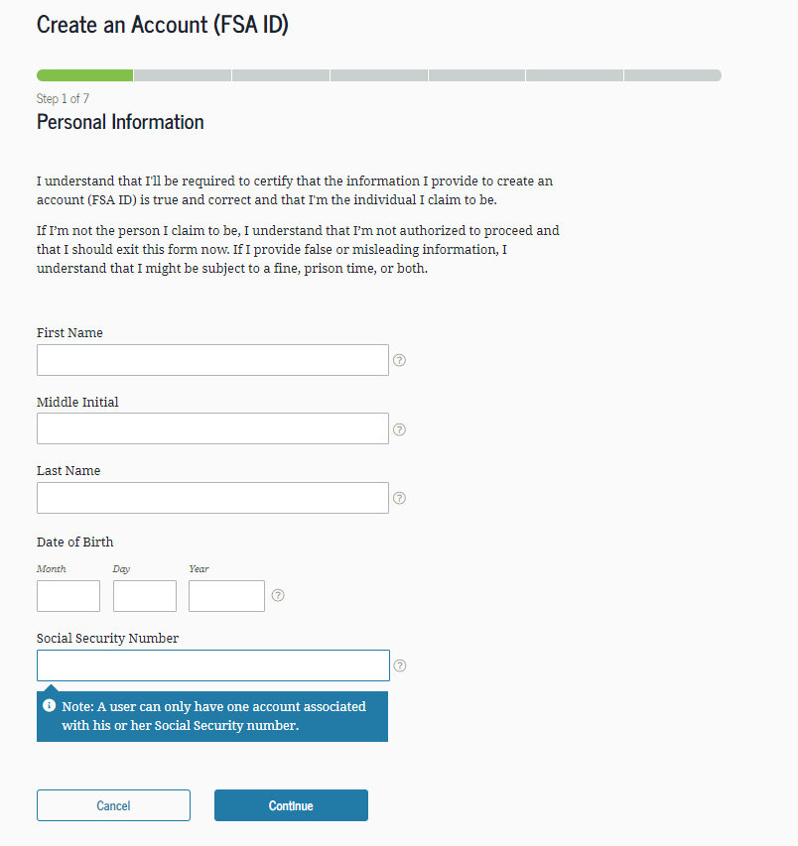
Create an StudentAid.gov account (FSA ID)
Key FSA ID points:
Students and at least one parent for FAFSA purposes need one (see parent wizard information)
Cannot share an e-mail address or phone number for FSA ID
Must be set up before completing the 2025-26 FAFSA
May take three days for the Social Security Administration to authenticate your information, so set up the FSA ID well before sitting down to complete the FAFSA
Go to StudentAid.gov, Create Account
Enter your personal information
Create your username and password
Enter your e-mail address
Create security questions
Submit your information
13

Slide 14
Using an FSA ID
Student
Sign in to StudentAid.gov
To contribute to the FAFSA
To access aid history
Parent
To apply for a Direct PLUS (Parent) Loan
To complete loan counseling
Sign in to StudentAid.gov
To apply for repayment plans
To contribute to the FAFSA
To complete Direct Loan Master Promissory Note
14
Notes:
Who needs an FSA ID? The answer is that both the student and the parent (if the student is a dependent student—which we will define a little later) need one. We recommend setting up the FSA ID before sitting down to complete the FAFSA, as it can help speed up the FAFSA completion process.
Students and parents use their FSA ID in the FAFSA itself. . .students can use theirs to log into the FAFSA and both students and parents can use the FSA ID to access their tax information and to sign the FAFSA electronically.
Your FSA ID can be used electronically to sign the Master Promissory Note for Direct Loans and to access your Federal Student Aid records online.
Be sure to keep your FSA ID a safe place, as it serves as your electronic signature and provides access to your personal records, so you should never give your FSA ID to anyone, including commercial services that may offer to help you complete your FAFSA. We do recommend using free resources to get help completing the FAFSA.

Slide 15
Gathering documents needed
Your Social Security number
Your parents’ Social Security numbers
2023 federal tax information, tax returns, W-2’s for you and for your parents
Records of your 2023 untaxed income
Information on cash, savings and checking account balances, investments, businesses, farms
15

Slide 16
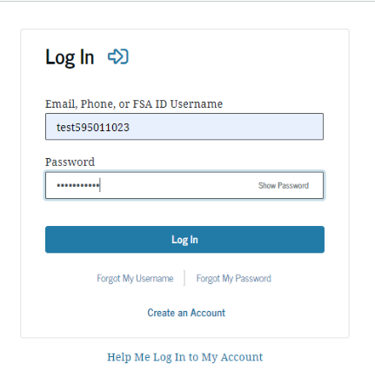
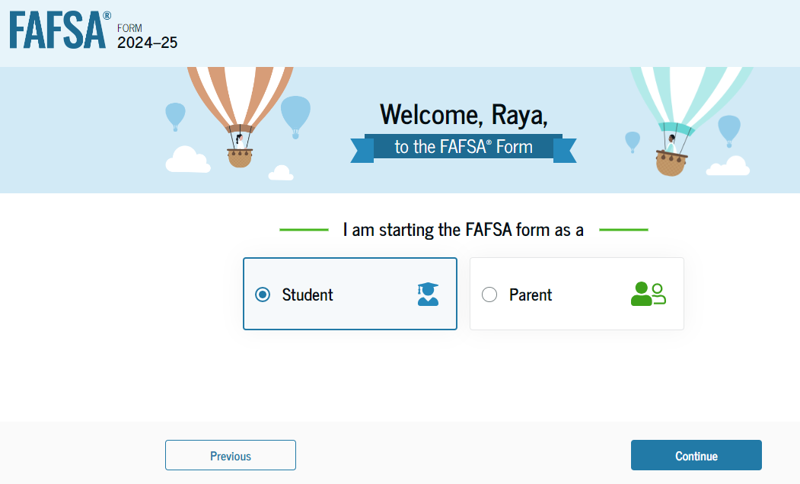
FAFSA log in

Slide 17
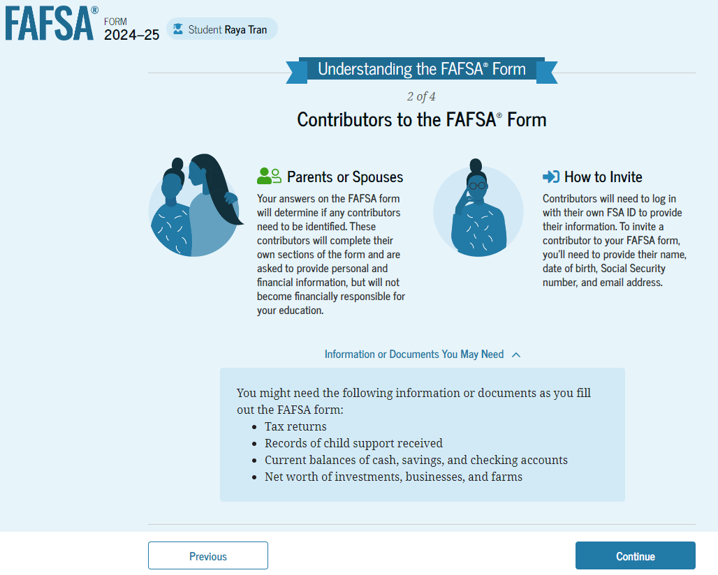
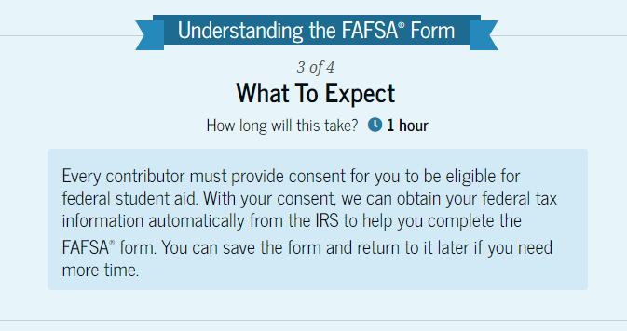
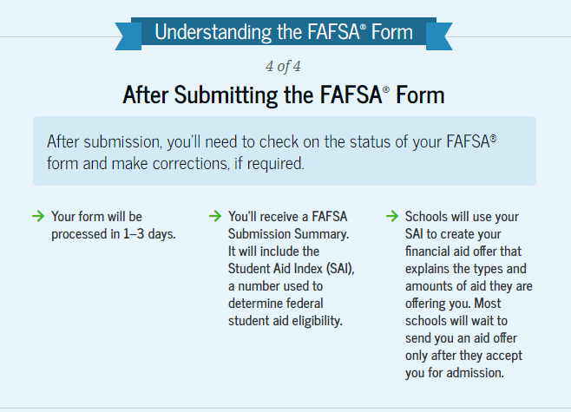
Student Onboarding
17

Slide 18
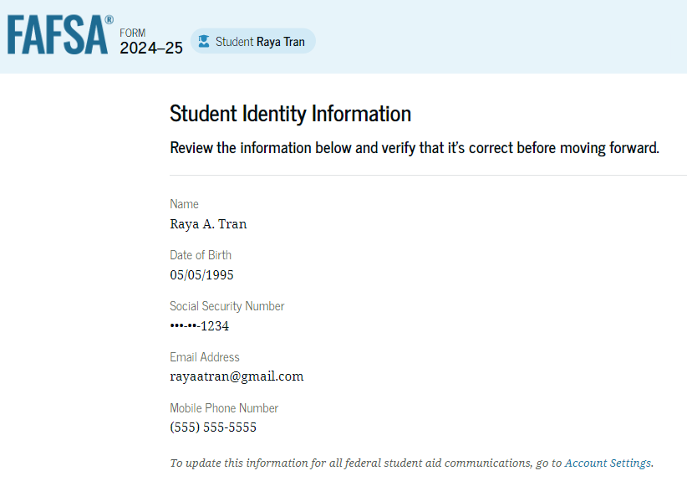
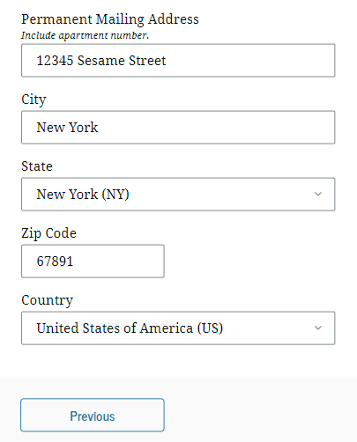
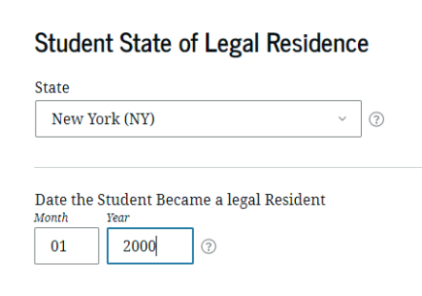
Student identifiers
Prefilled from the FSA ID information:
Name
Social Security Number
Date of birth
Email address
Phone number
Mailing address
Residency
18

Slide 19
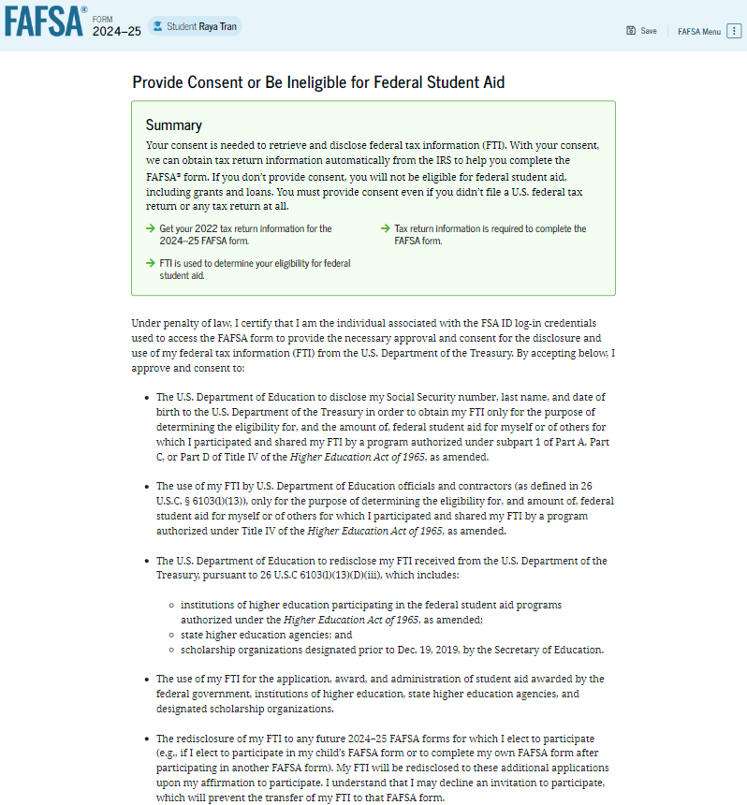
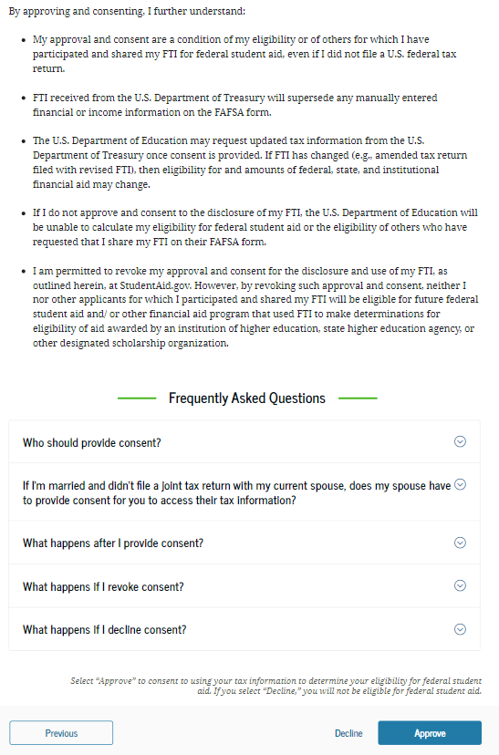
Approval
Student acknowledges consent to pull financial information from the IRS through the Direct Data Exchange (DDX)
19

Slide 20
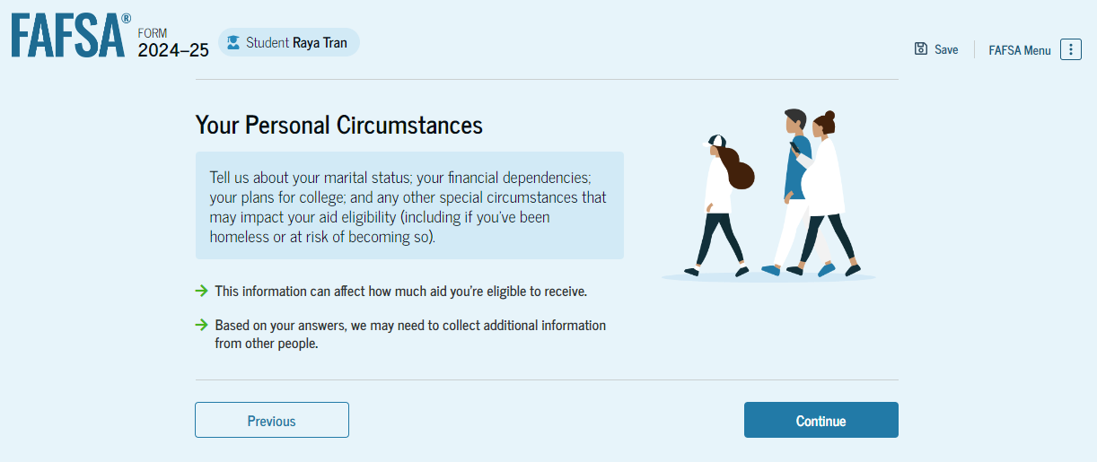
Personal circumstances
Marital status
College or career school plans
Student personal circumstances
Homeless
Unusual circumstances
20
Notes:
Pregnant— “now and between” –Basically the child needs to be born by the date the FAFSA is completed, and the student expects to continue to provide more than half of the support.

Slide 21
Student’s college or career plans
21

Slide 22
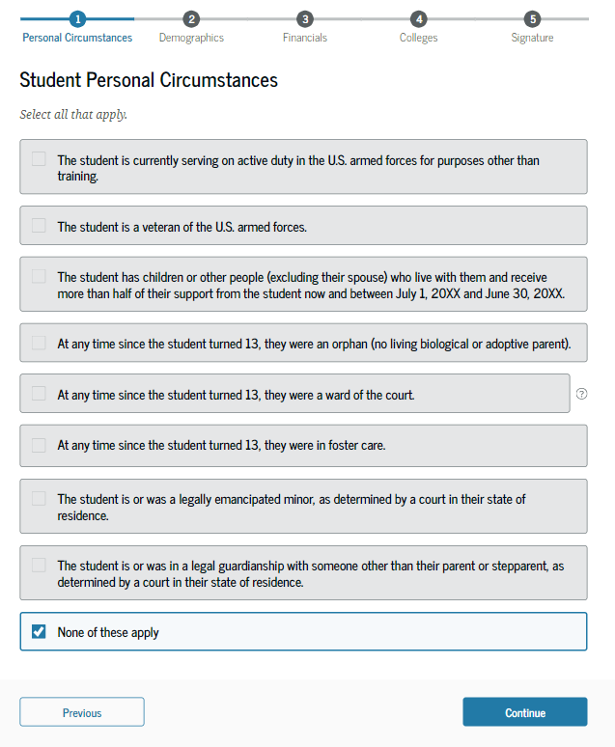
Student’s personal circumstances
24 years of age
Married
Master’s or doctorate program
Active-duty military
Veteran of the U.S. Armed Forces
Have children
Have dependents
Orphan, foster care or ward of the court
Emancipated minor
Legal guardianship
Homeless or self-supporting and at risk of being homeless
22

Slide 23
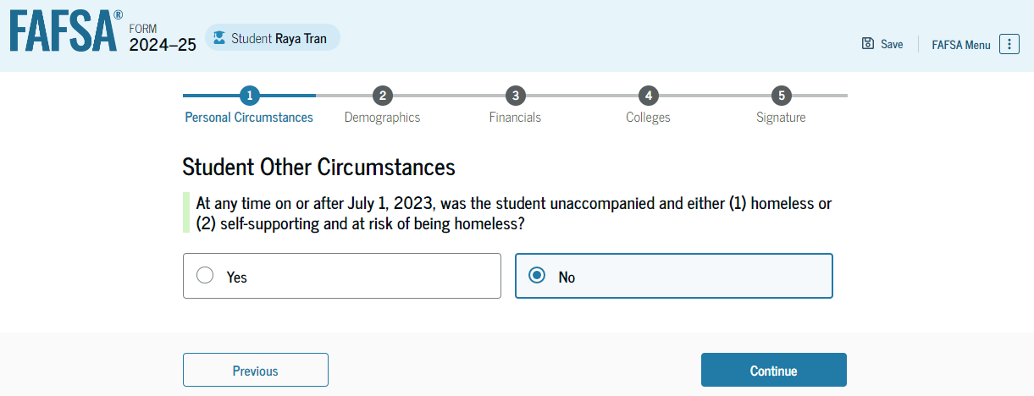
Other circumstances
Unaccompanied
Not in the physical custody of a parent
Homeless
Lacking fixed, regular, and adequate housing
Youth
23 years of age or younger
23
Notes:
Unaccompanied homeless youth status can be determined by:
School district liaison
Director or designee of a HUD-funded shelter
Director or designee of a RHYA-funded shelter
Financial aid administrator
Determination required every year

Slide 24
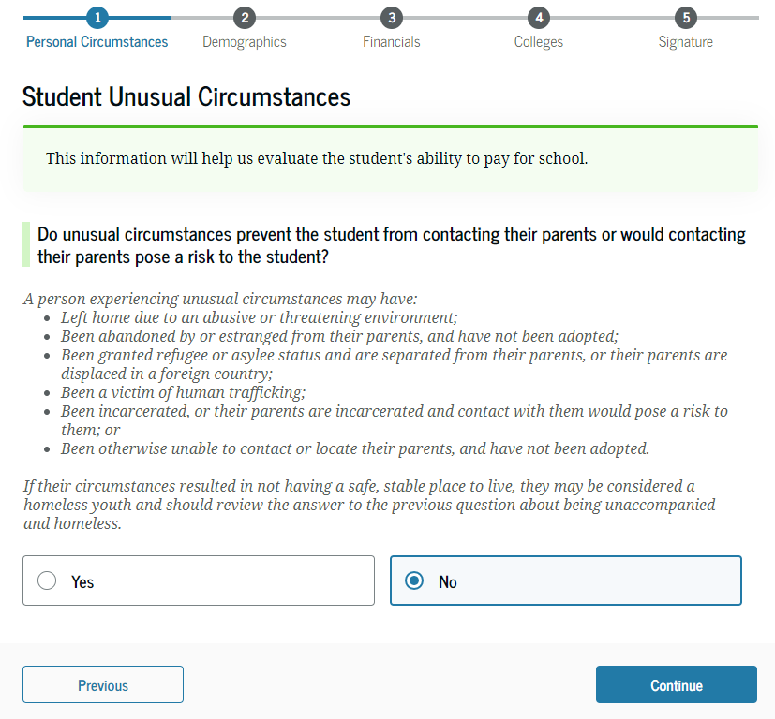
Unusual circumstances
Left home due to abusive or threatening environment
Been abandoned or estranged from parents, and have not been adopted
Been granted refugee or asylee status and are separated from parents
Been a victim of human trafficking
Been incarcerated, or parents are incarcerated and pose a risk to them
Been otherwise unable to contact or locate their parents, and have not been adopted
Notes:
Skip logic
The dependency questions listed on this slide are key to the FAFSA process, as the answers help determine whether the student is considered a dependent or an independent student.
Examples of the questions include:
Were you born before 1/1/1996?
Are you married?
Will you be working on a graduate or professional degree in the 2018-19 academic year?
Do you have a child (or other individual) for whom you provide more than half of their support?
Are you a veteran or are you currently serving in the US Armed Forces?
At any time since you were 13, were both your parents deceased, were you in foster care, or were you a dependent or ward of the court?
Are you or were you an emancipated minor?
Are you or were you in a legal guardianship?
On or after 7/1/18, were you homeless or were you self-supporting and at risk of being homeless?
On the next slide, we are going to go into more detail about the topic of unaccompanied homeless youth.

Slide 25
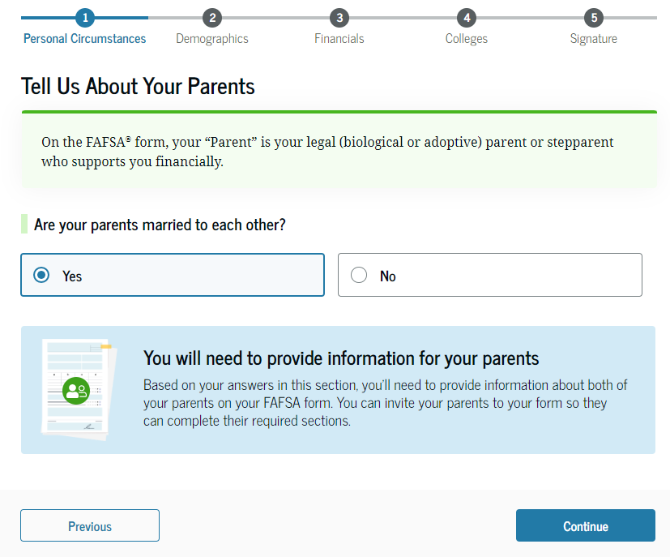
Determining the parent(s) for FAFSA purposes
Parent wizard to help determine the parent
Guidance has changed, now look at who provides more financial support
Look at who has the most income and assets if provided equal support
Student invites the parent through the FAFSA by entering parent’s name, date of birth, social security number and e-mail address
The second parent may be invited to contribute later, especially if the parents did not file joint taxes.
25

Slide 26
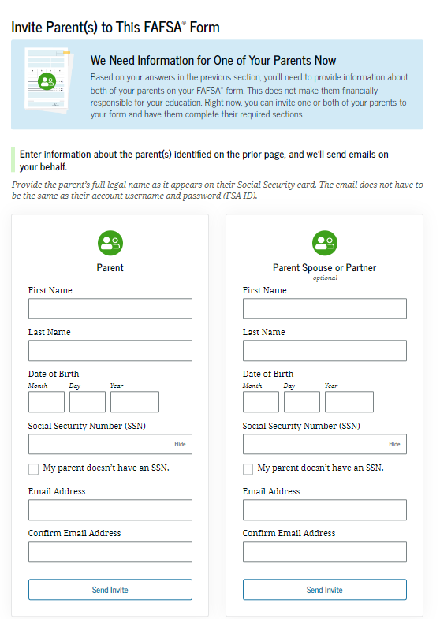
Invite parents to FAFSA form
Student enters parent information to send them an invite to contribute to the FAFSA
26

Slide 27
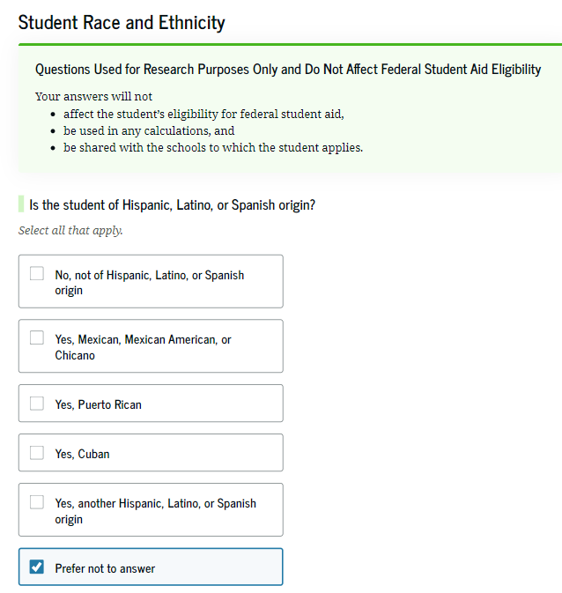
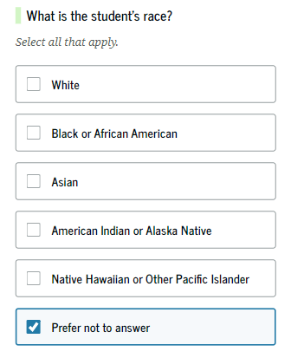
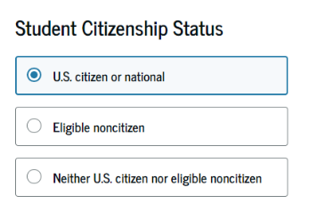
Student demographics
27

Slide 28
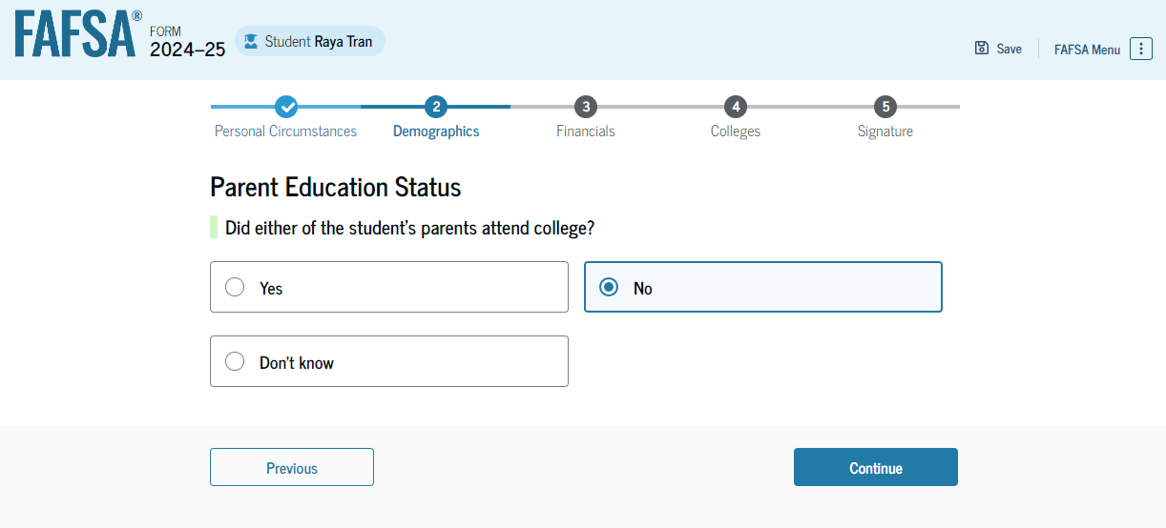
Parent’s education status
To identify possible first-generation college students
28

Slide 29
Parent killed in line of duty
29

Slide 30
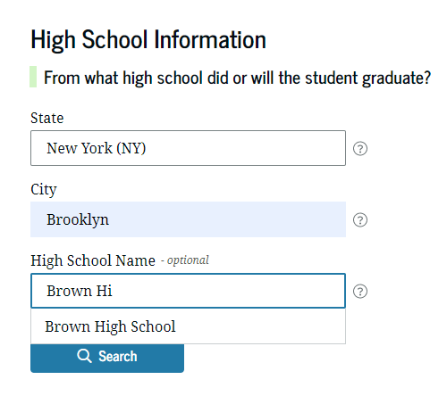
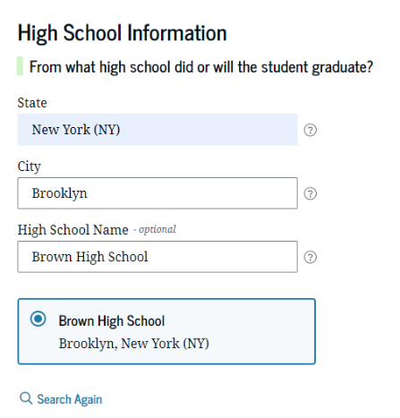
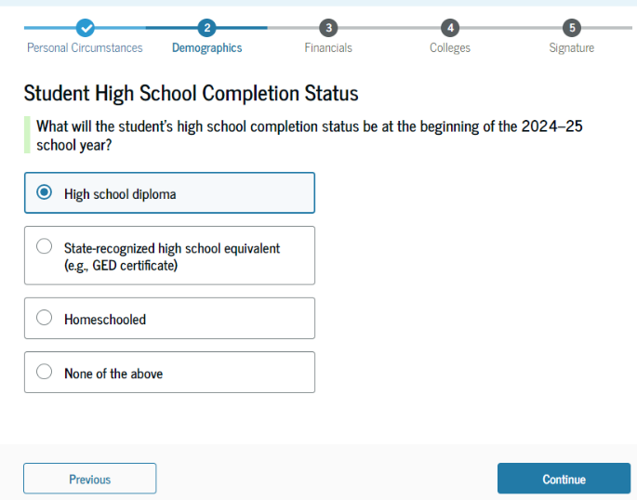
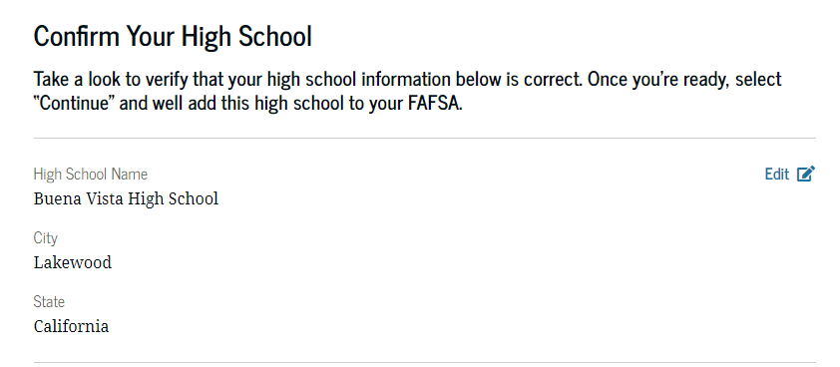
High school information
30

Slide 31
Student financial information
Once approval is granted, financial data is being transmitted behind the scenes
If the Direct Data Exchange (DDX) is not available to pull the tax information, a manual response to tax-related questions will be required.
Once the DDX is available again, the FAFSA will be re-run and the student’s eligibility may change
Information transferred through the DDX will not display
31

Slide 32
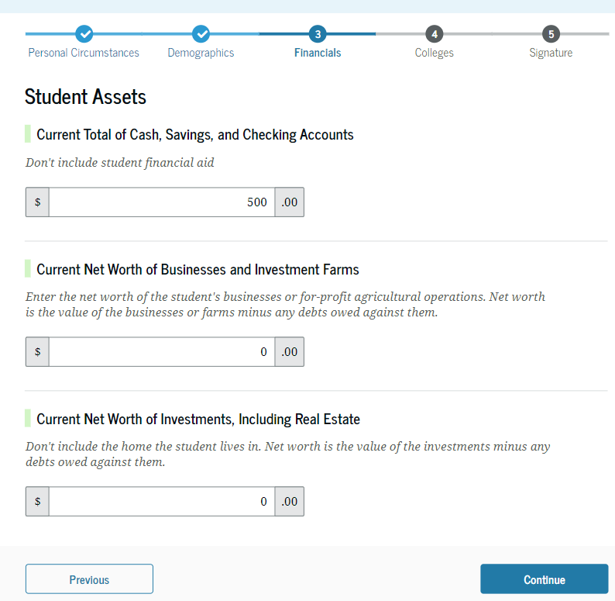
Student asset information
If the student starts the FAFSA, they will be asked the asset questions
If the parent starts the FAFSA and their adjusted gross income is less than $60,000, the asset information will not be asked
32

Slide 33
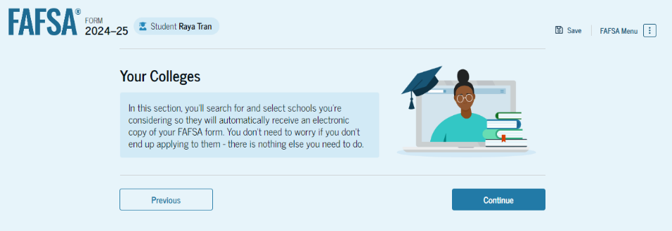
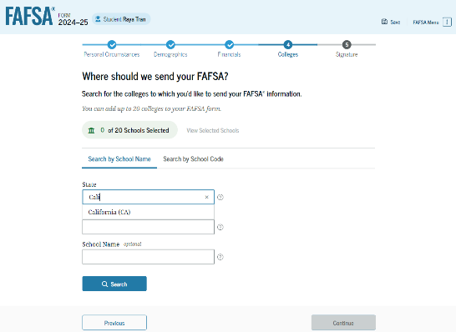
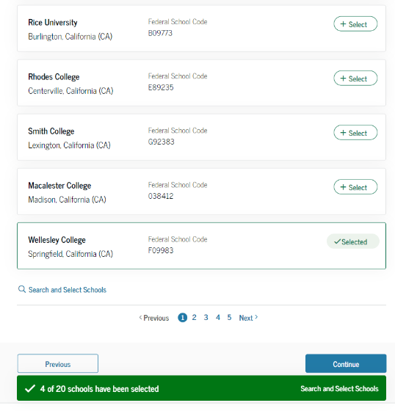
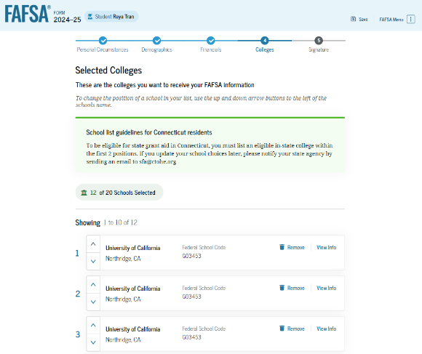
Select colleges
Select up to 20 schools to receive FAFSA information
Use Search or enter school’s Title IV code
33
33

Slide 34
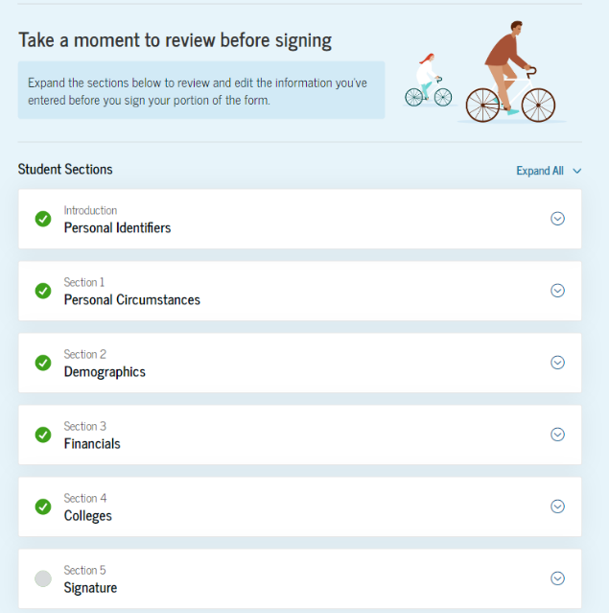
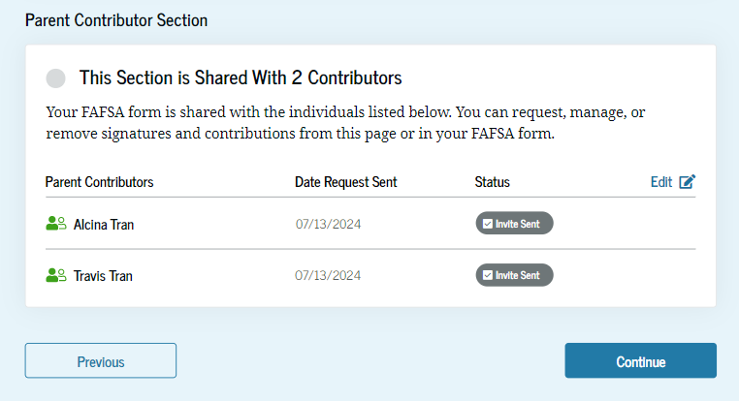
Student review page
Will list who was invited to contribute
Review information and make corrections, if needed
Can see status of parent contributors
34
34

Slide 35
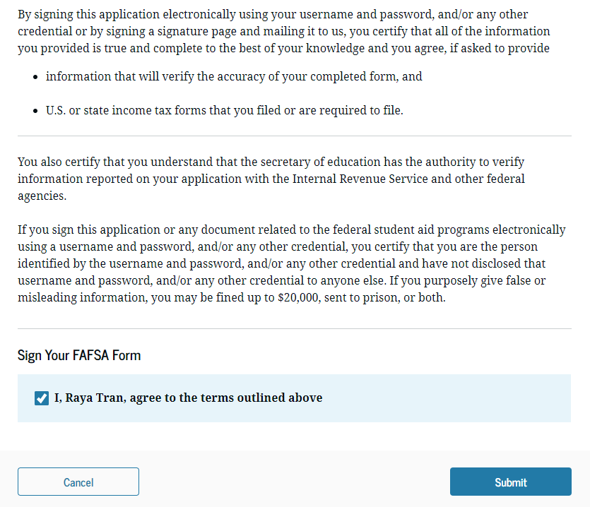
Dependent student signature
35

Slide 36
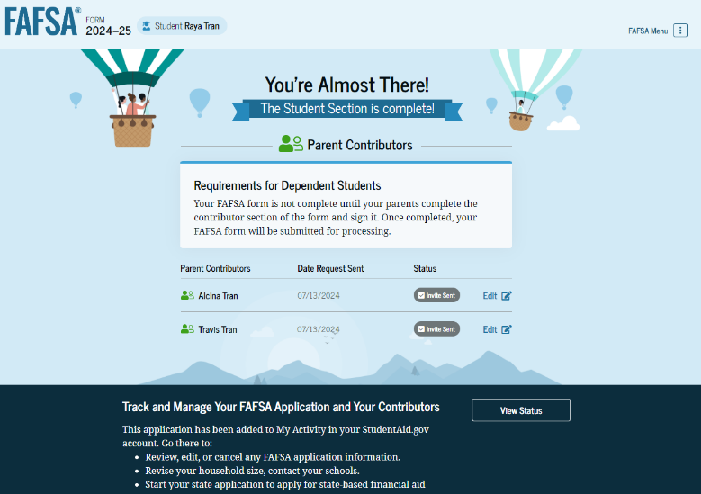
Student section complete
36

Slide 37
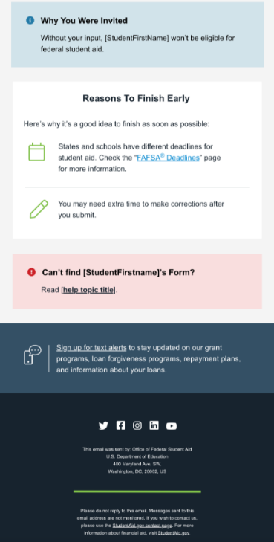
Parent e-mail
Parent is invited by e-mail to log in to StudentAid.gov to contribute to the student’s FAFSA.
37

Slide 38
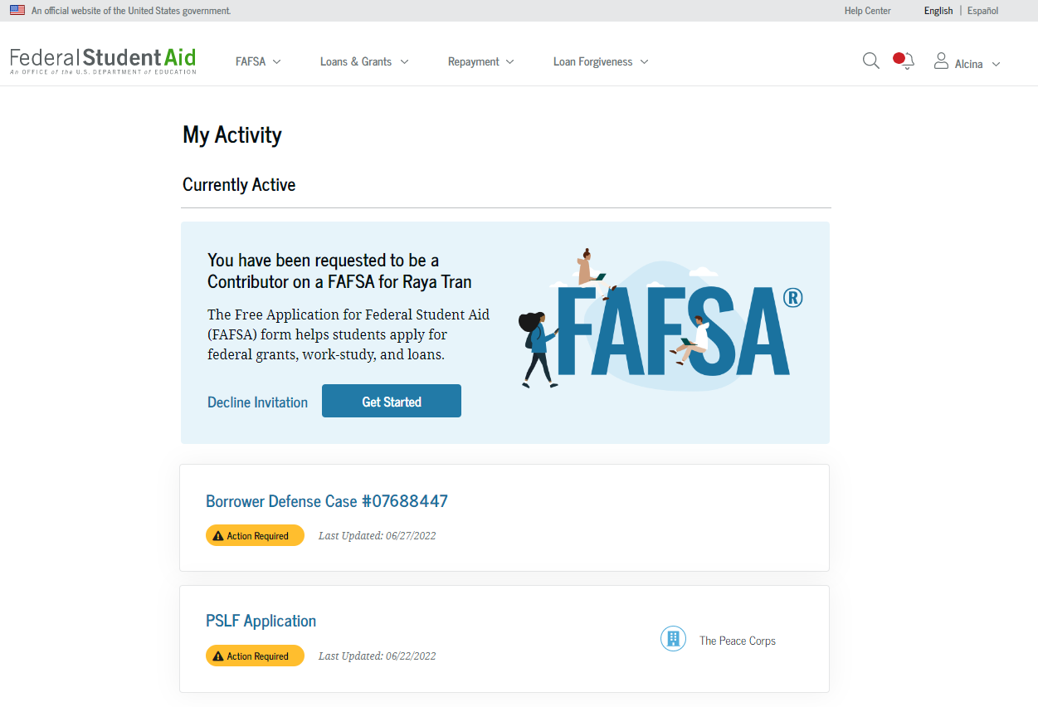
Parent log in
38

Slide 39
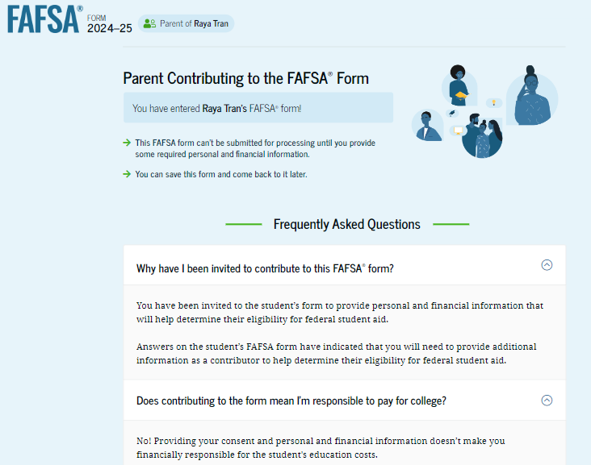
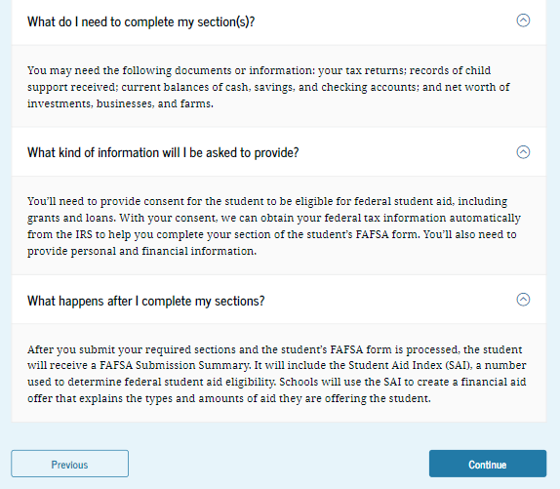
Parent contributing to the student’s FAFSA
39

Slide 40
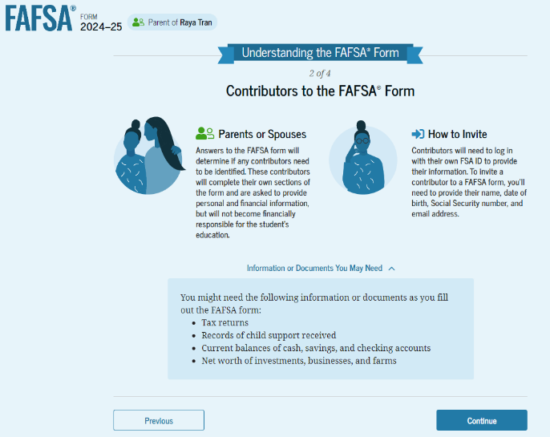
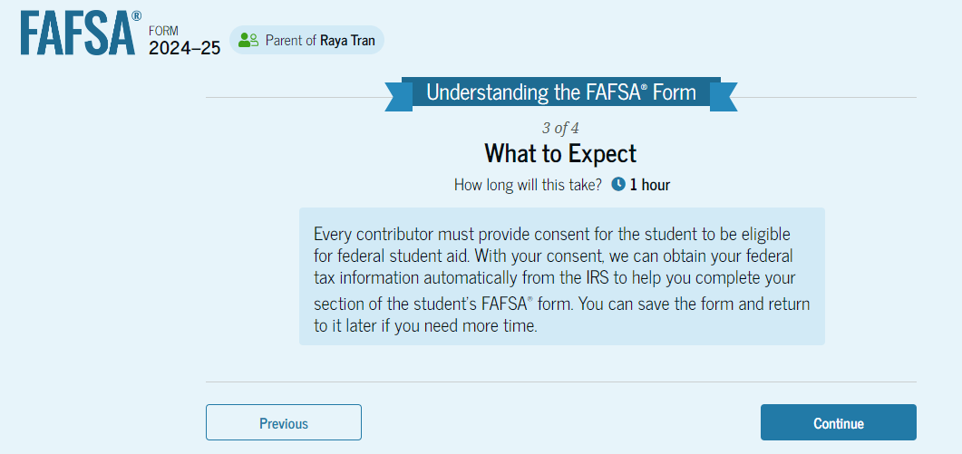
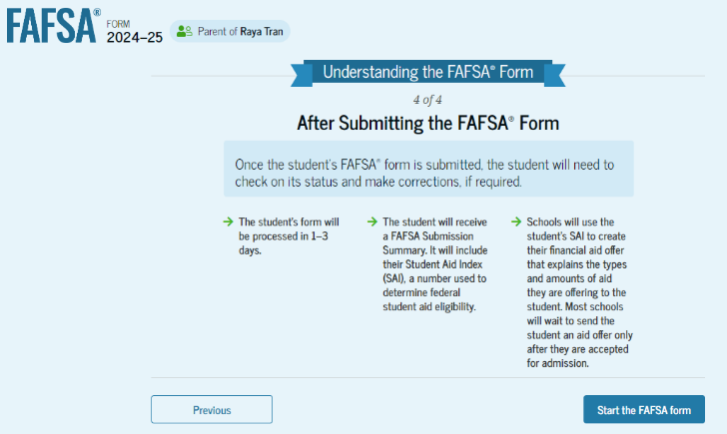
Parent’s onboarding
40

Slide 41
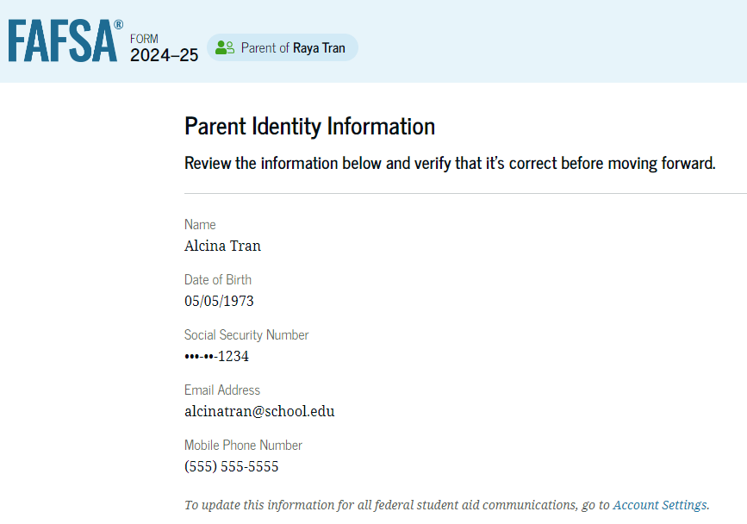
Parent identification information
Same process as for the student, can’t change name, date of birth, Social Security number or e-mail address
Go to Account Settings on StudentAid.gov if e-mail address or phone number is incorrect
Can change mailing address
41

Slide 42
Parent approval screen
42

Slide 43
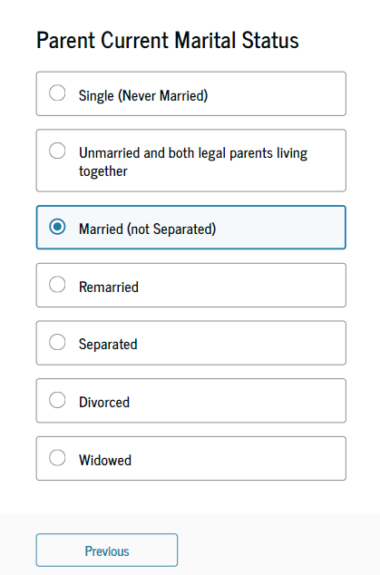
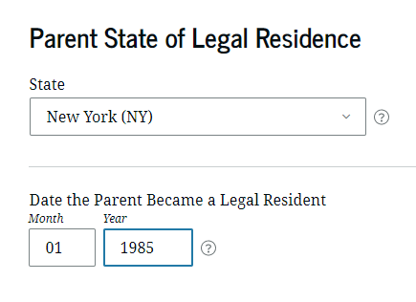
Parent demographics
43

Slide 44
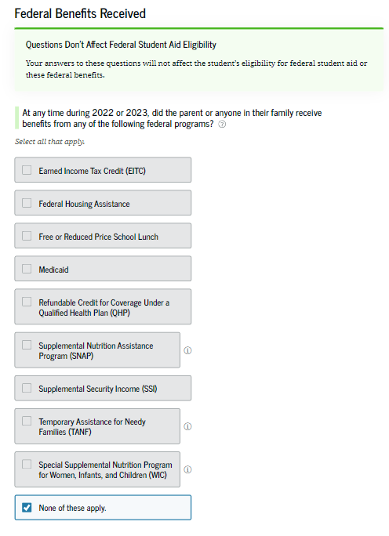
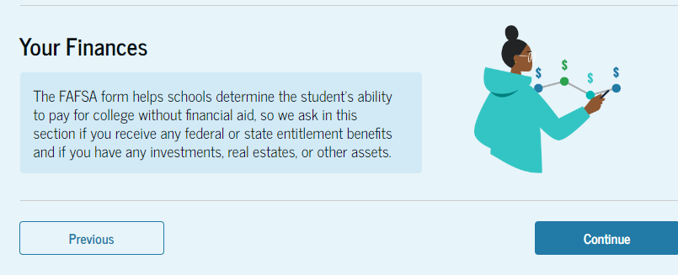
Parent financial information

Slide 45
Students with undocumented parents
Parents must still report information on the FAFSA
Can get an FSA ID, even if don’t have a Social Security number
May be authenticated against the credit bureau instead of the Social Security Administration
May be asked to income earned from work instead of tax information
45

Slide 46
Family size
Can report if the number of dependents is different than the number of individuals claimed on 2023 tax return
46

Slide 47
Who is included in the number in college? Dependent student
Student
NOT the parent(s)
Others attending at least half time in an approved program during 2025-26 that leads to a degree or certificate at a postsecondary school eligible to participate in any of the federal student aid programs
Does not factor into need analysis calculation
47

Slide 48
Tax return information
Income tax information will be pulled through the Direct Data Exchange (DDX)
48

Slide 49
Asset questions
Annual child support received
Cash, savings, and checking accounts
Businesses and investment farms
Investments, including real estate (not parents’ home)
49
Notes:
What is the net worth of your parents’ investments?
This is question 91 on the paper FAFSA.
The net worth of your parents’ current investments is the amount left over after deducting the debt from the value of each investment.
For example: Your parents own an investment property valued at $100,000; however, $75,000 in debt is owed on the property. The net worth of the investment is $25,000 ($100,000-$75,000 = $25,000).
If your parents own multiple investments, total the net worth amounts and report them as a lump sum.
For example: Your parents own two investment properties.
The first investment property is valued at $100,000. The debt that is owed on the property is $110,000.
To calculate the net worth, perform the following calculation:
(Value of Property) minus (Debt Owed on Property) = net worth
$100,000 – $110,000 = -$10,000
The net worth of this first investment property is considered $0, not negative value of $10,000.
The second investment property is valued at $200,000. The debt that is owed on the property is $100,000.
(Value of Property) minus (Debt Owed on Property) = net worth
$200,000 – $100,000 = $100,000
The net worth of this second investment property is $100,000.
If the net worth of the first investment property is $0 and the net worth of the second investment property is $100,000, then the amount to be reported for both properties is $100,000.
If your parents’ net worth as of the day you submit your Free Application for Federal Student Aid (FAFSA) is:
Net worth valueEnterTen million or more9999999Zero or less than zero0Round to the nearest dollar and do not include commas or decimal points.
Investments include real estate (do not include the home in which your parents live), rental property (includes a unit within a family home that has its own entrance, kitchen, and bath rented to someone other than a family member), trust funds, UGMA and UTMA accounts, money market funds, mutual funds, certificates of deposit, stocks, stock options, bonds, other securities, installment and land sale contracts (including mortgages held), commodities, etc.
Note: UGMA and UTMA accounts are considered assets of the student and must be reported as an asset of the student on the FAFSA, regardless of the student's dependency status. Do not include UGMA and UTMA accounts for which your parents are the custodian but not the owner.
Investments also include qualified educational benefits or education savings accounts such as Coverdell savings accounts, 529 college savings plans and the refund value of 529 prepaid tuition plans.
Note: Students who must report parental information on this form should report all qualified educational benefits or education savings accounts owned by the parents and / or the dependent student as part of the parental assets.
Investments do not include the home in which your parents live; cash, savings and checking accounts; the value of life insurance and retirement plans (401[k] plans, pension funds, annuities, noneducation IRAs, Keogh plans, etc.).
Investment value means the current balance or market value of these investments as of the day you submit your FAFSA. Investment debt means only those debts that are related to the investments.
For more information about reporting investments, call the Federal Student Aid Information Center 1-800-4-FED-AID (1-800-433-3243).

Slide 50
Determining the value of assets
Market value
Debt owed
Net value

Slide 51
Other parent information
Could be a biological or adoptive parent or step-parent
51

Slide 52
Parent review page
52
52

Slide 53
Parent signature and abbreviated confirmation page

Slide 54
FAFSA Submission summary
54

Slide 55
FAFSA help options
Questions and answers at the beginning
Help “bubbles” on each FAFSA question
Federal Student Aid Information Center 800-433-3243
Mapping Your Future 800-374-4072
More online resources may be available when the FAFSA is finalized
55

Slide 56
Student Aid Index (SAI)
The amount a family can reasonably be expected to contribute
Calculated using data from the FAFSA and federal formula
May be a negative number
Two components
Parent contribution
Student contribution
Stays the same regardless of college

Slide 57
Financial aid calculation
Cost of
Attendance
Student Aid Index
Other financial assistance
Need
57

Slide 58
Sample maximum federal financial aid amounts
Federal Pell Grant: up to $7,395*
Direct Loan: $5,500
Up to $3,500 Subsidized
Remaining $5,500 after subtracting Subsidized can be Unsubsidized
6.53% interest rate for undergrads, 8.08% for graduate students*
Direct PLUS Loan: Parents can borrow up to the cost of attendance less financial aid
9.08% interest rate*
*For the 2024-25 academic year

Slide 59
Sample financial aid offer Also referred to as award letter

Slide 60
South Dakota Opportunity Scholarship
Attend postsecondary school in SD
Starting Fall 2023, $1,500 for 3 years and $3,000 for final year
Must be SD resident
Eligibility requirements include minimum GPA, minimum ACT scores, curriculum requirements, etc.
Apply at https://sdos.sdbor.edu/ by September 1
Recommended that initial application and transcript be submitted by June 1
Programs may change – check website for the latest information
Notes:
Tuition is based on public university tuition rates
Before Fall 2023, was $1,300 for 3 years and $2,600 for final year

Slide 61
Dakota Corps Scholarship
Tuition and applicable fees at participating SD schools
Requirements include minimum grades and agreement to stay in state for work in specific critical need occupations
Understand the scholarship will turn into a loan if requirements are not met
Apply at https://www.sdbor.edu/dakotacorps/Pages/How-Do-I-Apply.aspx by December 15
Programs may change – check website for the latest information
Notes:
Tuition is based on public university tuition rates

Slide 62
South Dakota Needs Based Grant Program (SDNBGP)
Resident of SD
Enrolled at least part time at a participating institution
Completed FAFSA and requirements established by institution
Information at https://tdx.sdbor.edu/TDClient/33/Portal/KB/ArticleDet?ID=311
Programs may change – check website for the latest information

Slide 63
Build Dakota Scholarship
Full-ride scholarship
For students enrolled in a high-need workforce area program at one of the four technical colleges
Work full-time in SD for a minimum of three years.
Next application cycle will be January 1, 2025 – March 31, 2025
Understand the scholarship will turn into a loan if requirements are not met
More information at www.builddakotascholarships.com or on the technical college’s website
Programs may change – check website for the latest information
Notes:
Tuition is based on public university tuition rates

Slide 64
Freedom Scholarship
New state-wide initiative to encourage South Dakota students of all economic backgrounds to live and work in South Dakota after graduation
Available to students with unmet financial need as determined through their submission of the FAFSA, in conjunction with the financial aid office at the respective university.
Understand the scholarship will turn into a loan if requirements are not met
More information at www.freedomscholarshipsd.com
Programs may change – check website for the latest information

Slide 65
Jump Start Scholarship
Students who graduate from a SD public high school in 3 years or less
Enroll in an accredited institution located in SD within 1 year of high school graduation.
For first year only and dollar amount varies
For SD residents
Apply at https://ourdakotadreams.com/paying-for-college/sd-scholarships/ September 1
Programs may change – check website for the latest information

Slide 66
Critical Teaching Needs Scholarship
Agree to work in SD in a critical teaching need occupation for five years
Understand the scholarship will turn into a loan if requirements are not met
Attend a participating SD postsecondary institution
Application and more information online at https://ourdakotadreams.com/paying-for-college/sd-scholarships/
Programs may change – check website for the latest information

Slide 67
Scholarship tips
Develop a plan
Understanding the cost
Establish a scholarship goal
Conduct research
Research local, college, state, employer programs
Organizations/ employers that align with your career choice
Scholarship search
Prepare applications
Write the essay
Proof and edit, neatness counts
Stay organized
Use the scholarship tracking sheet
Follow deadlines, requirements
Have a dedicated e-mail address

Slide 69
Resources
SouthDakota.MappingYourFuture.org
https://southdakota.mappingyourfuture.org/college.cfm
https://southdakota.mappingyourfuture.org/career-sort.cfm
MappingYourFuture.org
StudentAid.gov
https://studentaid.gov/aid-estimator/
Scholarship tracking sheet: MappingYourFuture_Scholarship_Tracking.xlsx (live.com)
Scholarship searches
FastWeb: www.fastweb.com/
BigFuture: bigfuture.collegeboard.org/
Scholarship Resources: https://mappingyourfuture.org/wp-content/uploads/2024/08/MappingYourFutureScholarshipTips.pdf
69
Notes:
Frequently asked questions--https://studentaid.ed.gov/sa/about/data-center/student/application-volume/faq

Slide 70
Questions
70
© Mapping Your Future 2024

Slide 71
Thank you for participating
Cathy Mueller
Marlene Seeklander
(800) 374-4072 feedback@mappingyourfuture.org SouthDakota.MappingYourFuture.org

