Slide 1

2025-26
Financial Aid Night
December 2024
Notes:
NOTE:
To change the image on this slide, select the picture and delete it. Then click the Pictures icon in the placeholder to insert your own image.

Slide 2
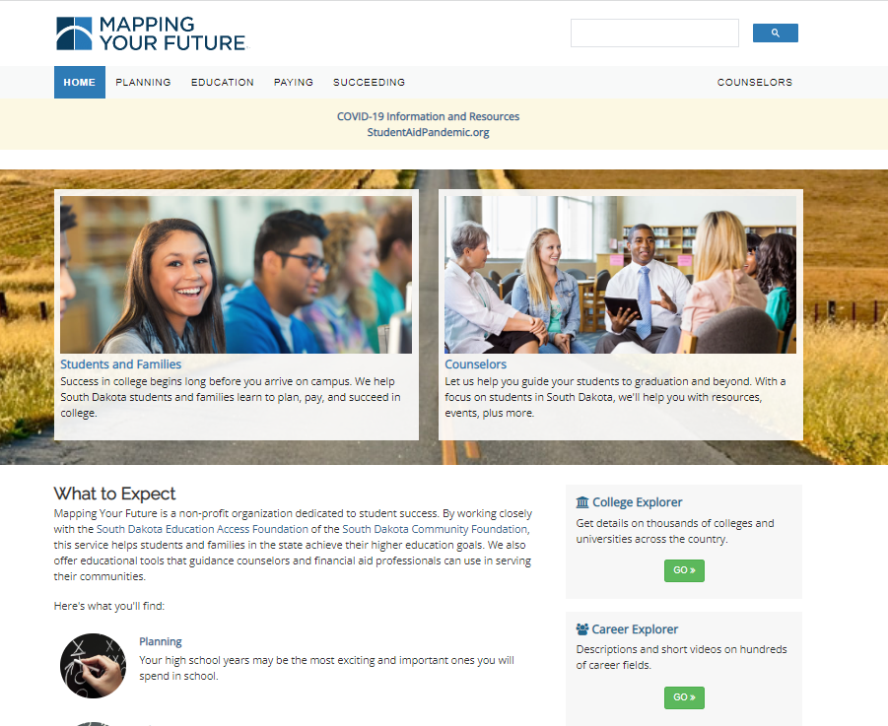
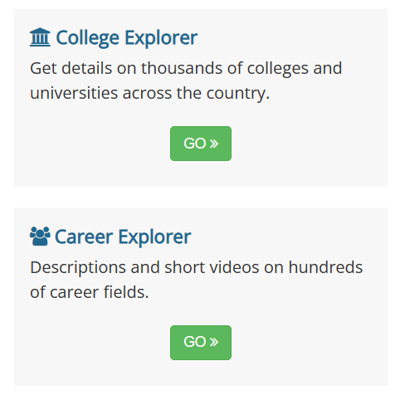
South Dakota Mapping Your Future website
Comprehensive website for students, parents, counselors, and other professionals at https://SouthDakota.MappingYourFuture.org
2

Slide 3

Agenda
Paying for college
Free Application for Federal Student Aid (FAFSA)
South Dakota programs
Resources

Slide 4
Paying for education
Savings
Earnings
Financial aid
Tax credits & deductions
4
Notes:
Most people use the following resources to pay for college.
Savings – student and/or parent
Cash & earnings – current salary of student/parent
Financial aid – what we are talking about tonight.
We include tax credits and deductions on this slide as a reminder. While the credits and deductions don’t pay for college, per se, they do help parents and students reduce the cost of education.

Slide 5
Financial aid process
Complete
2
the Free Application for Federal Student Aid (FAFSA)
Receive
3
FAFSA Submission Summary
Receive
4
a financial aid offer from the school
Decide
5
which aid to accept and return the financial aid offer
Create
1
FSA ID on StudentAid.gov
5
Notes:
These are the basic steps in the financial aid process.
Create your FSA ID – Your account at StudentAid.gov.
Complete the FAFSA.
Receive/review the FAFSA Submission Summary.
Receive/review Award Letter from the school (could be in the spring sometime).
Decide what aid to accept and return the award letter (or confirm it online).

Slide 6
Complete the FAFSA
Student starts the FAFSA
Student invites the parent to do their part in the FAFSA
Parent completes their part of the FAFSA
Submit the FAFSA when complete
Student completes their part of the FAFSA
6
Notes:
Complete the FAFSA*
This slide shows the process for completing the FAFSA.**
A student starts the FAFSA (preferred way).
The student Invites the parent to do their part of the FAFSA.
The student completes their part of the FAFSA.
Parent accepts invite and completes their part of the FAFSA.
FAFSA is submitted when complete.
**Parent can start a FAFSA and invite a student to complete their part.

Slide 7
Types of financial aid
Grants
Scholarships
Work-study programs
Loans
7
7
Notes:
Financial aid comes in different forms:
Grants – which typically don’t have to be repaid.
Scholarships – which typically don’t have to be repaid.
Work-study programs – allow a student to work and earn a salary they can use to pay for education.
Loans – which do have to be repaid. There are federal student loans or private student loans, and some states offer state student loan programs. Students considering student loans should consider federal loans first because of the repayment options and other benefits offered by those loans.
No matter what aid – even grants and scholarships – students should consider it carefully before accepting it.
Loans are a financial obligation and must be repaid.
Grants and scholarships can come with requirements (such as maintaining a GPA or pursuing a specific career) and, if those requirements are not met, the grant or scholarship could be lost or turned into a loan. Some of the South Dakota grants and scholarships have those requirements.

Slide 8
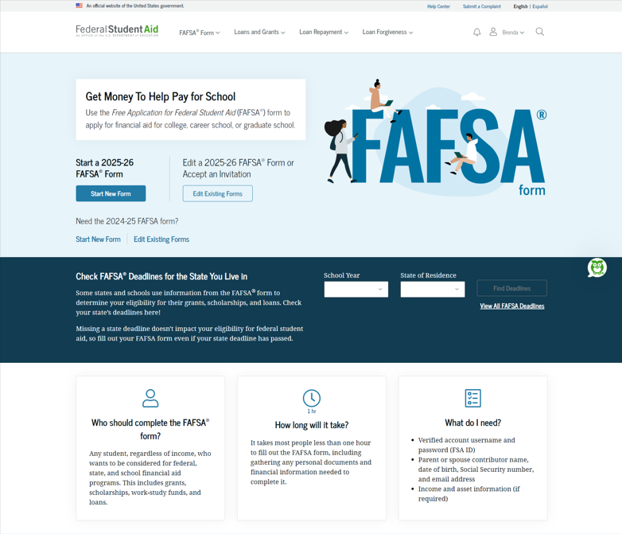

What is the FAFSA?
Free Application for Federal Student Aid
Base application for various forms of
financial aid (need based and non-need based)
  Federal
  State
  Institutional
  Private
2025-26 FAFSA now available (normally available October 1 for the following academic year)
8
Notes:
Free Application for Federal Student Aid. Note the word “Free.” You should never pay to complete the FAFSA.
Collects demographic and financial information about the student and family.
Information collected is used by other organizations to award financial aid. In addition to the federal government, state governments (including South Dakota), Colleges & Universities, and some private foundations use the data on the FAFSA to award financial aid, grants, and scholarships. So even if you don’t want student loans and don’t think you’ll qualify for any federal need-based aid, you will still want to complete the FAFSA.
Normally the FAFSA is available on October 1 for the following academic year but is delayed this year to allow the Department to test and resolve issues before making the form available to all students and contributors.

Slide 9
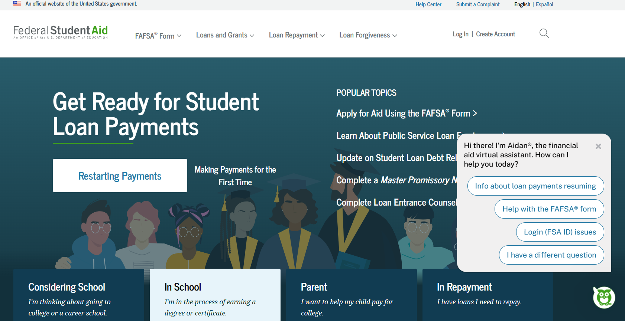
https://StudentAid.gov
Navigation tool for the applicant when accessing the FAFSA on the website
Includes Dashboard for the user
Provides options and messaging based on the status of the student’s FAFSA:
  Start a 2025-26 FAFSA
  View the FAFSA Submission Summary
  Make FAFSA corrections
  View correction history
  Complete and submit a Renewal FAFSA
9
Notes:
From the www.studentaid.gov homepage, the FAFSA application can be accessed through the “FAFSA Form” tab. Select “Complete the FAFSA Form” from the drop-down box.
New applications for 2025-26 are completed in the “New to the FAFSA Process?” option by selecting the “Start Here” button.
Dashboard is customized to user and contains:
On this site, you can take care of anything related to your financial aid:
Start a 2025-26 FAFSA
View the Student Aid Report
Make FAFSA corrections.
View correction history
Provide missing signatures.
Complete and submit a Renewal FAFSA

Slide 10

Dependent Student
Identity Information
FAFSA terminology
Contributor
Approval/Consent
Personal circumstances
Parent
Unusual circumstances
Special circumstances
FAFSA Submission Summary
Student Aid Index (SAI)
10
Notes:
Contributor – any individual required to provide consent and approval for federal tax information (FTI) along with their signature on the FAFSA® form, including the student; the student’s spouse; a biological or adoptive parent; or the parent’s spouse (stepparent). The contributor does not necessarily contribute financially to the student’s education.
Approval/Consent – This is required for the IRS to provide income information for the FAFSA. Without approval, the FAFSA will not be processed by Federal Student Aid.
Personal circumstances – This is information provided by the student to determine dependency status and whether they will need to provide parent information.
Parent – The biological or adoptive parent(s). For a dependent student, the parents are divorced or separated, the parent who provides the most support contributes information on the FAFSA.
Primary or Custodial Parent: for a dependent student whose parents are divorced or separated, the primary or custodial parent is the parent who provides the greater portion of the student’s financial support and is required to provide their information (and if applicable their spouse’s information) on the FAFSA form.
Unusual Circumstances: conditions that justify a financial aid administrator making an adjustment to a student’s dependency status, commonly referred to as a dependency override, based on an unusual situation (e.g., human trafficking or parental abandonment).
Special Circumstances: special or extenuating situations (such as the loss of a job) that impact a student’s financial condition and support a financial aid administrator adjusting data elements in the COA or in the SAI calculation on a case-by-case basis.
FAFSA Submission Summary - replaces the Student Aid Report (SAR) as the student’s output document providing a summary of data input on the FAFSA form.
Student Aid Index (SAI) - replaces the Expected Family Contribution (EFC) as a formal evaluation of a student’s approximate financial resources to contribute toward their postsecondary education for a specific award year.

Slide 11
Who is the parent for FAFSA purposes?
Your biological and/or adoptive parents are considered your legal parents.
  Must report information for both biological or adoptive parents if they are married or unmarried and living together
Grandparents, foster parents, legal guardians, older brothers or sisters, and aunts and uncles are not considered parents unless they have legally adopted you.
Parent wizard tool in the FAFSA helps determine which parent’s or parents’ information to include.
Department of Education has made the parent wizard tool available outside of the FAFSA to help students and parents prepare to complete the form. https://studentaid.gov/fafsa-apply/parents
11
Notes:
Your biological and/or adoptive parents are considered your legal parents.
Must report information for both biological or adoptive parents if they are married or unmarried and living together
Grandparents, foster parents, legal guardians, older brothers or sisters, and aunts and uncles are not considered parents unless they have legally adopted you.
Parent wizard tool in the FAFSA helps determine which parent’s or parents’ information to include. The next slide provides information on how you determine the parental information and income to include on the FAFSA.

Slide 12
Which parent provides information/needs a StudentAid.gov account (FSA ID)
Divorced or Separated
Parent who provided the most financial support reports information and needs an FSA ID.
Remarried
Parent who provided the most financial support reports information for parent and step-parent
  Only the biological parent needs an FSA ID if filed joint taxes.
  If filed separately, parent and step-parent needs an FSA ID.
Widowed
Surviving parent provides information and needs an FSA ID.
Married
Report information on both parents:
  Only one parent needs an FSA ID if filed joint taxes.
  If filed separately, both parents need an FSA ID.
Unmarried but living together
Report information on both parents and both parents need an FSA ID.
Never married and not living together
Parent who provided the most financial support reports information and needs an FSA ID.
12
Notes:
Primary or Custodial Parent: for a dependent student whose parents are divorced or separated, the primary or custodial parent is the parent who provides the greater portion of the student’s financial support and is required to provide their information (and if applicable their spouse’s information) on the FAFSA form.

Slide 13
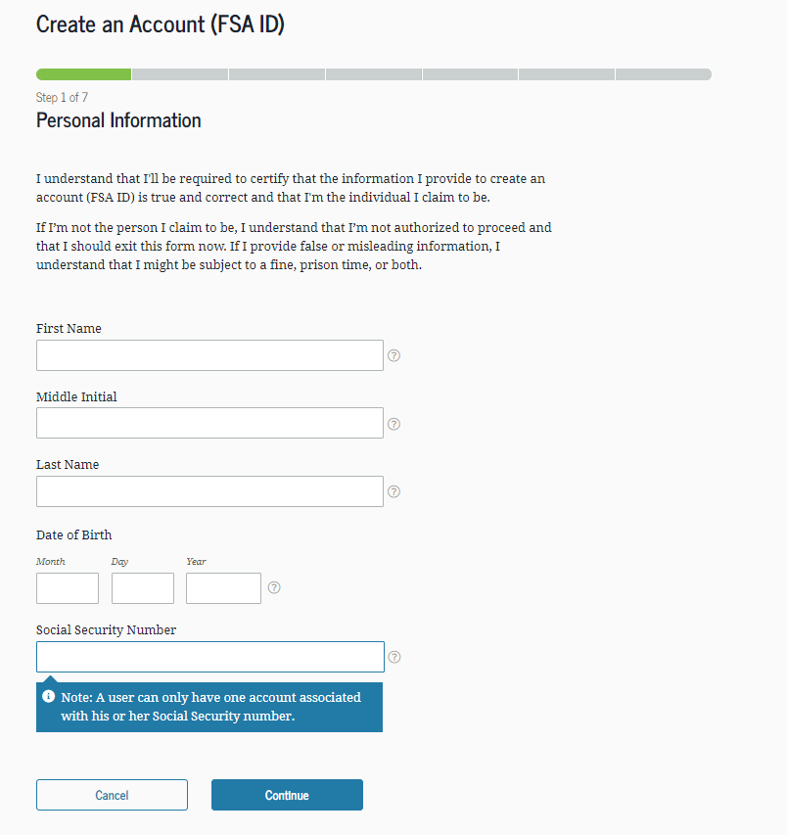
Create an StudentAid.gov account (FSA ID)
Key FSA ID points:
Students and at least one parent for FAFSA purposes need one (see parent wizard information)
Cannot share an e-mail address or phone number for FSA ID
Must be set up before completing the 2025-26 FAFSA
May take three days for the Social Security Administration to authenticate your information, so set up the FSA ID well before sitting down to complete the FAFSA
Go to StudentAid.gov, Create Account
Enter your personal information
Create your username and password
Enter your e-mail address
Create security questions
Submit your information
13
Notes:
Items Needed to Create an Account:
Social Security number
Your own mobile phone number and/or email address
Steps to create an account (I don’t think we need to go through this step-by-step, so this is just background)
Access the "Create Account" page at StudentAid.gov
Provide a unique username.
Enter your email address.
Provide a unique password.
Provide your name, date of birth, and Social Security Number (SSN).
Provide your mailing address.
Select your language preference.
Provide your mobile phone number. Select the box if you would like to register your mobile phone to receive one-time secure codes if you forget your username or password. (You will be required to either provide your email address or to provide your mobile phone number and opt-in to messaging before you can proceed.)
For security purposes, complete the challenge questions and answers.
Confirm and verify your information.
Agree to the terms and conditions.
Verify your email address and/or mobile phone number. This verification allows you to retrieve your username or reset your password without answering your challenge questions. Also, you can use your mobile phone number or your email address as your username when logging in to ED systems. We'll also be able to notify you by email to changes to your account.

Slide 14

StudentAid.gov account (FSA ID)
Student
Sign in to StudentAid.gov
To contribute to the FAFSA
To access aid history
Parent
To apply for a Direct PLUS (Parent) Loan
To complete loan counseling
Sign in to StudentAid.gov
To apply for repayment plans
To contribute to the FAFSA
To complete Direct Loan Master Promissory Note
14
Notes:
How the student will use their FSA ID (StudentAid.gov Account):
Filling out the Free Application for Federal Student Aid (FAFSA®) form
Signing your Master Promissory Note (MPN)
Applying for repayment plans
Completing loan counseling
Using the Public Service Loan Forgiveness Help Tool
How the parent will use the FSA ID for the StudentAid.Gov account:
To sign in to StudentAid.gov
To obtain a Direct PLUS (Parent) Loan
Reminders
Set it up early – it will need to be verified before you complete the FAFSA, which could take up to a week.
Both the student and the parent(s) contributing information will need an FSA ID.
Each contributor must use their own email address.
Don’t use a work or school email address

Slide 15
Gathering documents needed
Your Social Security number
Your parents’ Social Security numbers
2023 federal tax information, tax returns, W-2’s for you and for your parents
Records of your 2023 untaxed income
Information on cash, savings and checking account balances, investments, businesses and farms
15
Notes:
Your Social Security number
Your parents’ Social Security numbers
Your driver’s license number
Your Alien Registration number (if not a U.S. citizen)
2023 federal tax information, tax returns, W-2’s for you and for your parents
Records of your untaxed income
A significant change will be the reduction of untaxed income items included in the need analysis, which will include only the following:
Deductions and payments to self-employed SEP, SIMPLE, Keogh, and other qualified individual retirement accounts excluded from income for federal tax purposes, but excluding payments made to tax-deferred pension and retirement plans, paid directly or withheld from earnings, that are not on the federal tax return
Tax-exempt interest income
The untaxed portion of individual retirement account distributions (excluding rollovers)
The untaxed portion of pensions (excluding rollovers)
The foreign earned income exclusion
Other types of untaxed income have been eliminated from the need analysis.
Information on cash, savings and checking account balances, and assets.

Slide 16
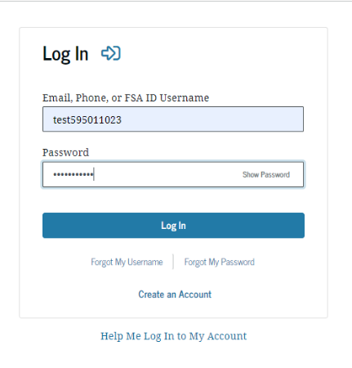
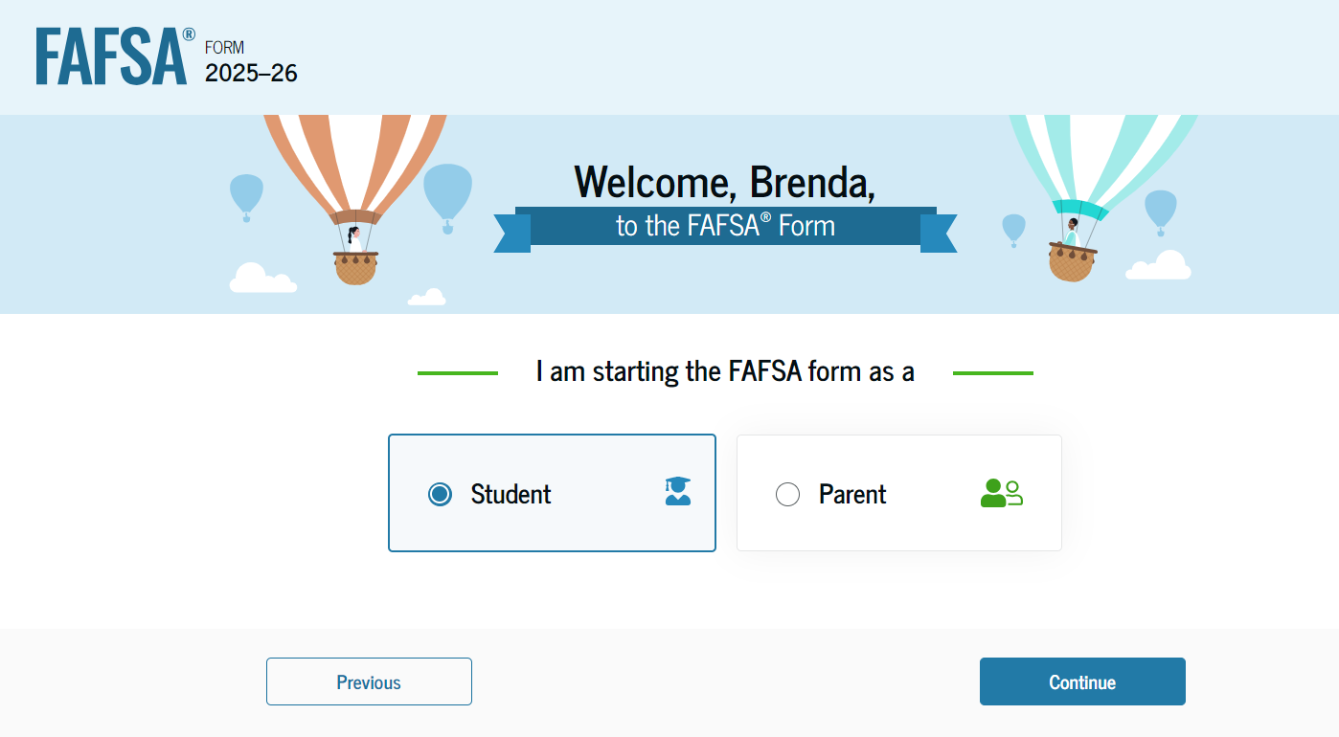
FAFSA log in
Notes:
The student will log into the FAFSA with the FSA ID username and password.
The FAFSA belongs to the student and so we recommend the student is the one who starts the FAFSA process. (U.S. Department of Education prefers this process).
A parent can start the process, but they will need to “invite” the student to complete their part of the FAFSA (the process of inviting someone to complete the FAFSA will be shown later).
Be sure to select the correct FAFSA.
Students may stop at any time and return to complete the FAFSA later without losing any data they’ve already entered.

Slide 17
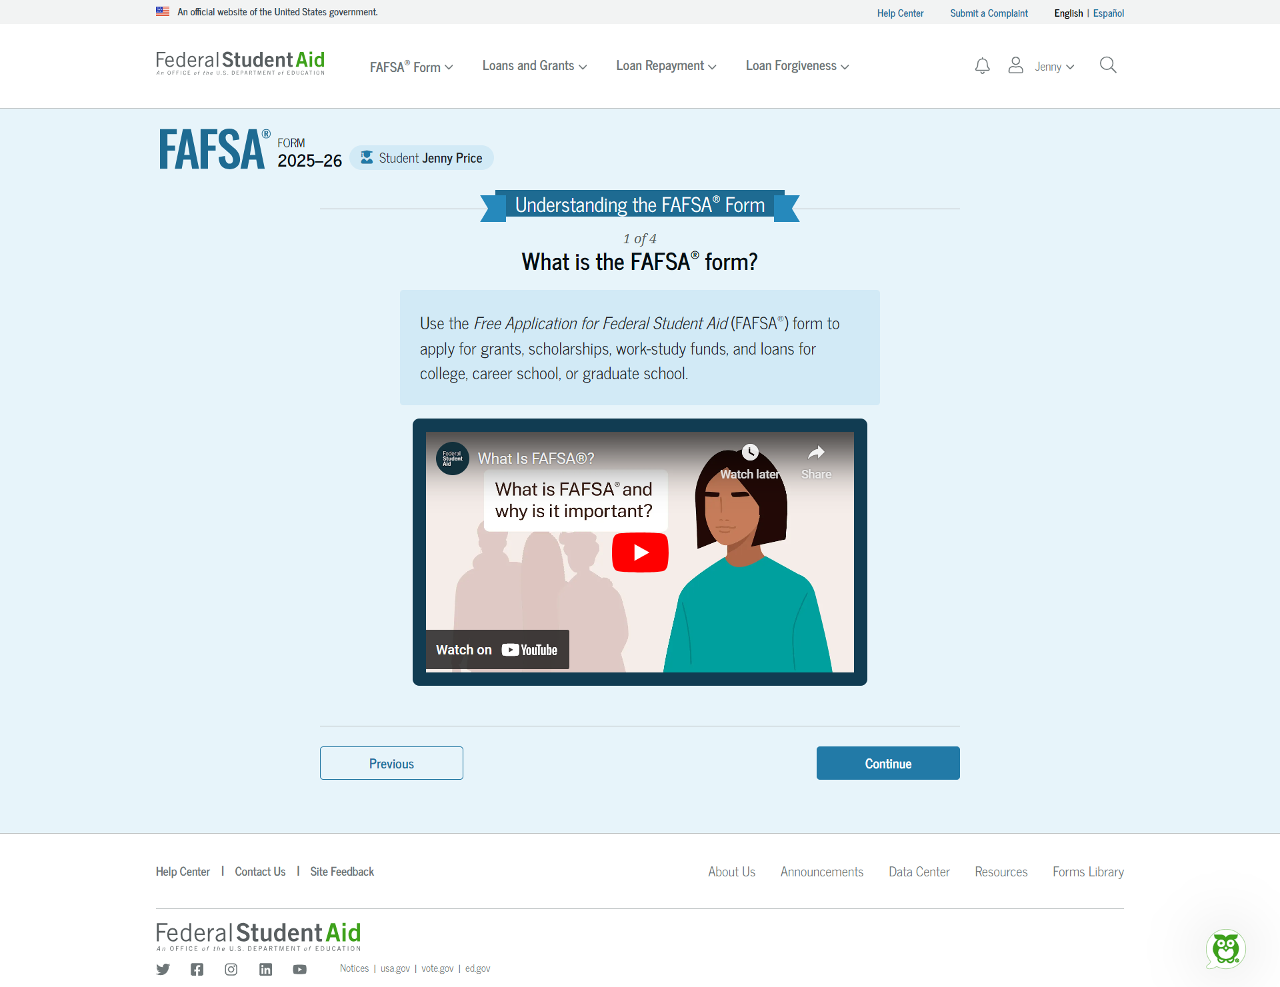
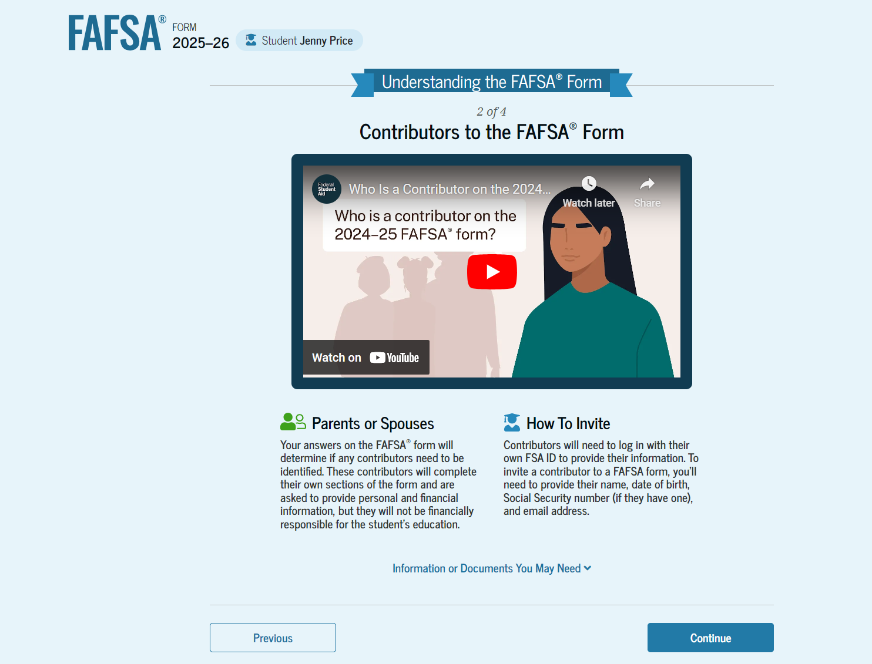
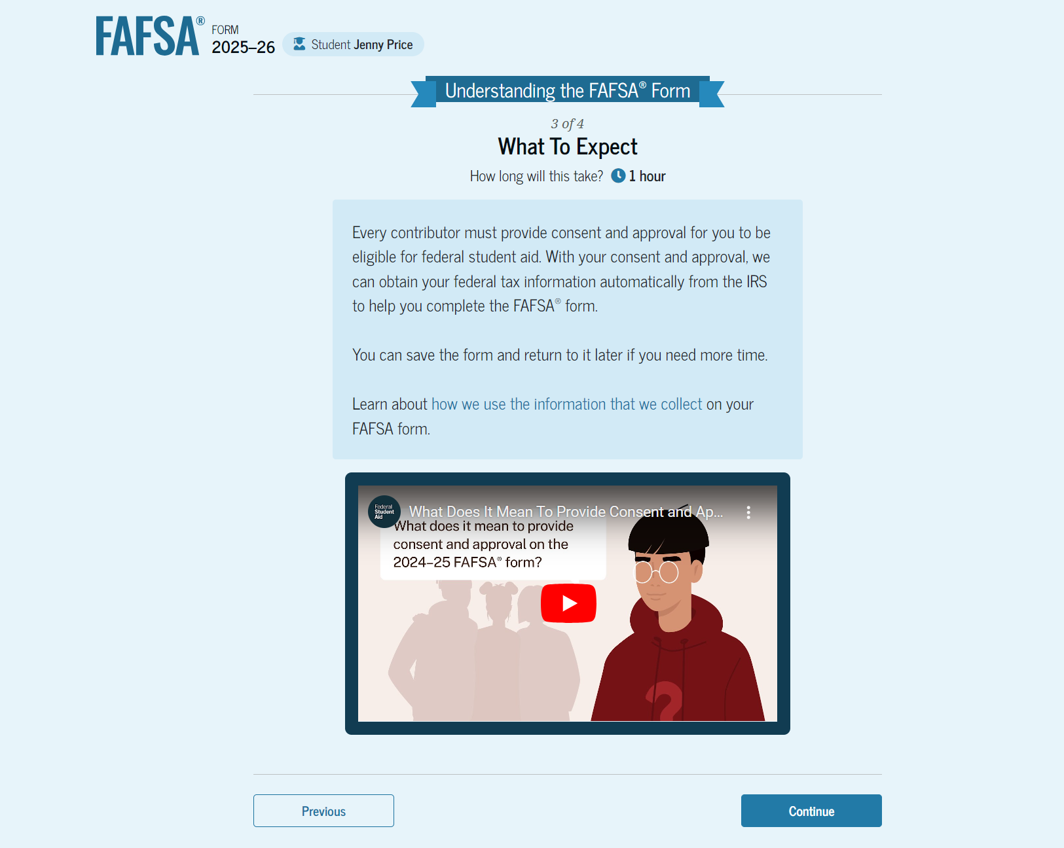
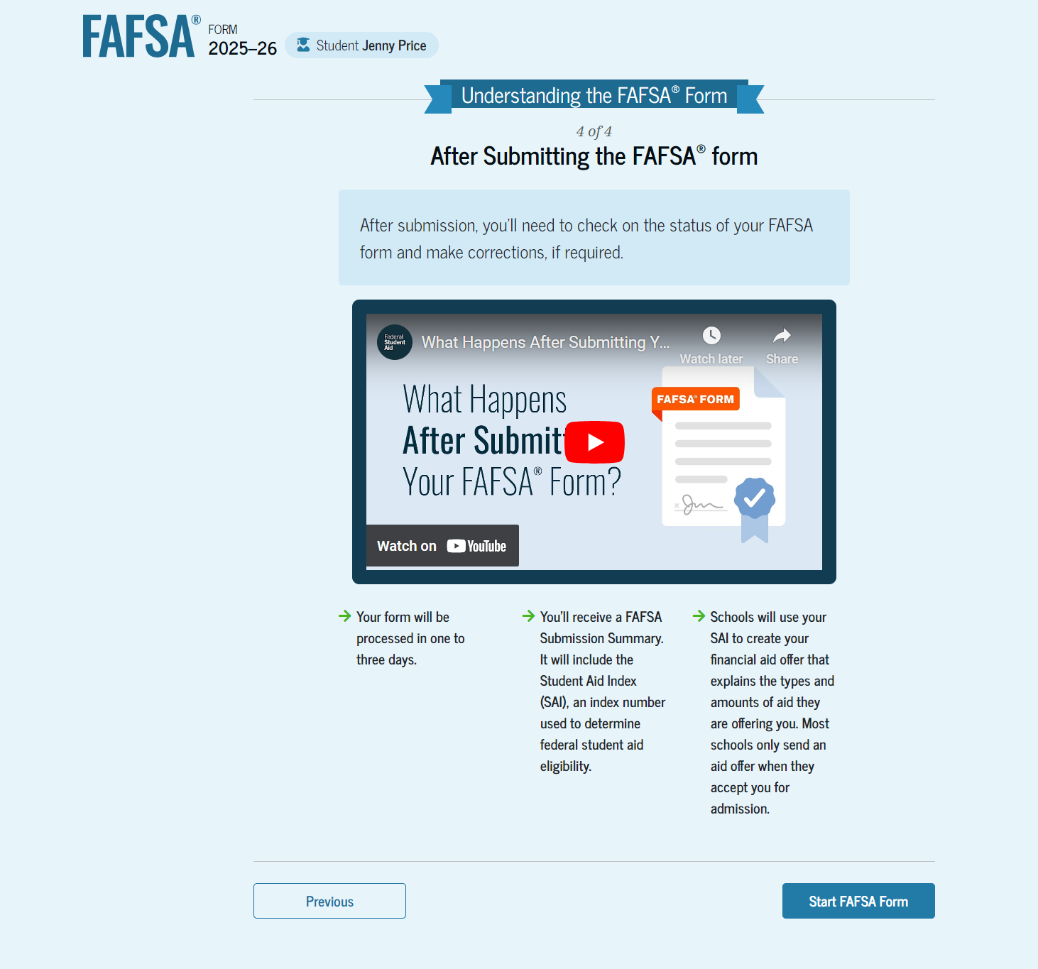
Student Onboarding
17
Notes:
When the student starts the 2025–26 FAFSA® form for the first time, they are taken through the FAFSA onboarding process. The first onboarding page provides an overview of the FAFSA form and an accompanying video.
The second FAFSA® onboarding page provides information about the different roles that may be required to participate in the student’s FAFSA form and documents that may be needed to fill out the form.
The third FAFSA® onboarding page provides information about the types of questions the student can expect to see and how they can get additional help with filling out the FAFSA form.
The last FAFSA® onboarding page provides information about what to expect once the FAFSA form is completed and submitted. On this page, the student can select "Start the FAFSA form" to begin.

Slide 18
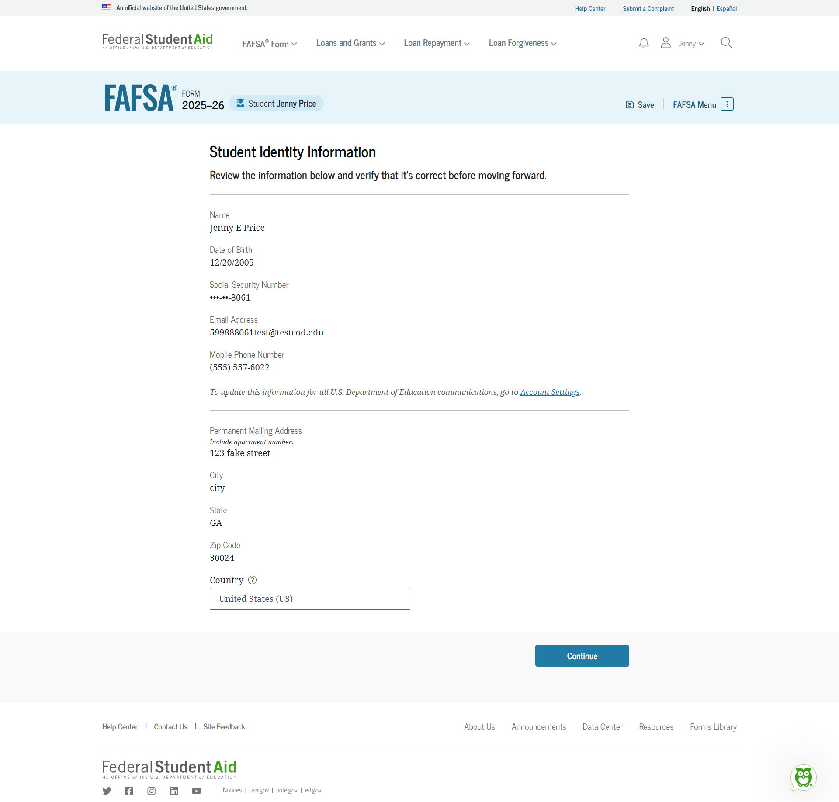
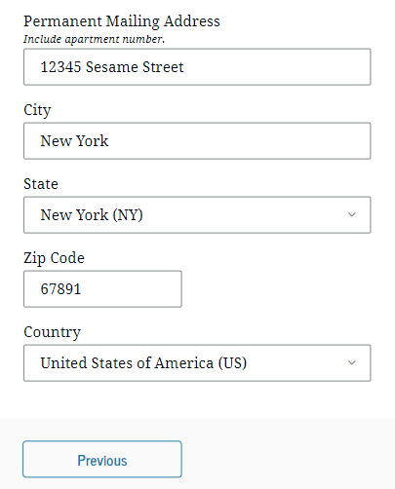
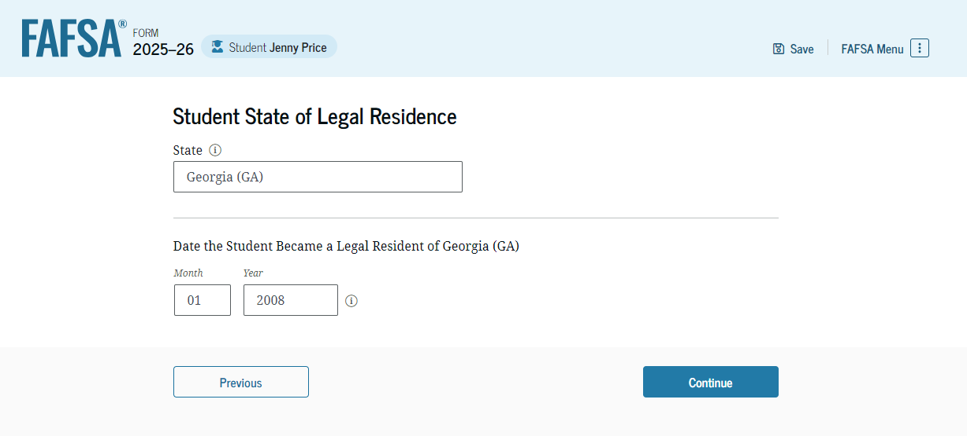
Student identifiers
Prefilled from the FSA ID information:
  Name
  Social Security Number
  Date of birth
  Email address
  Phone number
Mailing address
Residency
18
Notes:
This is the basic information about the student.
The information should be prefilled based on information associated with your FSA ID (profile in your StudentAid.gov account)
Some of the information can be changed here (like address) but if other information needs to be updated, it will have to be done in the account profile.
Some information cannot be updated either on FAFSA or in StudentAid.gov profile.
Residency question is asked to determine eligibility for state programs

Slide 19
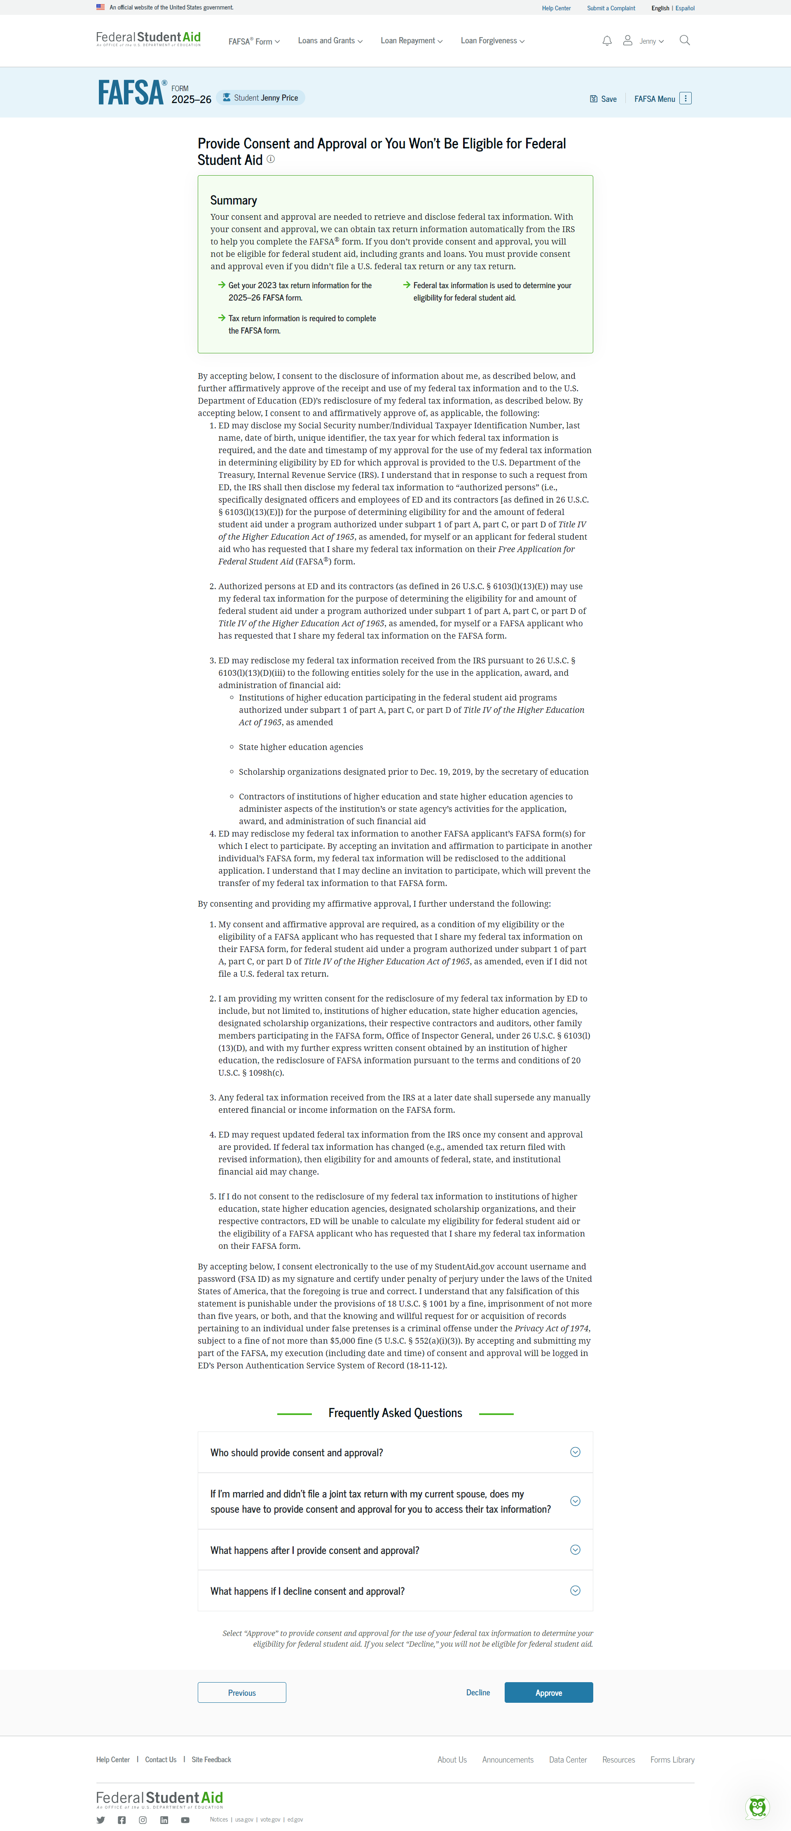
Approval
Student acknowledges consent to pull financial information from the IRS through the Direct Data Exchange (DDX)
19
Notes:
Student provides approval (acknowledges consent) for the Department of Education to pull financial information from the IRS through the Direct Data Exchange (DDX)
If the student does not provide consent, their FAFSA will not be processed.

Slide 20
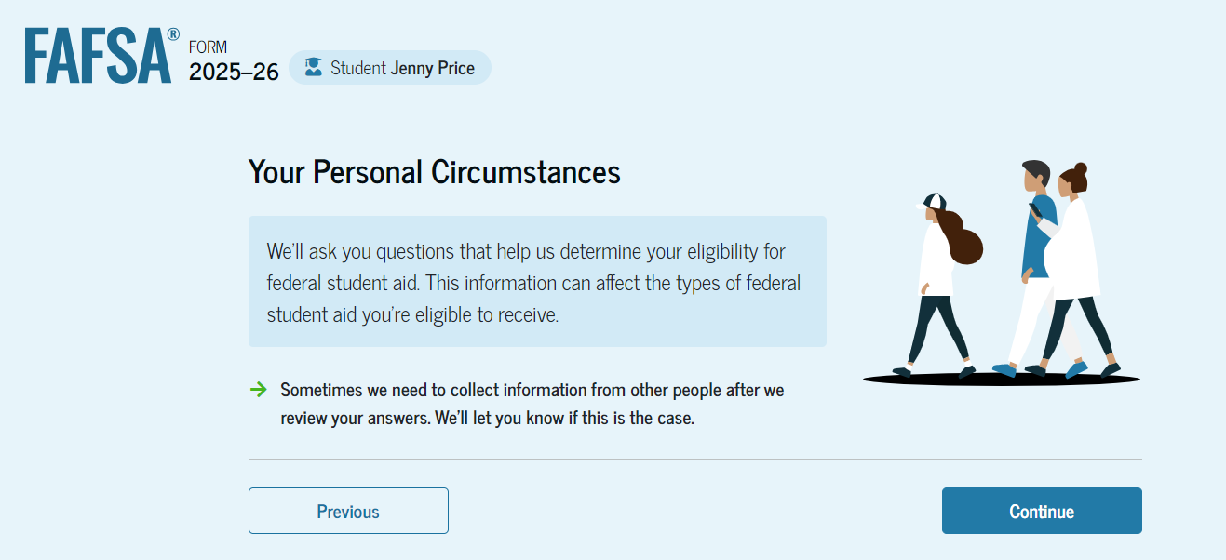
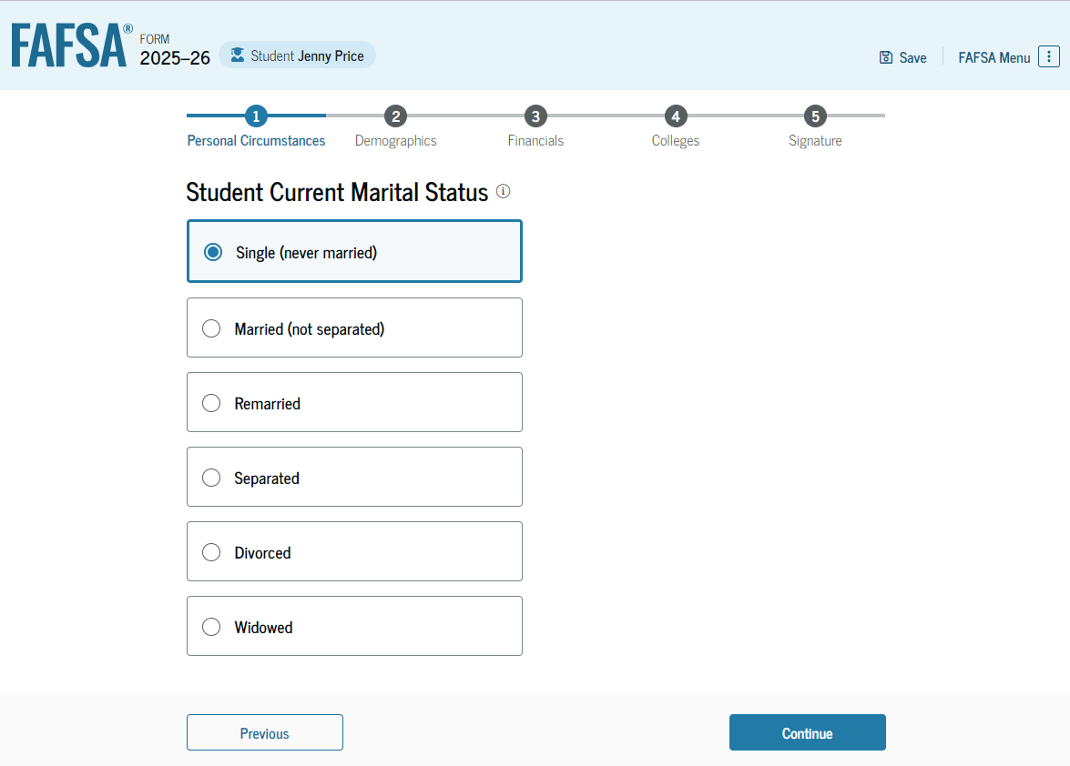
Personal circumstances
Marital status
College or career school plans
Student personal circumstances
Homeless
Unusual circumstances
20
Notes:
The student provides information about personal circumstances.
Marital status
College or career school plans
Student personal circumstances
Homeless
Unusual circumstances
The next few slides display screen shots of the FAFSA questions that collect information which may be used to determine eligibility and to determine whether student needs to provide parent information (dependency status).

Slide 21
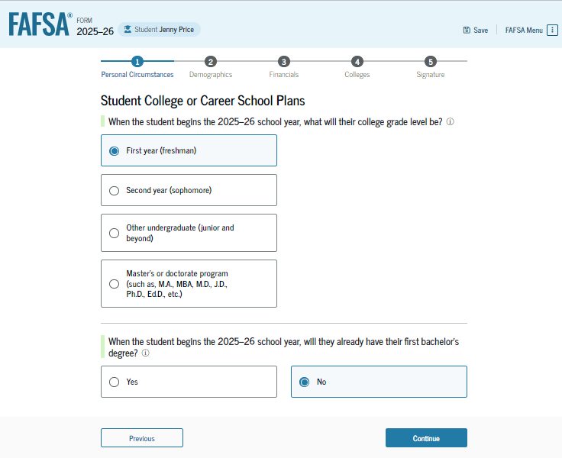
Student’s college or career plans
21
Notes:
Student indicates what year their college grade level. Students with dual credit should enter first-time freshmen.

Slide 22
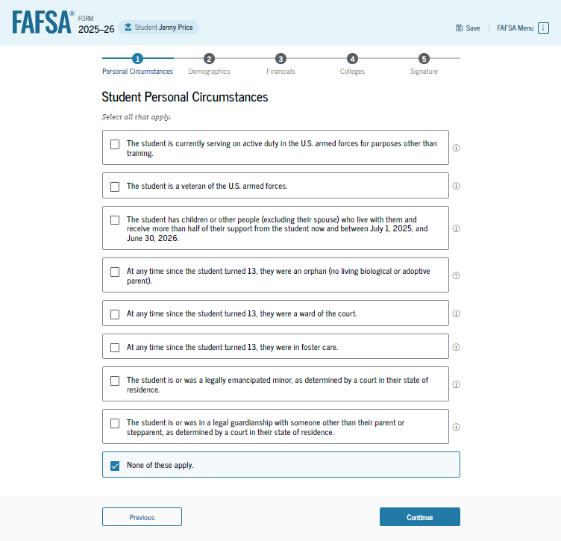
Student’s personal circumstances
24 years of age
Married
Master’s or doctorate program
Active-duty military
Veteran of the U.S. Armed Forces
Have children
Have dependents
Orphan, foster care or ward of the court
Emancipated minor
Legal guardianship
Homeless or self-supporting and at risk of being homeless
22
Notes:
Student should review the statements on the screen. If none apply, the student will select that and will be determined a dependent student and must invite a parent or parents to contribute to the FAFSA. If one applies, the student will be considered independent and would only invite a contributor to their FAFSA if they have a spouse.
24 years of age
Married
Have children
Have dependents
Master’s or doctorate program
Active-duty military
Veteran of the U.S. Armed Forces
Orphan, foster care or ward of the court
Emancipated minor
Legal guardianship
Homeless or self-supporting and at risk of being homeless

Slide 23
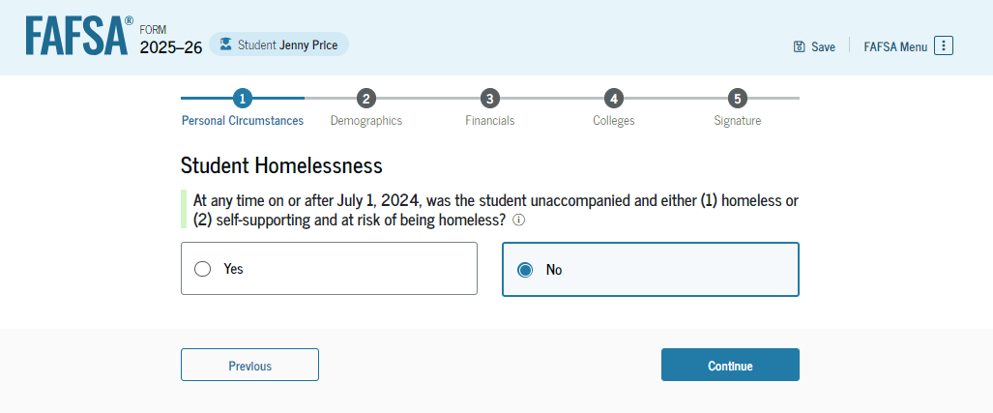
Other circumstances
Unaccompanied
  Not in the physical custody of a parent
Homeless
  Lacking fixed, regular, and adequate housing
Youth
  23 years of age or younger
23
Notes:
The FAFSA includes a question about whether the student was homeless or at risk of homelessness. This will be used to determine a student’s dependency status and if the student will not provide parental information if they answer yes. The status will need to be verified by the financial aid office and to be considered a homeless youth, the student will need to meet these three criteria:
Not in the physical custody of a parent
Lacking fixed, regular, and adequate housing
23 years of age or younger.

Slide 24
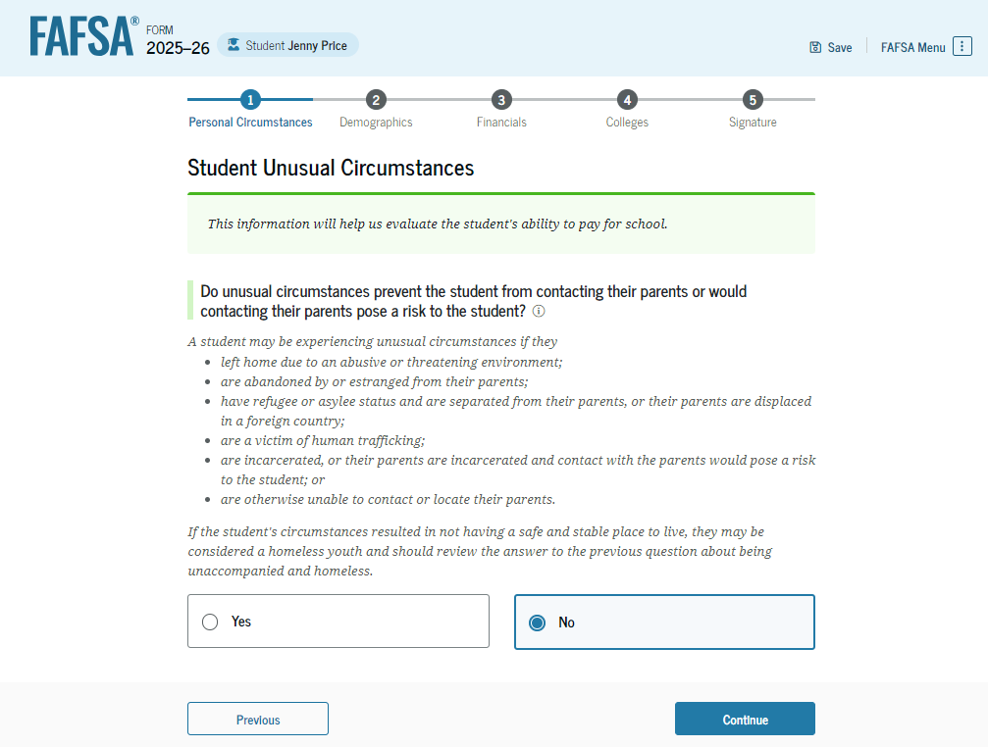
Unusual circumstances
Left home due to abusive or threatening environment
Been abandoned or estranged from parents, and have not been adopted
Been granted refugee or asylee status and are separated from parents
Been a victim of human trafficking
Been incarcerated, or parents are incarcerated and pose a risk to them
Been otherwise unable to contact or locate their parents, and have not been adopted
Notes:
The student is asked if unusual circumstances prevent them from contacting their parent(s). Intended for students who meet the following criteria:
Left home due to abusive or threatening environment
Been abandoned or estranged from parents, and have not been adopted
Been granted refugee or asylee status and are separated from parents
Been a victim of human trafficking
Been incarcerated, or parents are incarcerated and pose a risk to them
Been otherwise unable to contact or locate their parents, and have not been adopted

Slide 25
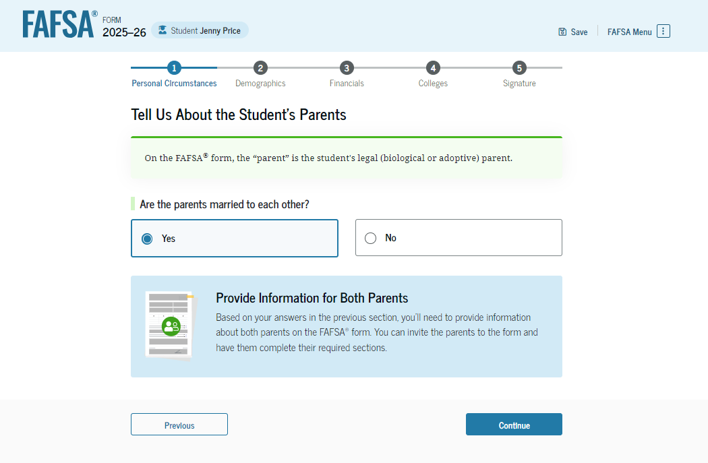
Determining the parent(s) for FAFSA purposes
Parent wizard to help determine the parent
Guidance has changed, now look at who provides more financial support
  Look at who has the most income and assets if provided equal support
Student invites the parent through the FAFSA by entering parent’s name, date of birth, social security number and e-mail address
  The second parent may be invited to contribute later, especially if the parents did not file joint taxes.
25
Notes:
Parent wizard to help determine the parent
Guidance has changed, now look at who provides more financial support
Look at who has the most income and assets if provided equal support
Student invites the parent through the FAFSA by entering parent’s name, date of birth, social security number and e-mail address
The second parent may be invited to contribute later, especially if the parents did not file joint taxes.

Slide 26
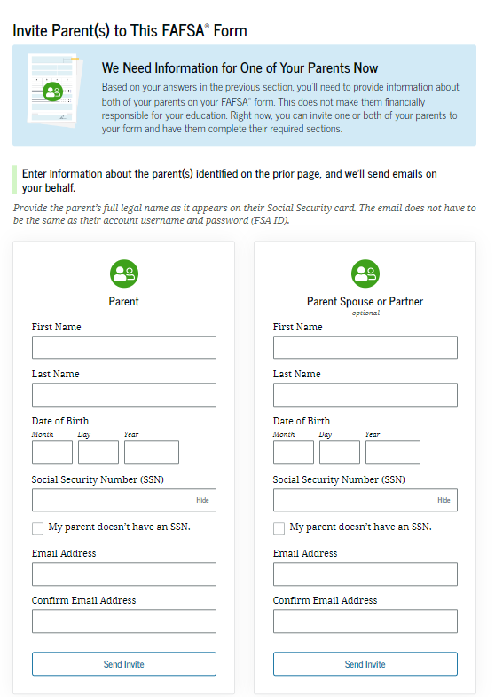
Invite parents to FAFSA form
Student enters parent information to send them an invite to contribute to the FAFSA
26
Notes:
It is recommended that parents help complete these invites to make sure information is accurate.

Slide 27
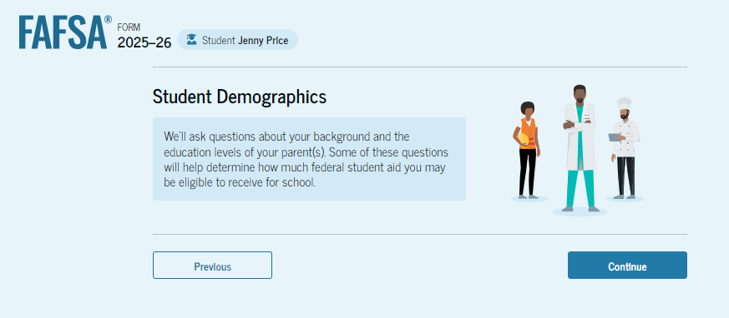
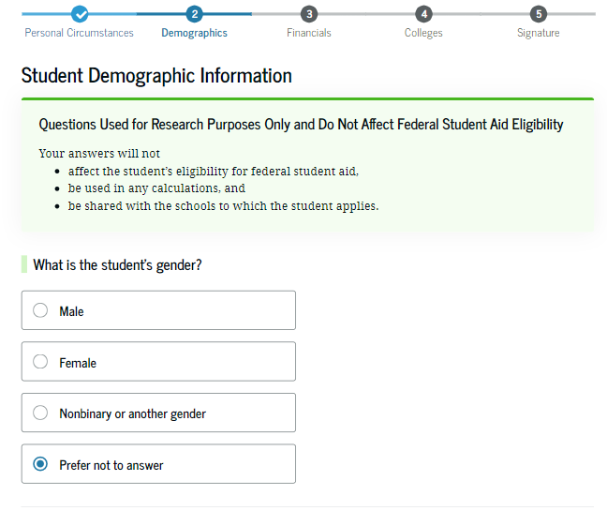
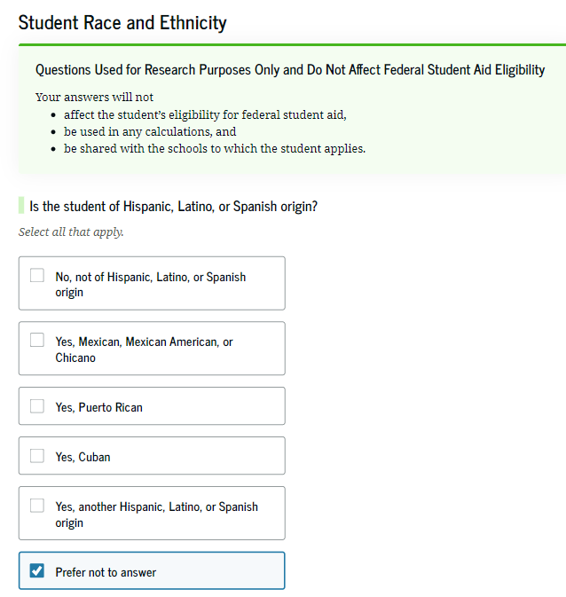
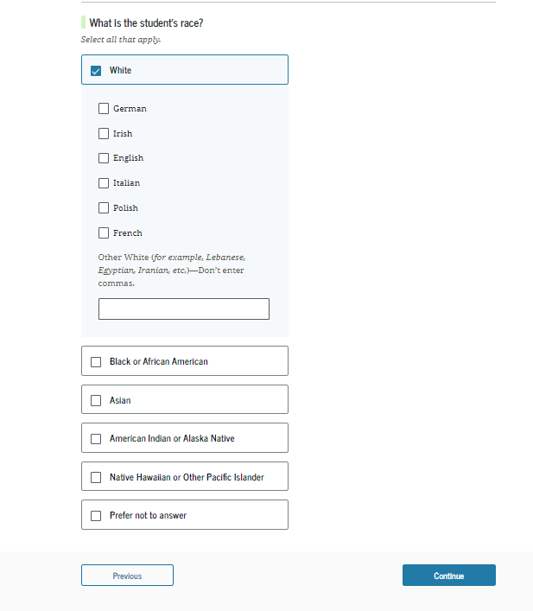
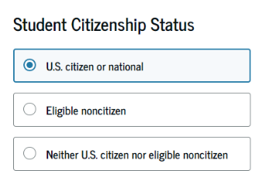
Student demographics
27
Notes:
Students must complete a demographic survey. The survey is mandatory (legislated by Congress), but the student can indicate they prefer not to answer. The information collected does not impact a student’s financial aid award.

Slide 28
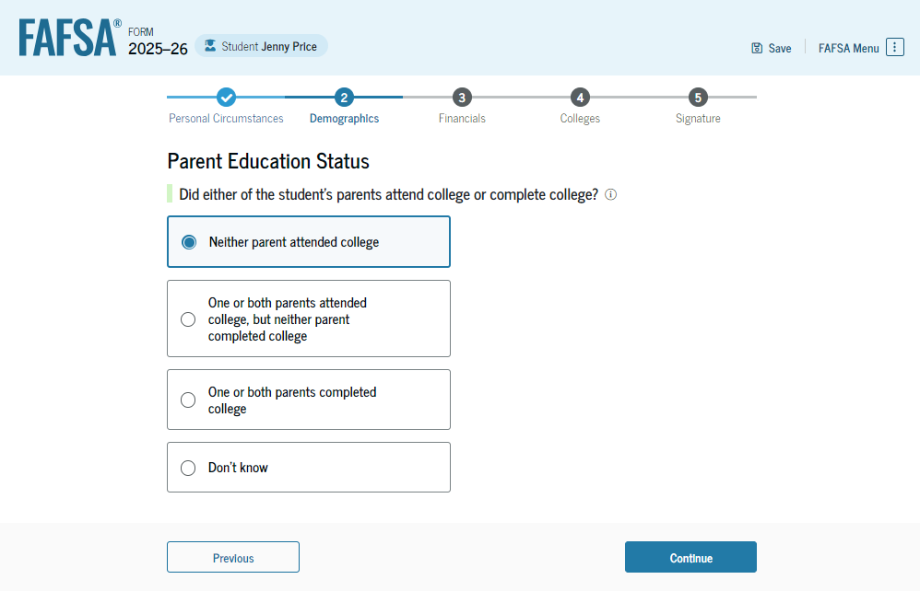
Parent’s education status
To identify possible first-generation college students
28
Notes:
The student is asked about their parents’ education status. This is to identify possible first-generation college students.

Slide 29
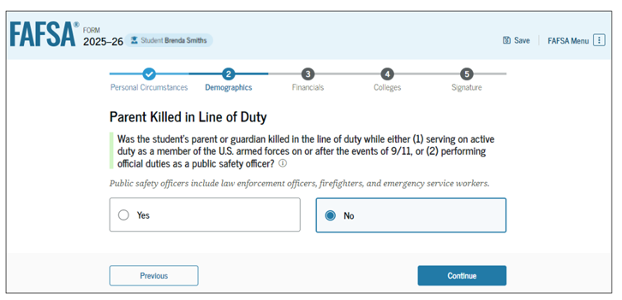
Parent killed in line of duty
29
Notes:
This question is asked to determine if the student is eligible for a federal grant program.

Slide 30
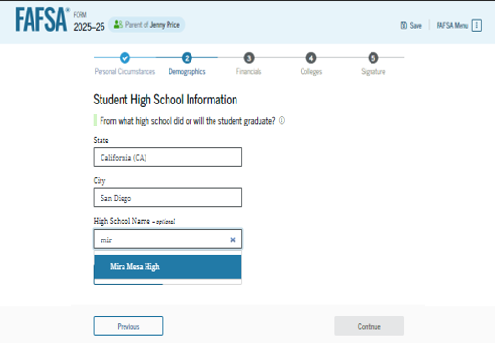
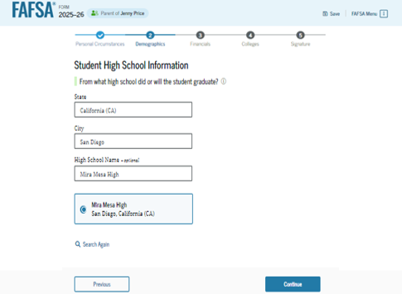
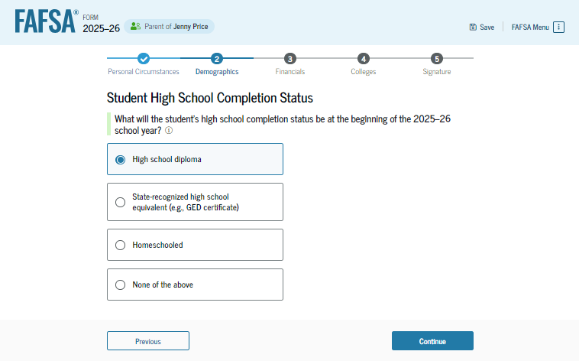
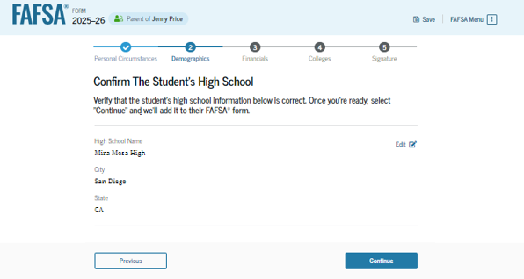
High school information
30
Notes:
The student will select what their high school completion status will be they begin their college. Students are required to provide information about their high school. The student will type in the information, hit search, and then select the appropriate school. This question is asked so they can determine if the student went to valid high school and can benefit from a college education. It also helps catch issues with high school diploma mills.

Slide 31
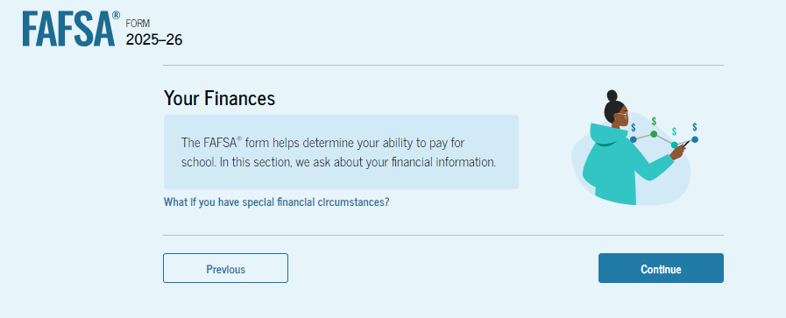
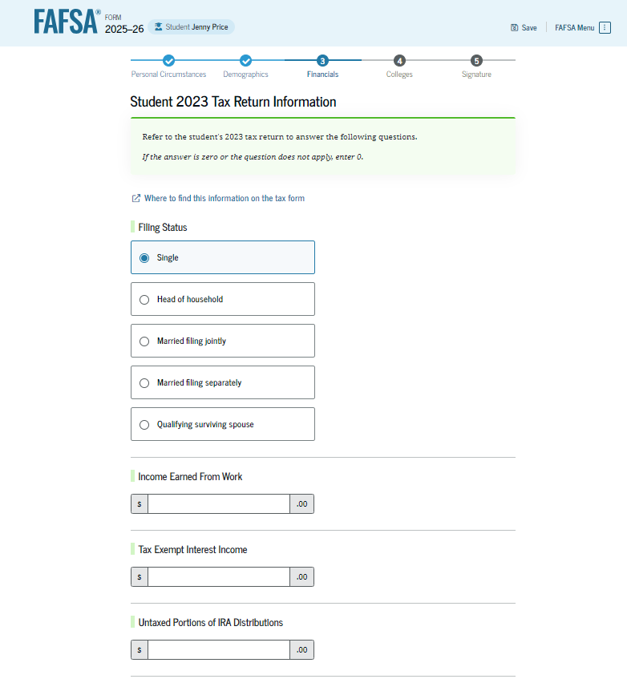
Student financial information
Once approval is granted, financial data is being transmitted behind the scenes
If the Direct Data Exchange (DDX) is not available to pull the tax information, a manual response to tax-related questions will be required.
  Once the DDX is available again, the FAFSA will be re-run and the student’s eligibility may change
Information transferred through the DDX will not display
31

Slide 32
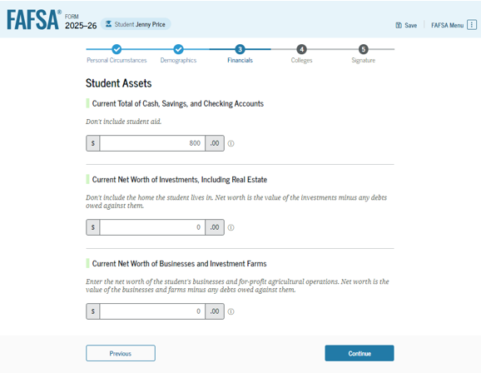
Student asset information
If the student starts the FAFSA, they will be asked the asset questions
If the parent starts the FAFSA and their adjusted gross income is less than $60,000, the asset information will not be asked
32
Notes:
If the student starts the FAFSA, they will be asked the asset questions.
If the parent starts the FAFSA and their income is less than $60,000, the asset information will not be asked either of the parent or the student.

Slide 33
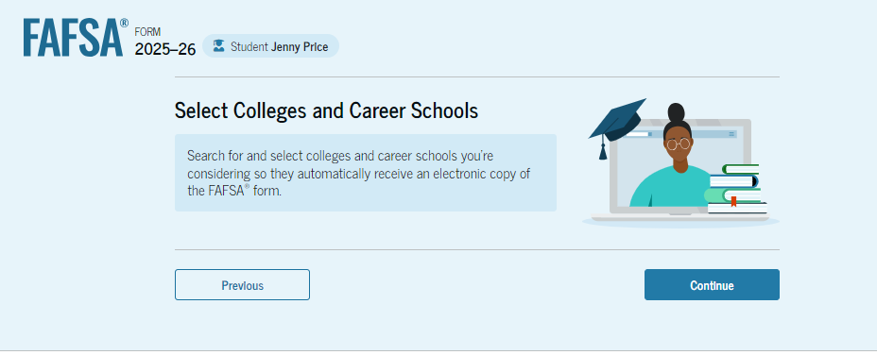
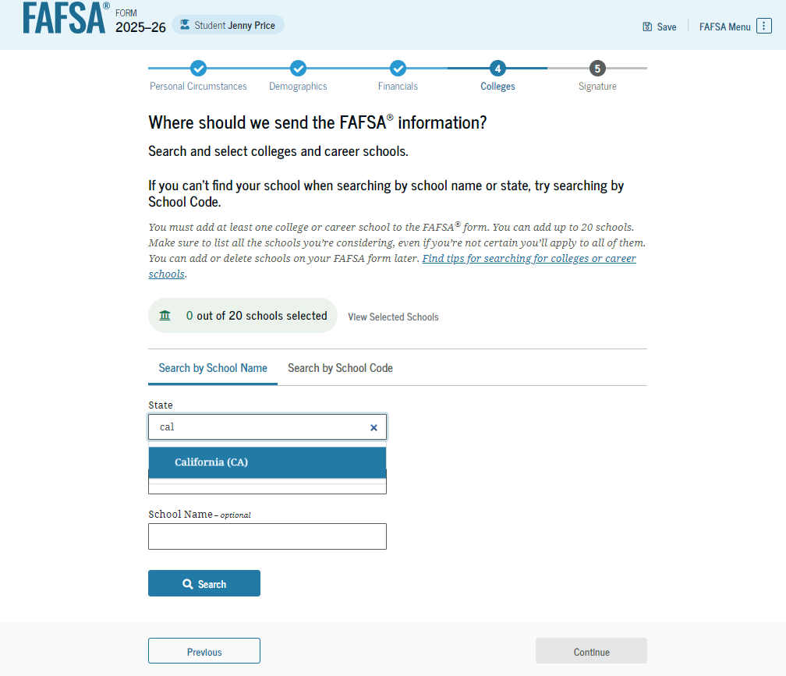
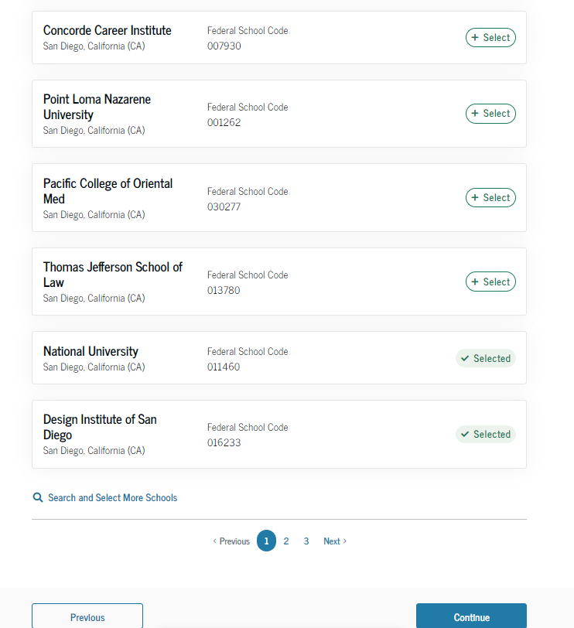
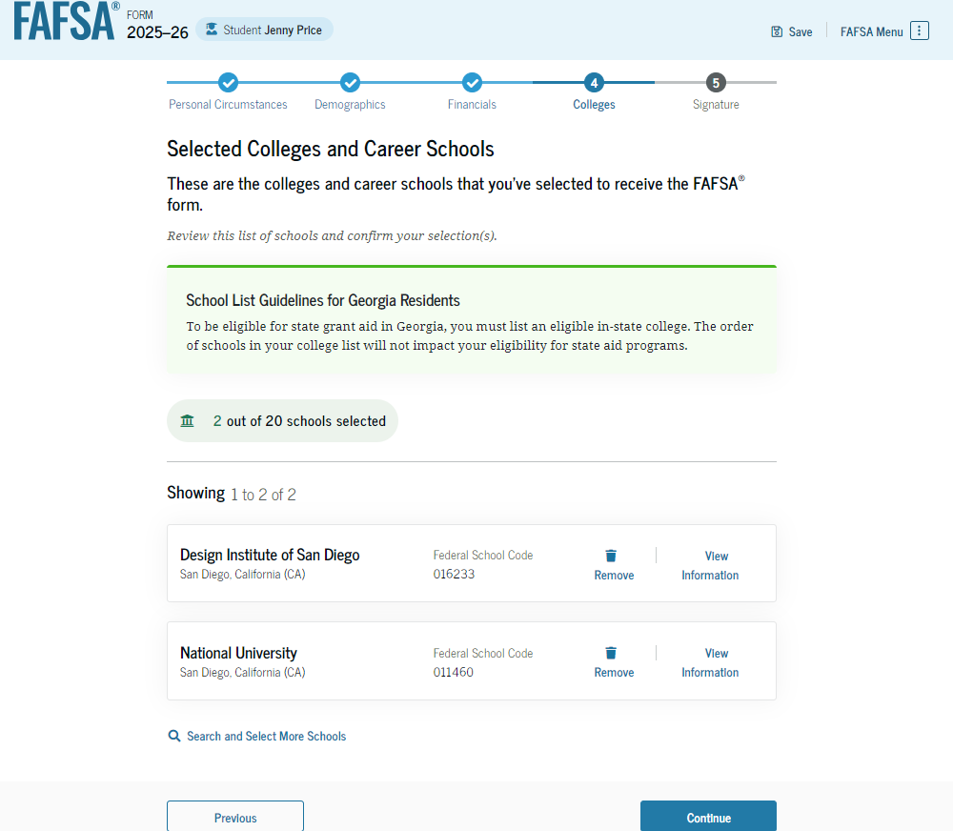
Select colleges
Select up to 20 schools to receive FAFSA information
Use Search or enter school’s Title IV code
33
33
Notes:
Select up to 20 schools to receive FAFSA information
Use Search or enter school’s Title IV code
Order does not matter in most states (Some states require students to list a state institution in their top three choices if they want state aid).

Slide 34
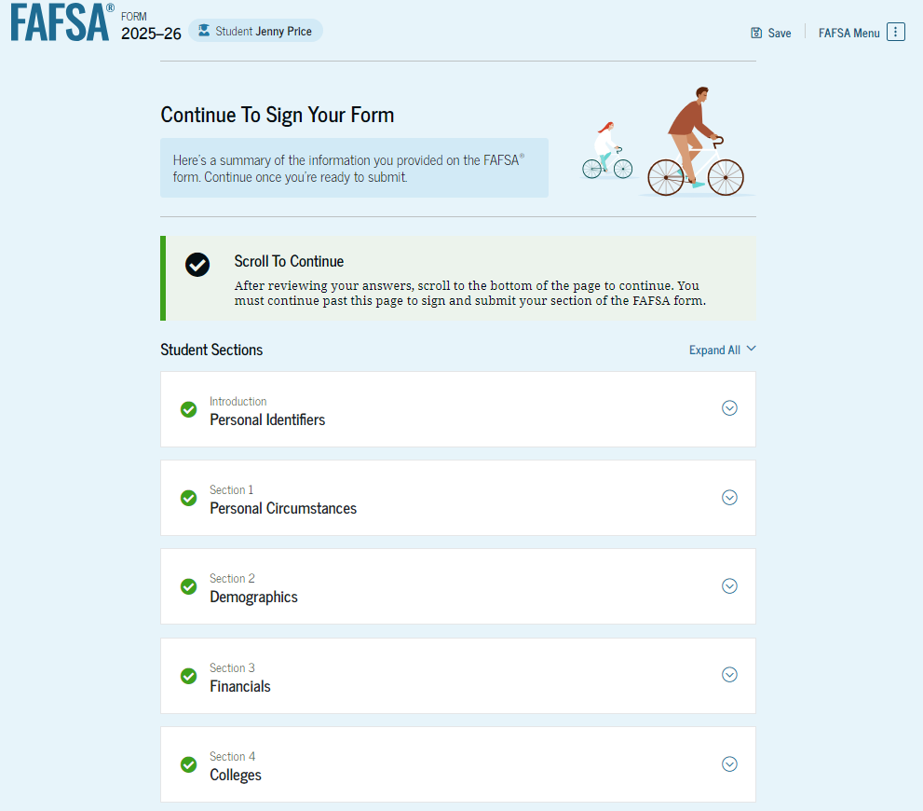
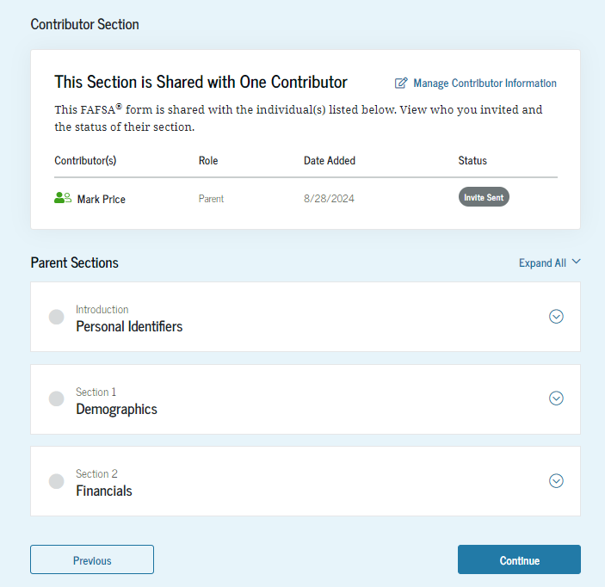
Student review page
Will list who was invited to contribute
Review information and make corrections, if needed
Can see status of parent contributors
34
34
Notes:
Will list who was invited to contribute
Review information and make corrections, if needed
Can see status of parent contributors

Slide 35
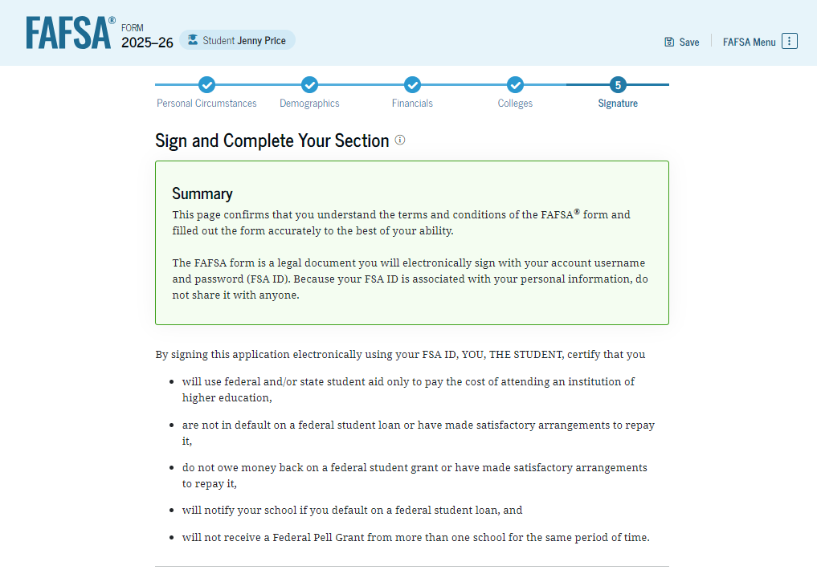
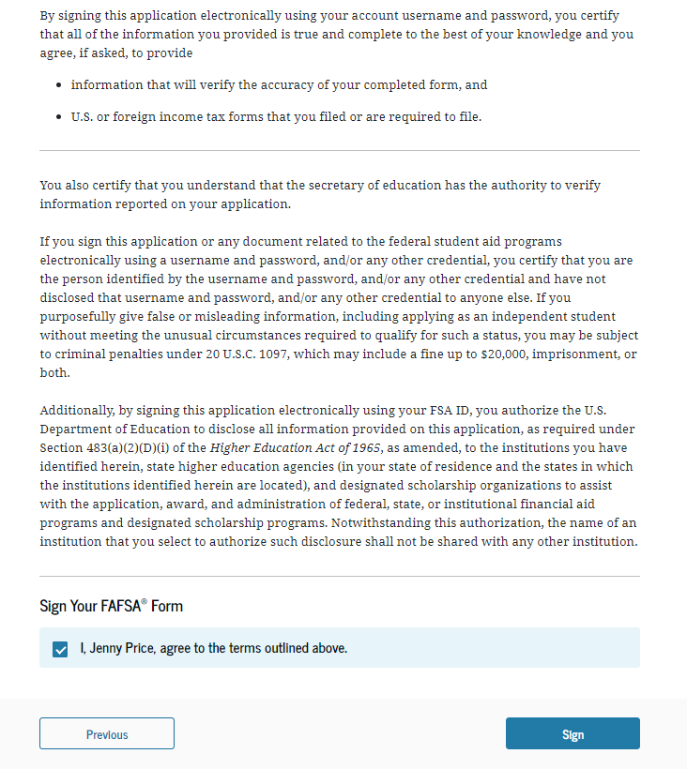
Dependent student signature
35
Notes:
Student should review the statement that, in part, indicates that all the information they provide is accurate and true and that they will only use financial aid funds for the purposes intended.
On this page, the student acknowledges the terms and conditions of the FAFSA® form and signs their section. After agreeing and signing, the student is able to submit their section of the FAFSA form. Since parent information has not been provided, the FAFSA form is not considered complete and can’t be processed yet.

Slide 36
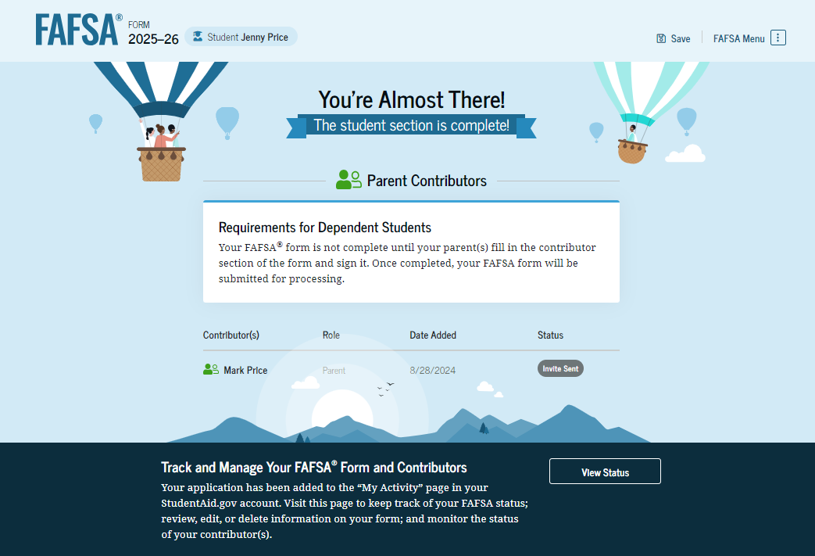
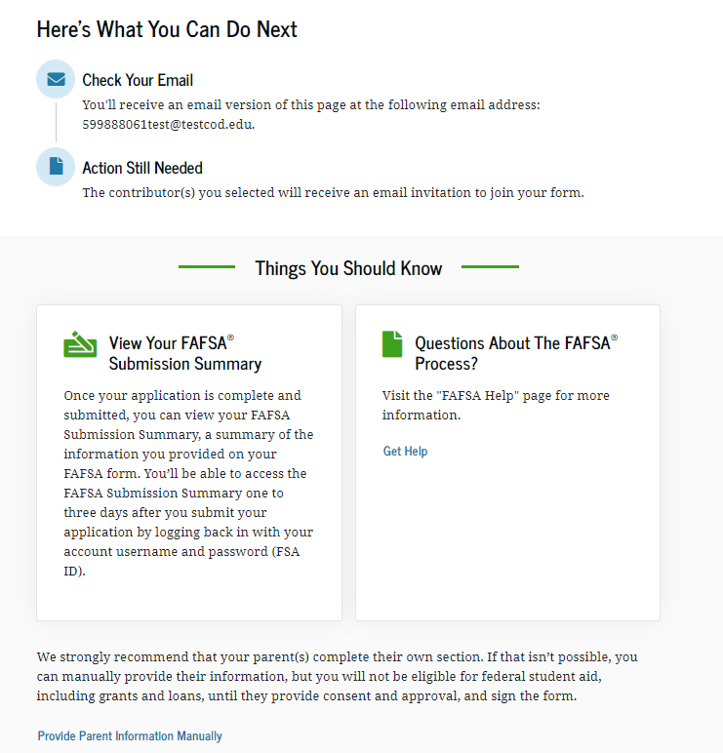
Student section complete
36
Notes:
Upon signing the student section, the student is presented the student section complete page. This page displays information for the student about the next steps, including tracking their FAFSA® form. The student. If dependent, is reminded that their form is not completed and can’t be submitted until the parent completes the contributor section of the form and signs it.

Slide 37
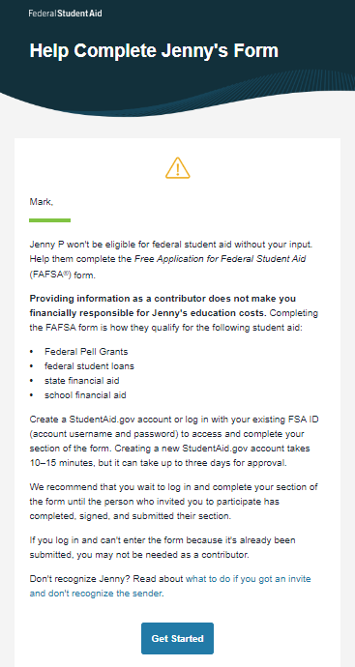
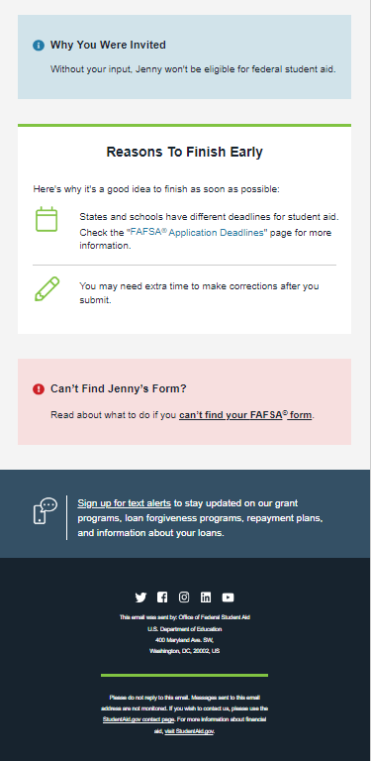
Parent e-mail
Parent is invited by e-mail to log in to StudentAid.gov to contribute to the student’s FAFSA.
37
Notes:
Parent is invited by e-mail to log in to StudentAid.gov to contribute to the student’s FAFSA.

Slide 38
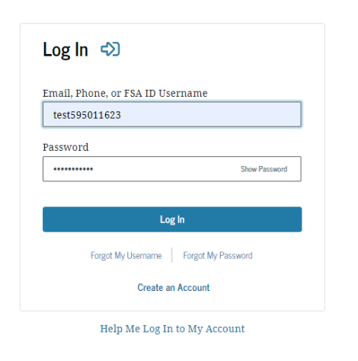


Parent log in
38
Notes:
Parent will log into their StudentAid.gov account using their FSA ID user name and password and hit “Get Started.”

Slide 39



Parent contributing to the student’s FAFSA
39
Notes:
Parent is advised that their student’s FAFSA can’t be submitted for processing until the parent provides information. A FAQ is provided to answer common questions.

Slide 40




Parent’s onboarding

Slide 41


Parent identification information
Same process as for the student, can’t change name, date of birth, Social Security number or e-mail address
  Go to Account Settings on StudentAid.gov if e-mail address or phone number is incorrect
Can change mailing address
41

Slide 42
Parent approval screen
42

Slide 43



Parent demographics
43
Notes:
Collect marital status, state of legal residence, and number of college students in household. While the number in college is no longer a factor in determining need for federal financial aid, the information is used by some states and scholarship programs.

Slide 44



Parent financial information
Notes:
Financial questions.
If anyone in the family was eligible to receive the federal benefits listed, they will not be asked to provide assets.

Slide 45
Students with undocumented parents
Parents must still report information on the FAFSA
  Can get an FSA ID, even if don’t have a Social Security number
  May be authenticated against the credit bureau instead of the Social Security Administration
  May be asked to income earned from work instead of tax information
45
Notes:
Parents must still report information on the FAFSA
Can get an FSA ID, even if don’t have a Social Security number
Will be authenticated against the credit bureau instead of the Social Security Administration (authentication happens later)
May be asked later to provide income earned from work instead of tax information.
Must provide FTI approval/consent

Slide 46

Family size
Can report if the number of dependents is different than the number of individuals claimed on 2023 tax return
46
Notes:
Family size information is retrieved from income tax information, but the parent can report if the family size is different than the number of individuals claimed on 2023 tax return

Slide 47

Who is included in the number in college?
Dependent student
Student
NOT the parent(s)
Others attending at least half time in an approved program during 2025-26 that leads to a degree or certificate at a postsecondary school eligible to participate in any of the federal student aid programs
Does not factor into need analysis calculation
47
Notes:
This page asks the parent how many people in the family will be in college between July 1, 2025, and June 30, 2026. The parent enters a response into the entry field.
Student
NOT the parent(s)
Others attending at least half time in an approved program during 2024-25 that leads to a degree or certificate at a postsecondary school eligible to participate in any of the federal student aid programs
Does not factor into need analysis calculation but some states, colleges or foundations may use it for awarding aid.

Slide 48


Tax return information
Income tax information will be pulled through the Direct Data Exchange (DDX)
48
Notes:
Parent may be asked to provide financial information from tax return.

Slide 49

Asset questions
Annual child support received
Cash, savings, and checking accounts
Businesses and investment farms
Investments, including real estate (not parents’ home)
49
Notes:
What is the net worth of your parents’ investments?
The net worth of your parents’ current investments is the amount left over after deducting the debt from the value of each investment.
For example: Your parents own an investment property valued at $100,000; however, $75,000 in debt is owed on the property. The net worth of the investment is $25,000 ($100,000-$75,000 = $25,000).
If your parents own multiple investments, total the net worth amounts and report them as a lump sum.
For example: Your parents own two investment properties.
The first investment property is valued at $100,000. The debt that is owed on the property is $110,000.
To calculate the net worth, perform the following calculation:
(Value of Property) minus (Debt Owed on Property) = net worth
$100,000 – $110,000 = -$10,000
The net worth of this first investment property is considered $0, not negative value of $10,000.
The second investment property is valued at $200,000. The debt that is owed on the property is $100,000.
(Value of Property) minus (Debt Owed on Property) = net worth
$200,000 – $100,000 = $100,000
The net worth of this second investment property is $100,000.
If the net worth of the first investment property is $0 and the net worth of the second investment property is $100,000, then the amount to be reported for both properties is $100,000.
If your parents’ net worth as of the day you submit your Free Application for Federal Student Aid (FAFSA) is:
Net worth valueEnterTen million or more9999999Zero or less than zero0Round to the nearest dollar and do not include commas or decimal points.
Investments include real estate (do not include the home in which your parents live), rental property (includes a unit within a family home that has its own entrance, kitchen, and bath rented to someone other than a family member), trust funds, UGMA and UTMA accounts, money market funds, mutual funds, certificates of deposit, stocks, stock options, bonds, other securities, installment and land sale contracts (including mortgages held), commodities, etc.
Note: UGMA and UTMA accounts are considered assets of the student and must be reported as an asset of the student on the FAFSA, regardless of the student's dependency status. Do not include UGMA and UTMA accounts for which your parents are the custodian but not the owner.
Investments also include qualified educational benefits or education savings accounts such as Coverdell savings accounts, 529 college savings plans and the refund value of 529 prepaid tuition plans.
Note: Students who must report parental information on this form should report all qualified educational benefits or education savings accounts owned by the parents and / or the dependent student as part of the parental assets.
Investments do not include the home in which your parents live; cash, savings and checking accounts; the value of life insurance and retirement plans (401[k] plans, pension funds, annuities, noneducation IRAs, Keogh plans, etc.).
Investment value means the current balance or market value of these investments as of the day you submit your FAFSA. Investment debt means only those debts that are related to the investments.
For more information about reporting investments, call the Federal Student Aid Information Center 1-800-4-FED-AID (1-800-433-3243).

Slide 50
Determining the value of assets
Market value
Debt owed
Net value

Slide 51

Other parent information
Could be a biological or adoptive parent or step-parent
51
Notes:
Parent may be asked to provide information about other parent – either biological or step-parent.

Slide 52

Parent review page
52
52
Notes:
The review page displays the responses that the parent has provided in the previous student and parent sections of the student’s FAFSA® form. The parent can view all their responses by selecting "Expand All" or expand each section individually. To edit a response, they can select the question’s hyperlink to be taken to the corresponding page.

Slide 53


Parent signature and abbreviated confirmation page
Notes:
On this page, the parent acknowledges the terms and conditions of the FAFSA® form and signs their section. After agreeing and signing, the parent is able to submit their section of the FAFSA form. Upon submitting the student’s FAFSA® form, the parent is presented an abbreviated confirmation page. This page displays information about tracking the student’s FAFSA form and next steps. The student will receive an email with the full, detailed confirmation. With the student and parent sections completed and signed, the FAFSA form is now considered complete and submitted for processing.

Slide 54



FAFSA Submission summary
54
Notes:
After the FAFSA form is processed, the applicant receives a FAFSA Submission Summary, which is a summary of the data provided on the FAFSA form. The applicant reviews the FAFSA Submission Summary for accuracy and if necessary, makes corrections or updates to the submitted FAFSA data.
The FAFSA Submission Summary includes the SAI, which is the new measure of the ability to pay for college. The new formula allows a minimum SAI of negative $1,500 to give financial aid administrators more insight when making determinations for students with especially challenging situations.
The FAFSA Submission Summary provides information about the postsecondary institutions that the student listed on the FAFSA and provides information on next steps in the college preparation process.
The FAFSA Submission Summary provides information on estimated financial aid. This will help students and parents with college planning – specifically in choosing an institution that is a good fit financially (Students should also choose a postsecondary school based on their career choice and whether the institution is a good fit for them personally.)

Slide 55
FAFSA help options
Questions and answers at the beginning
Help “bubbles” on each FAFSA question
Federal Student Aid Information Center
800-433-3243
Mapping Your Future
800-374-4072
More online resources may be available when the FAFSA is finalized
55

Slide 56
Student Aid Index (SAI)
The amount a family can reasonably be expected to contribute
Calculated using data from the FAFSA and federal formula
  May be a negative number
Two components
  Parent contribution
  Student contribution
Stays the same regardless of college
Notes:
The SAI is a number that determines each student’s eligibility for certain types of federal student aid. An applicant’s SAI is calculated using modified need analysis formulas outlined in the Act. These formulas use information that applicants provide on the FAFSA® form and, in most cases, federal tax information (FTI) that is retrieved directly from the Internal Revenue Service (IRS).
The most significant changes to the need analysis formulas include:
Removal of the number of family members in college from the eligibility calculation
The possibility for an SAI to be a negative number, with a minimum SAI of -1,500 instead of zero

Slide 57




Financial aid calculation
Cost of
Attendance
Student Aid Index
Other financial assistance
Need
57
Notes:
The financial aid office will subtract your SAI and any other financial assistance received from your Cost of Attendance (COA)to determine the amount of your financial need and therefore how much need-based aid you can get.
Your Cost of Attendance (COA) is the amount it will cost you to go to school. Most two-year and four-year colleges will calculate your COA to show your total cost for the school year
If you’re attending, your COA is the estimate of
tuition and fees;
the cost of room and board (or living expenses for students who do not contract with the school for room and board);
the cost of books, supplies, transportation, loan fees, and miscellaneous expenses (including a reasonable amount for the documented cost of a personal computer
Other reasonable education related expenses

Slide 58
Sample maximum federal financial aid amounts
Federal Pell Grant: up to $7,395*
Direct Loan: $5,500
  Up to $3,500 Subsidized
  Remaining $5,500 after subtracting Subsidized can be Unsubsidized
  6.53% interest rate for undergrads, 8.08% for graduate students*
Direct PLUS Loan: Parents can borrow up to the cost of attendance less financial aid
  9.08% interest rate*
  *For the 2024-25 academic year

Slide 59

Sample financial aid offer
Also referred to as award letter
Notes:
A school aid offer (sometimes called an award letter) tells you what financial aid you can receive at a particular college or career school.
The offer includes the types and amounts of financial aid you may receive from federal, state, private, and school sources. This combination of aid is your financial aid package.
Review the letter carefully. Understand which aid is loans and which are grants.
Be sure to understand any obligations before accepting any financial aid.

Slide 60
South Dakota Opportunity Scholarship
Attend postsecondary school in SD
Starting Fall 2023, $1,500 for 3 years and $3,000 for final year
Must be SD resident
Eligibility requirements include minimum GPA, minimum ACT scores, curriculum requirements, etc.
Apply at https://sdos.sdbor.edu/ by September 1
Recommended that initial application and transcript be submitted by June 1
Programs may change – check website for the latest information
Notes:
Tuition is based on public university tuition rates
Before Fall 2023, was $1,300 for 3 years and $2,600 for final year

Slide 61
Dakota Corps Scholarship
  Tuition and applicable fees at participating SD schools
  Requirements include minimum grades and agreement to stay in state for work in specific critical need occupations
  Understand the scholarship will turn into a loan if requirements are not met
  Apply at https://www.sdbor.edu/dakotacorps/Pages/How-Do-I-Apply.aspx by December 15
Programs may change – check website for the latest information
Notes:
Tuition is based on public university tuition rates

Slide 62
South Dakota Needs Based Grant Program (SDNBGP)
  Resident of SD
  Enrolled at least part time at a participating institution
  Completed FAFSA and requirements established by institution
  Information at https://tdx.sdbor.edu/TDClient/33/Portal/KB/ArticleDet?ID=311
Programs may change – check website for the latest information

Slide 63
Build Dakota Scholarship
Full-ride scholarship
For students enrolled in a high-need workforce area program at one of the four technical colleges
Work full-time in SD for a minimum of three years.
Next application cycle will be January 1, 2025 – March 31, 2025
Understand the scholarship will turn into a loan if requirements are not met
More information at www.builddakotascholarships.com or on the technical college’s website
Programs may change – check website for the latest information
Notes:
Tuition is based on public university tuition rates

Slide 64
Freedom Scholarship
New state-wide initiative to encourage South Dakota students of all economic backgrounds to live and work in South Dakota after graduation
Available to students with unmet financial need as determined through their submission of the FAFSA, in conjunction with the financial aid office at the respective university.
Understand the scholarship will turn into a loan if requirements are not met
More information at www.freedomscholarshipsd.com
Programs may change – check website for the latest information

Slide 65
Jump Start Scholarship
Students who graduate from a SD public high school in 3 years or less
Enroll in an accredited institution located in SD within 1 year of high school graduation.
For first year only and dollar amount varies
For SD residents
Apply at https://ourdakotadreams.com/paying-for-college/sd-scholarships/ September 1
Programs may change – check website for the latest information

Slide 66
Critical Teaching Needs Scholarship
Agree to work in SD in a critical teaching need occupation for five years
Understand the scholarship will turn into a loan if requirements are not met
Attend a participating SD postsecondary institution
Application and more information online at https://ourdakotadreams.com/paying-for-college/sd-scholarships/
Programs may change – check website for the latest information

Slide 67
Scholarship tips
Develop a plan
Understanding the cost
Establish a scholarship goal
Conduct research
Research local, college, state, employer programs
Organizations/
employers that align with your career choice
Scholarship search
Prepare applications
Write the essay
Proof and edit, neatness counts
Stay organized
Use the scholarship tracking sheet
Follow deadlines, requirements
Have a dedicated
e-mail address

Slide 68


Slide 69

Resources
SouthDakota.MappingYourFuture.org
  https://southdakota.mappingyourfuture.org/college.cfm
  https://southdakota.mappingyourfuture.org/career-sort.cfm
MappingYourFuture.org
StudentAid.gov
  https://studentaid.gov/aid-estimator/
Scholarship tracking sheet: MappingYourFuture_Scholarship_Tracking.xlsx (live.com)
Scholarship searches
  FastWeb: www.fastweb.com/
  BigFuture: bigfuture.collegeboard.org/
  Scholarship Resources: https://mappingyourfuture.org/wp-content/uploads/2024/08/MappingYourFutureScholarshipTips.pdf
69
Notes:
Frequently asked questions--https://studentaid.ed.gov/sa/about/data-center/student/application-volume/faq

Slide 70

Questions
70
© Mapping Your Future 2024

Slide 71

Thank you for participating
Cathy Mueller
Marlene Seeklander
(800) 374-4072
feedback@mappingyourfuture.org
SouthDakota.MappingYourFuture.org

