Slide 1

2026-27
Financial Aid Event
High School
September 2025

Slide 2
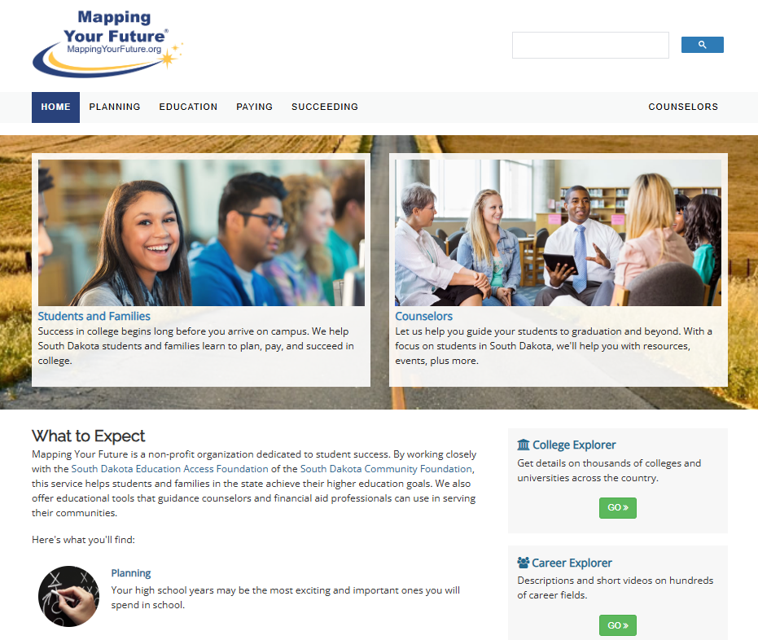
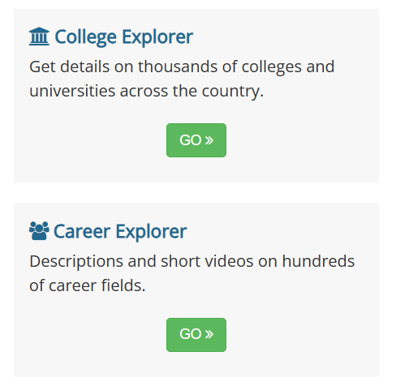
South Dakota Mapping Your Future website
Comprehensive website for students, parents, counselors, and other professionals at https://SouthDakota.MappingYourFuture.org

Slide 3

Agenda
Paying for college
Financial Aid
South Dakota programs
Resources
Free Application for Federal Student Aid (FAFSA)

Slide 4
Paying for education
Savings
Earnings
Financial aid
Tax credits & deductions

Slide 5
Financial aid process
Complete
2
the Free Application for Federal Student Aid (FAFSA)
Receive
3
FAFSA Submission Summary
Receive
4
a financial aid offer from the school
Decide
5
which aid to accept and return the financial aid offer
Create
1
FSA ID on StudentAid.gov

Slide 6
Complete the FAFSA
Student starts the FAFSA
Student invites the parent to do their part in the FAFSA
Parent completes their part of the FAFSA
Submit the FAFSA when complete
Student completes their part of the FAFSA
Notes:
Complete the FAFSA*
This slide shows the process for completing the FAFSA.**
A student starts the FAFSA (preferred way).
The student Invites the parent to do their part of the FAFSA.
The student completes their part of the FAFSA.
Parent accepts invite and completes their part of the FAFSA.
FAFSA is submitted when complete.
**Parent can start a FAFSA and invite a student to complete their part.

Slide 7
Types of financial aid
Grants
Scholarships
Work-study programs
Loans
7

Slide 8
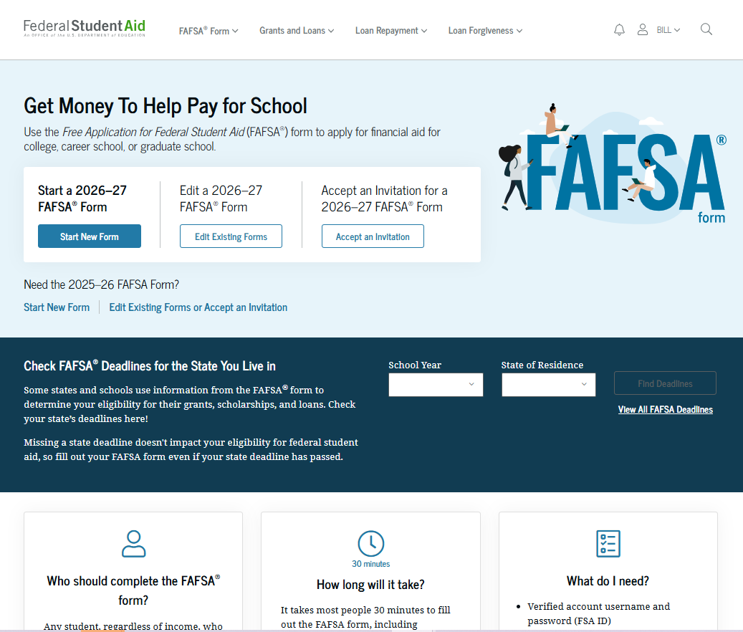

What is the FAFSA?
Free Application for Federal Student Aid
Base application for various forms of
financial aid (need based and non-need based)
  Federal
  State
  Institutional
  Private
2026-27 FAFSA available October 1 for the following academic year

Slide 9
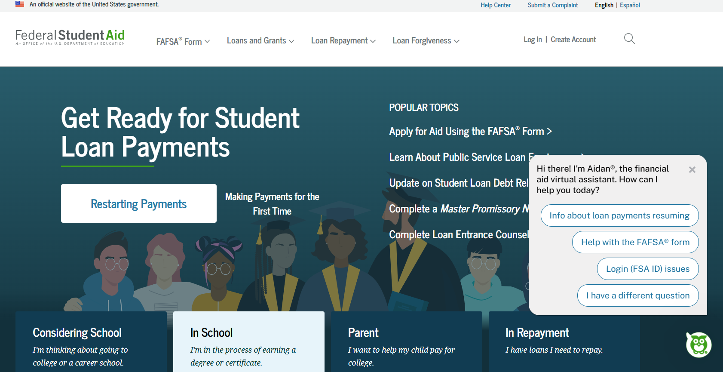
https://StudentAid.gov
Navigation tool for the applicant when accessing the FAFSA on the website
Includes Dashboard for the user
Provides options and messaging based on the status of the student’s FAFSA:
  Start a 2026-27 FAFSA
  View the FAFSA Submission Summary
  Make FAFSA corrections
  View correction history
  Complete and submit a Renewal FAFSA

Slide 10

Dependent Student
Identity Information
FAFSA terminology
Contributor
Approval/Consent
Personal circumstances
Parent
Unusual circumstances
Special circumstances
FAFSA Submission Summary
Student Aid Index (SAI)

Slide 11
Who is the parent for FAFSA purposes?
Your biological and/or adoptive parents are considered your legal parents.
  Must report information for both biological or adoptive parents if they are married or unmarried and living together
Grandparents, foster parents, legal guardians, older brothers or sisters, and aunts and uncles are not considered parents unless they have legally adopted you.
Parent wizard tool in the FAFSA helps determine which parent’s or parents’ information to include.
Department of Education has made the parent wizard tool available outside of the FAFSA to help students and parents prepare to complete the form. https://studentaid.gov/fafsa-apply/parents

Slide 12
Which parent provides information/needs a StudentAid.gov account (FSA ID)
Divorced or Separated
Parent who provided the most financial support reports information and needs an FSA ID.
Remarried
Parent who provided the most financial support reports information for parent and step-parent
  Only the biological parent needs an FSA ID if filed joint taxes.
  If filed separately, parent and step-parent needs an FSA ID.
Widowed
Surviving parent provides information and needs an FSA ID.
Married
Report information on both parents:
  Only one parent needs an FSA ID if filed joint taxes.
  If filed separately, both parents need an FSA ID.
Unmarried but living together
Report information on both parents and both parents need an FSA ID.
Never married and not living together
Parent who provided the most financial support reports information and needs an FSA ID.

Slide 13
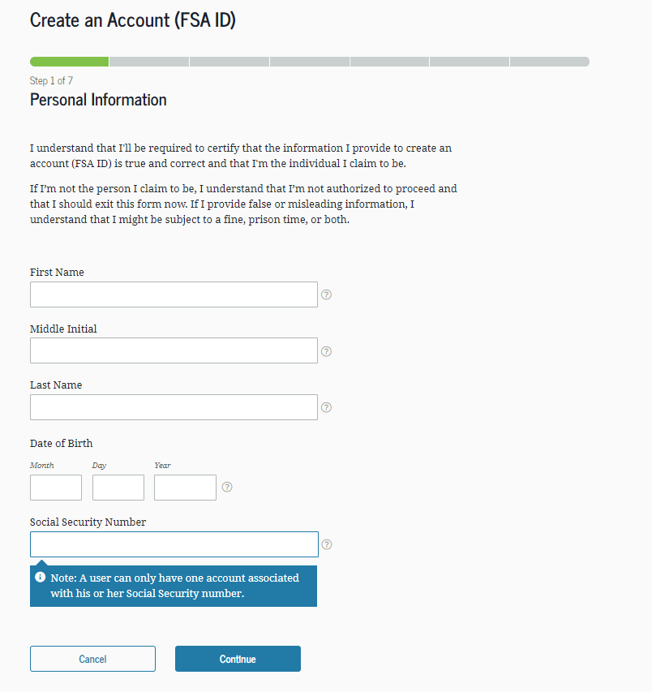
Create an StudentAid.gov account (FSA ID)
Key FSA ID points:
Students and at least one parent for FAFSA purposes need one (see parent wizard information)
Cannot share an e-mail address or phone number for FSA ID
Must be set up before completing the 2026-27 FAFSA
New!: Identity verification will be real-time
Go to StudentAid.gov, Create Account
Enter your personal information
Create your username and password
Enter your e-mail address
Create security questions
Submit your information

Slide 14

StudentAid.gov account (FSA ID)
Student
Sign in to StudentAid.gov
To contribute to the FAFSA
To access aid history
Parent
To apply for a Direct PLUS (Parent) Loan
To complete loan counseling
Sign in to StudentAid.gov
To apply for repayment plans
To contribute to the FAFSA
To complete Direct Loan Master Promissory Note
14

Slide 15
Gathering documents needed
Your Social Security number
Your parents’ Social Security numbers
2024 federal tax information, tax returns, W-2’s for you and for your parents
Records of your 2024 untaxed income
Information on cash, savings and checking account balances, investments, businesses and farms

Slide 16
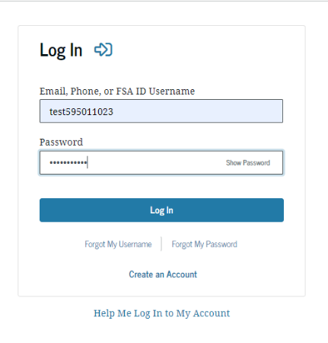
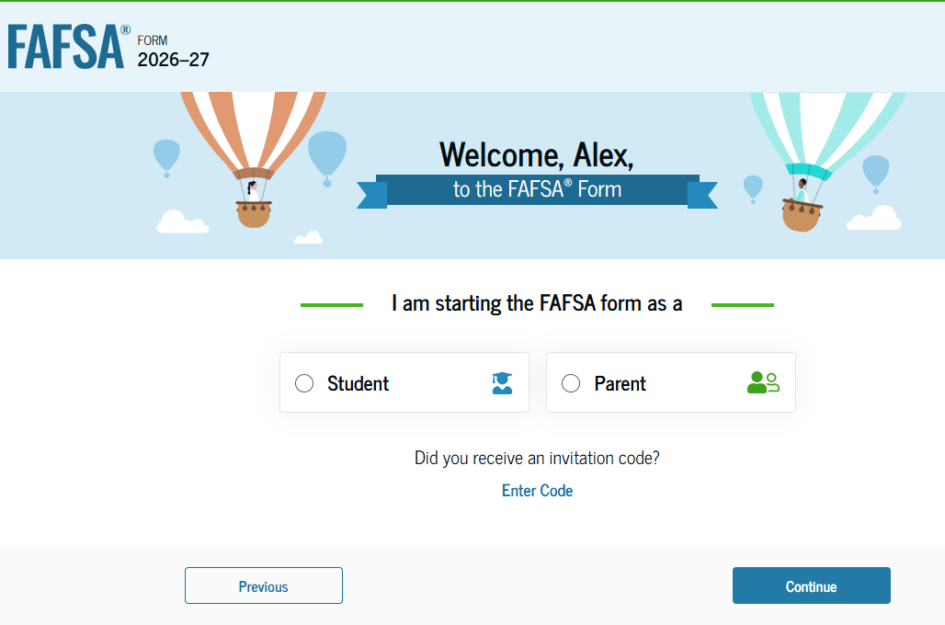
FAFSA log in

Slide 17
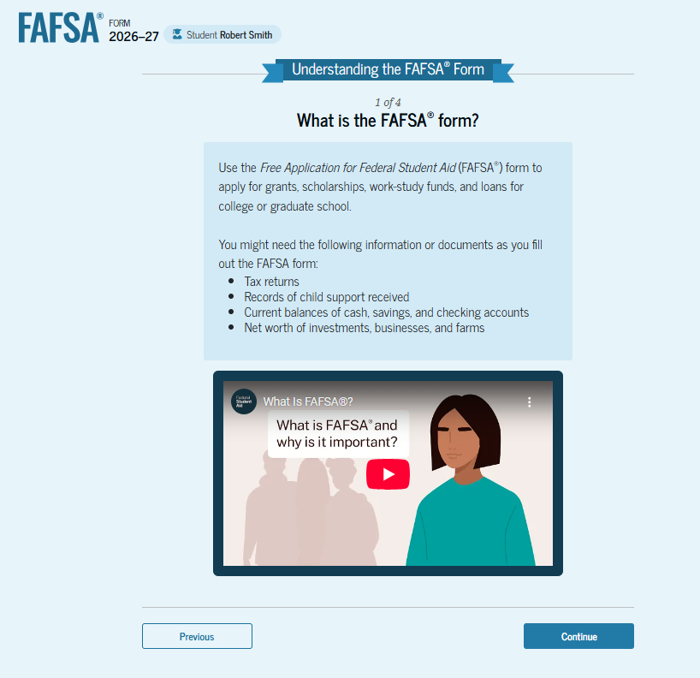
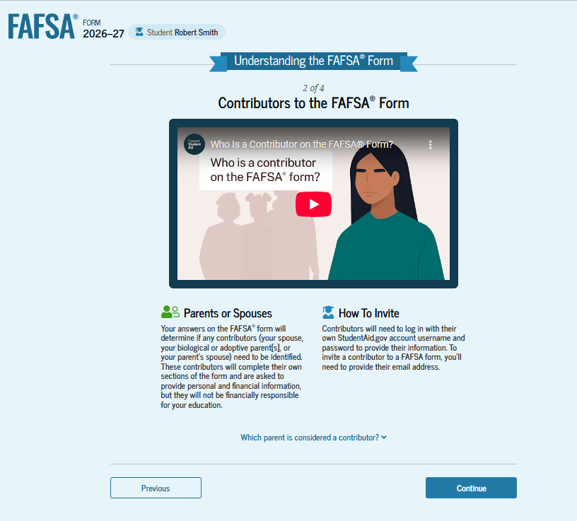
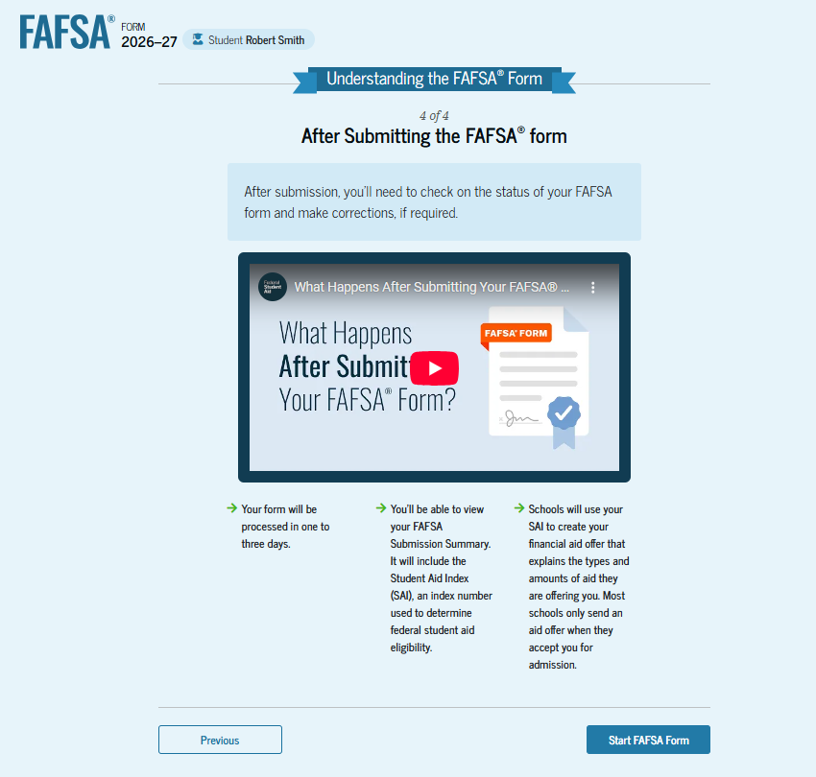
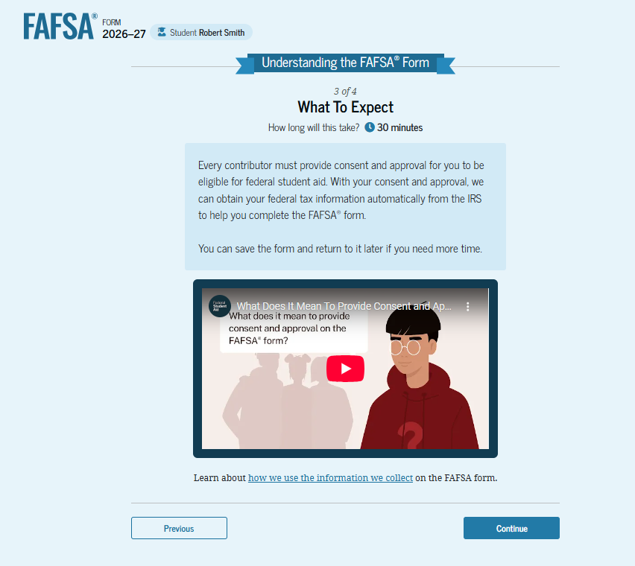
Student Onboarding

Slide 18
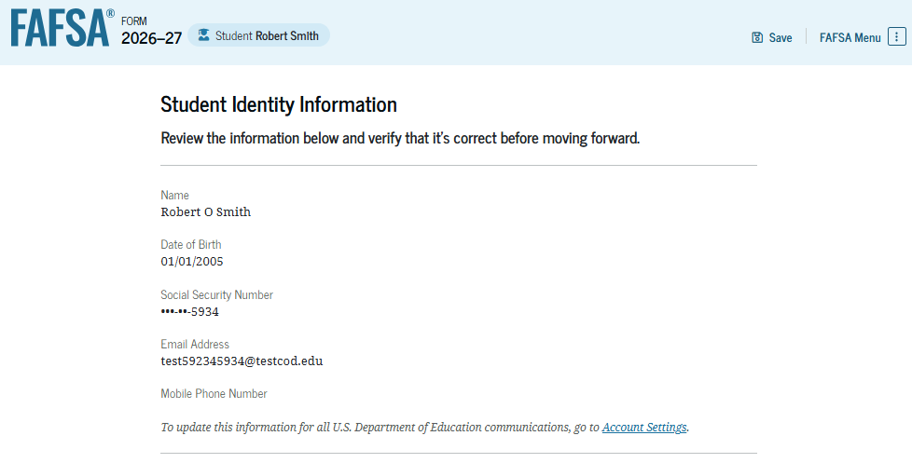
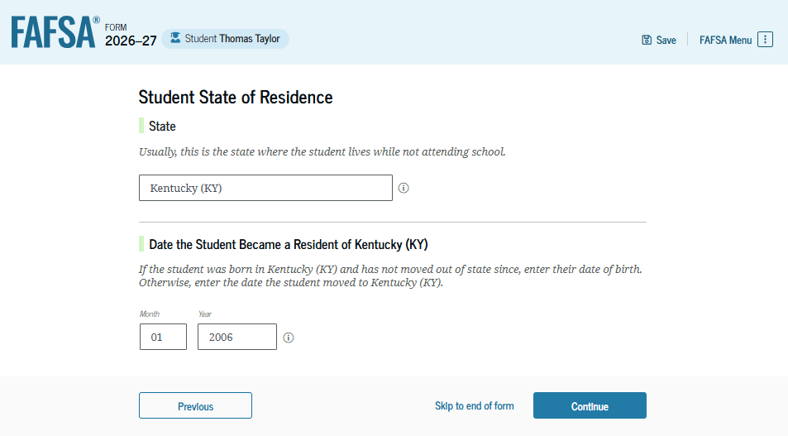
Student identifiers
Prefilled from the FSA ID information:
  Name
  Social Security Number
  Date of birth
  Email address
  Phone number
Mailing address
Residency

Slide 19
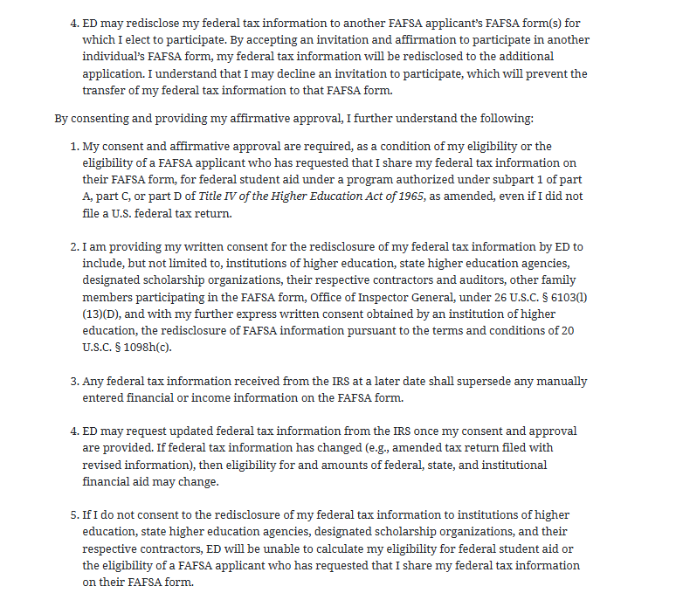
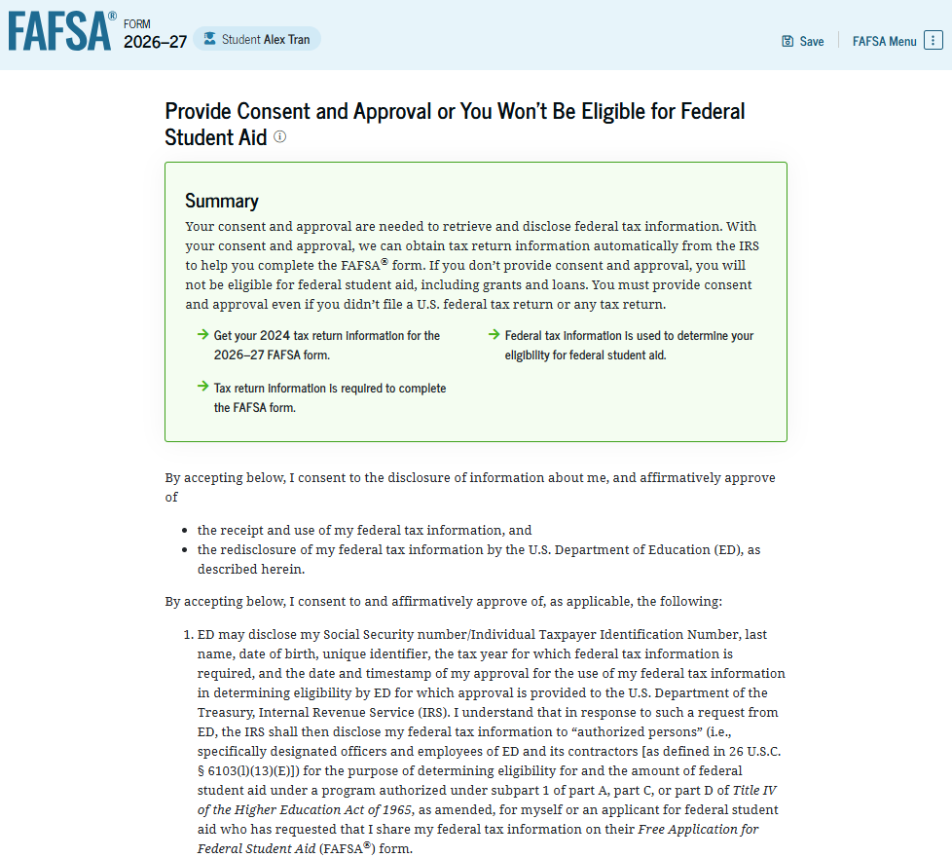
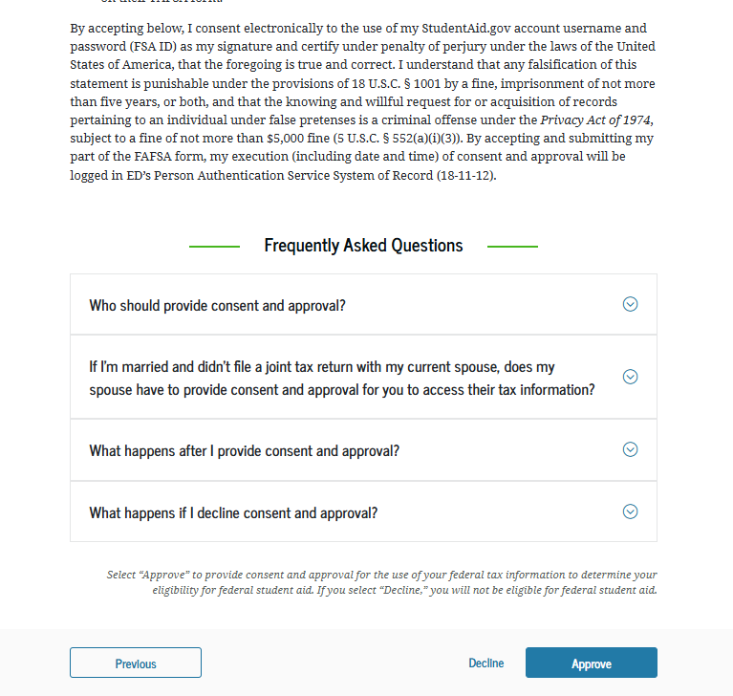
Approval
Student acknowledges consent to pull financial information from the IRS through the Direct Data Exchange (DDX)
19

Slide 20
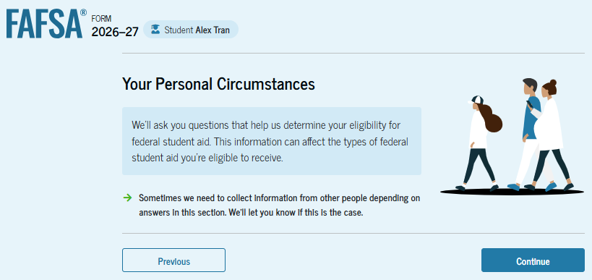
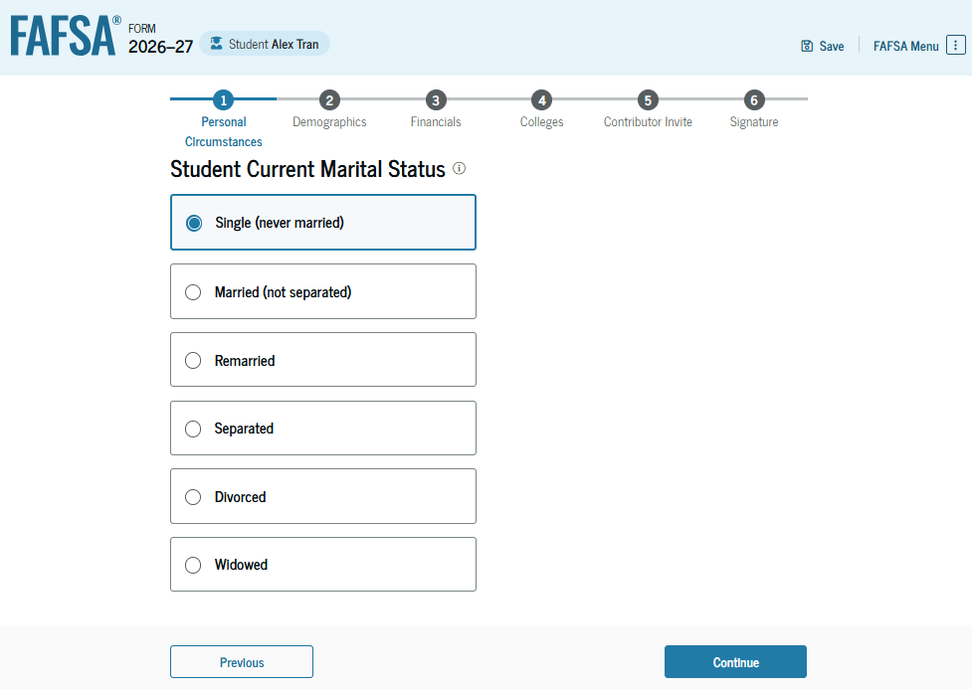
Personal circumstances
Marital status
College or career school plans
Student personal circumstances
Homeless
Unusual circumstances

Slide 21
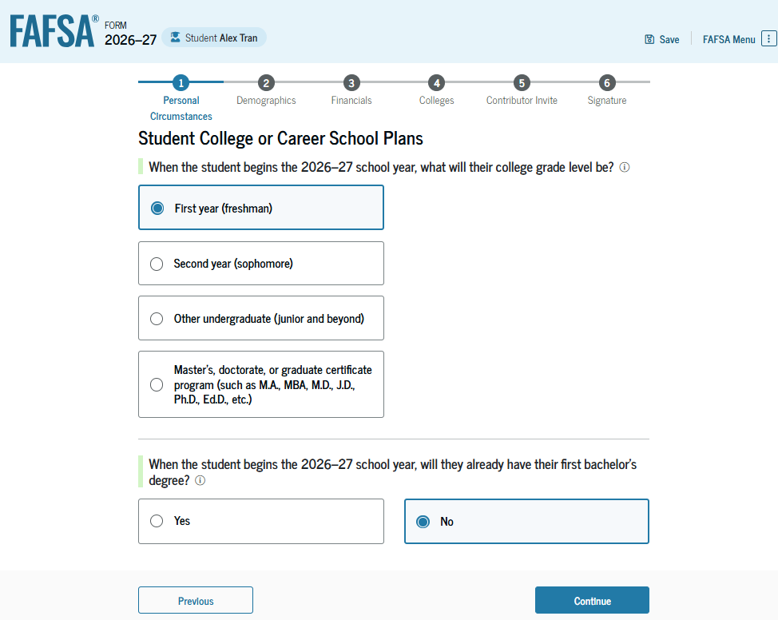
Student’s college or career plans

Slide 22
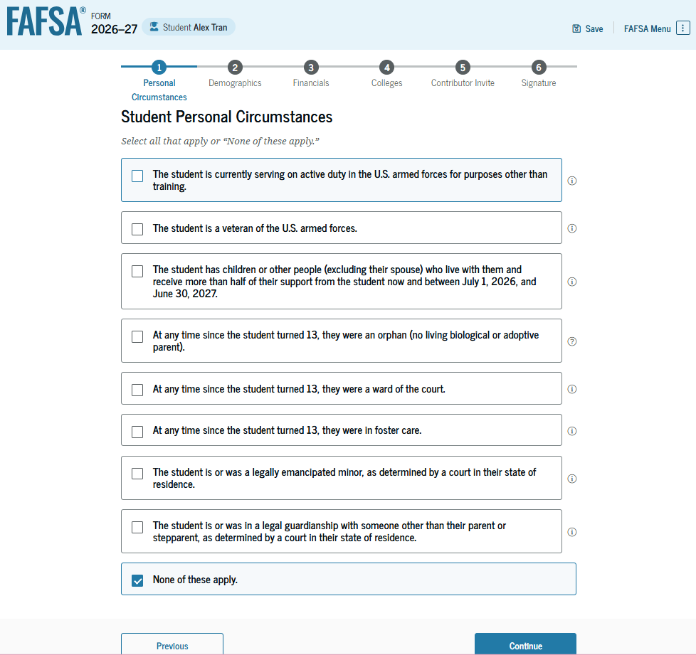
Student’s personal circumstances
24 years of age
Married
Master’s or doctorate program
Active-duty military
Veteran of the U.S. Armed Forces
Have children
Have dependents
Orphan, foster care or ward of the court
Emancipated minor
Legal guardianship
Homeless or self-supporting and at risk of being homeless
22

Slide 23
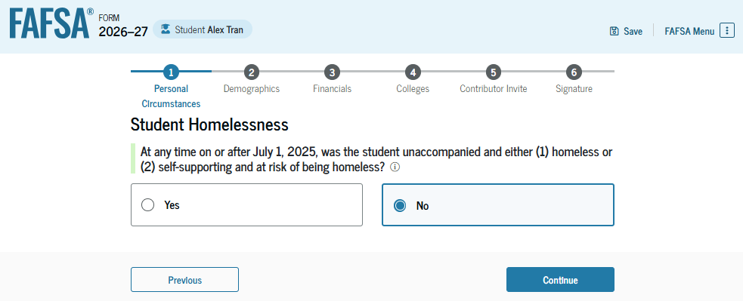
Other circumstances
Unaccompanied
  Not in the physical custody of a parent
Homeless
  Lacking fixed, regular, and adequate housing
Youth
  23 years of age or younger

Slide 24
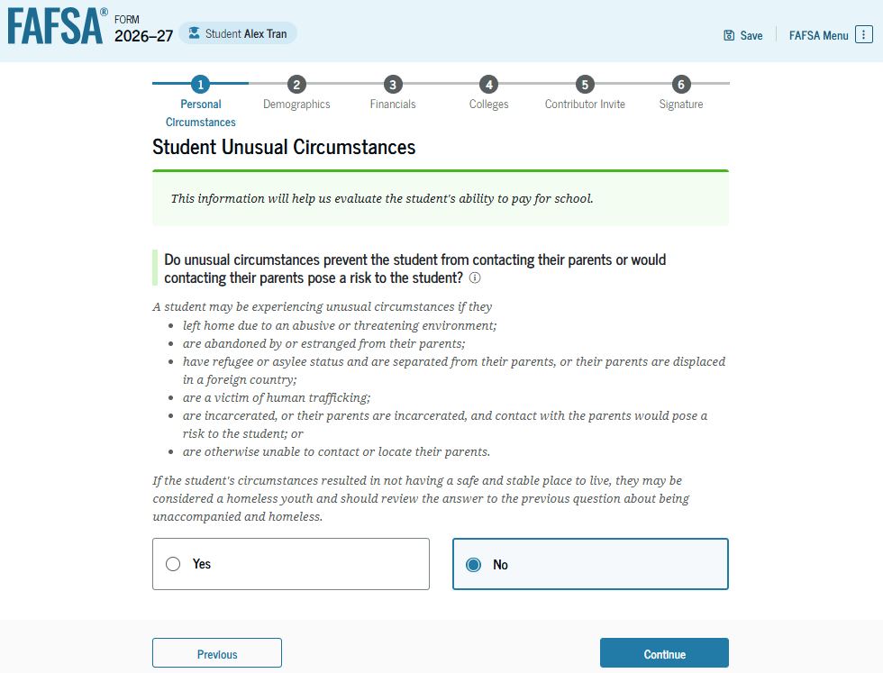
Unusual circumstances
Left home due to abusive or threatening environment
Been abandoned or estranged from parents, and have not been adopted
Been granted refugee or asylee status and are separated from parents
Been a victim of human trafficking
Been incarcerated, or parents are incarcerated and pose a risk to them
Been otherwise unable to contact or locate their parents, and have not been adopted

Slide 25
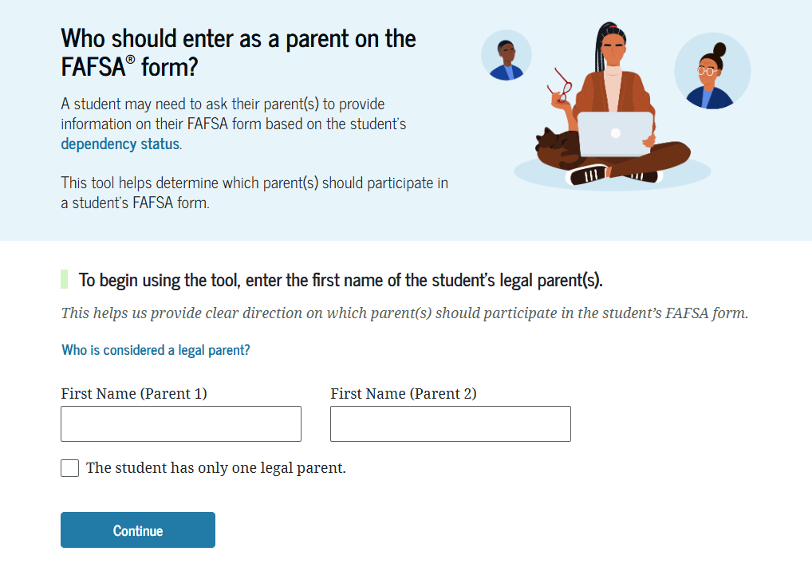
Determining the parent(s) for FAFSA purposes
Parent wizard to help determine the parent
Guidance has changed, now look at who provides more financial support
  Look at who has the most income and assets if provided equal support
Student invites the parent through the FAFSA by entering parent’s e-mail address
  The second parent may be invited to contribute later, especially if the parents did not file joint taxes.

Slide 26
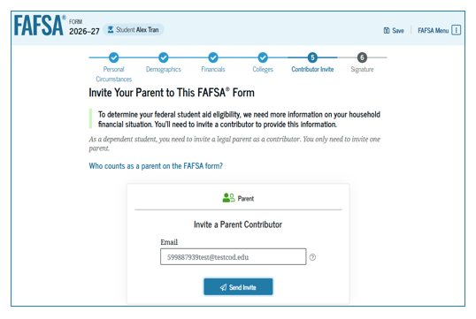
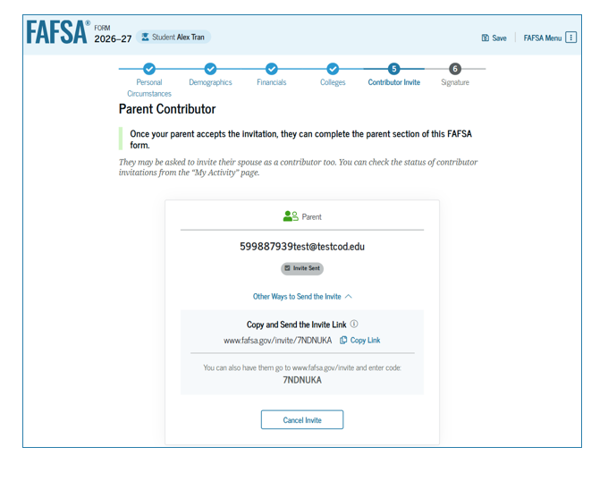
Invite parents to FAFSA form
Student enters parent email to send them an invite to contribute to the FAFSA

Slide 27
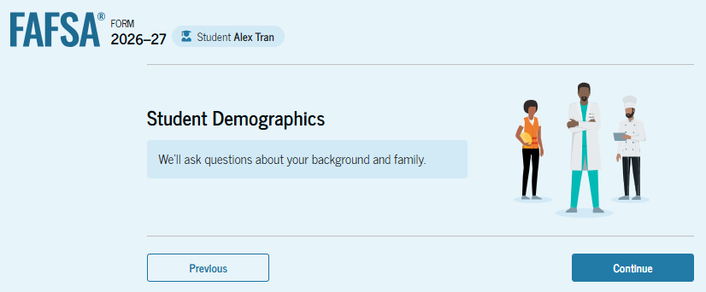
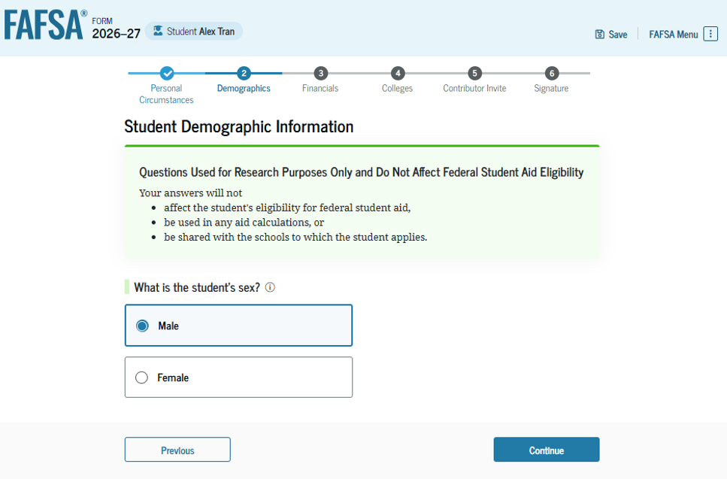
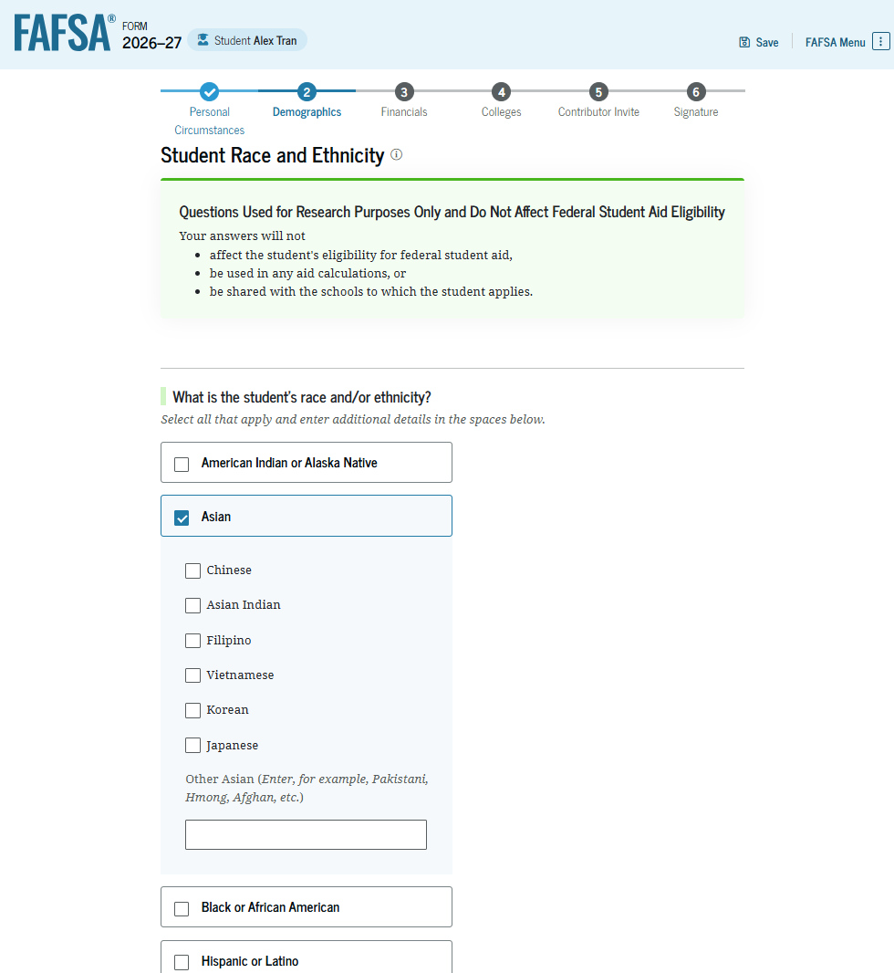
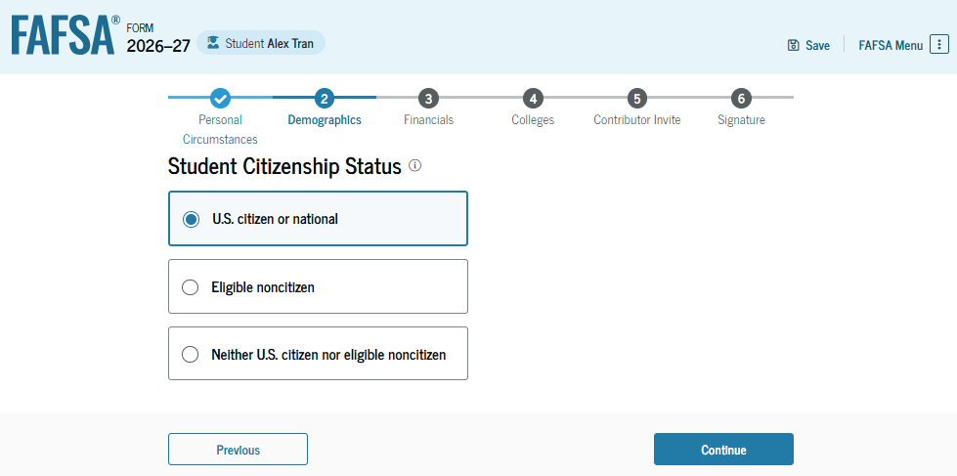
Student demographics
Notes:
Students must complete a demographic survey. The survey is mandatory (legislated by Congress), but the student can indicate they prefer not to answer. The information collected does not impact a student’s financial aid award.

Slide 28
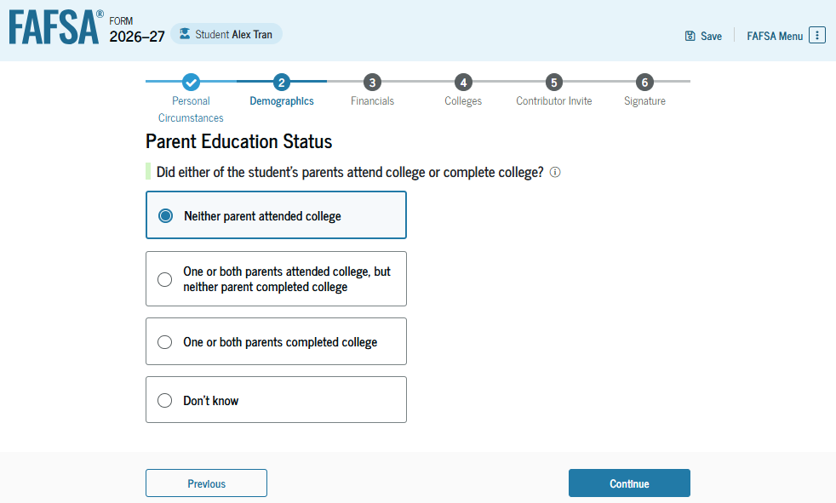
Parent’s education status
To identify possible first-generation college students
Notes:
The student is asked about their parents’ education status. This is to identify possible first-generation college students.

Slide 29
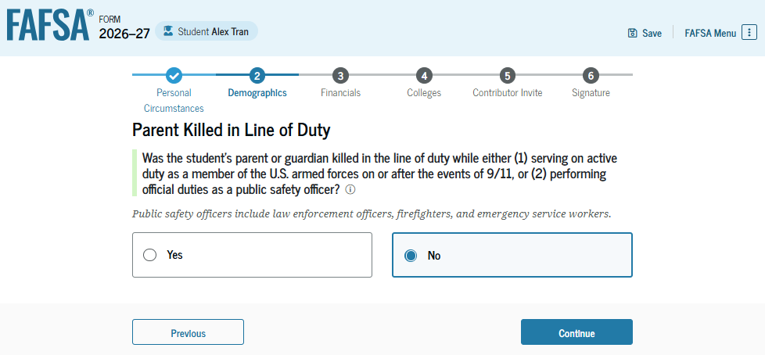
Parent killed in line of duty
Notes:
This question is asked to determine if the student is eligible for a federal grant program.

Slide 30
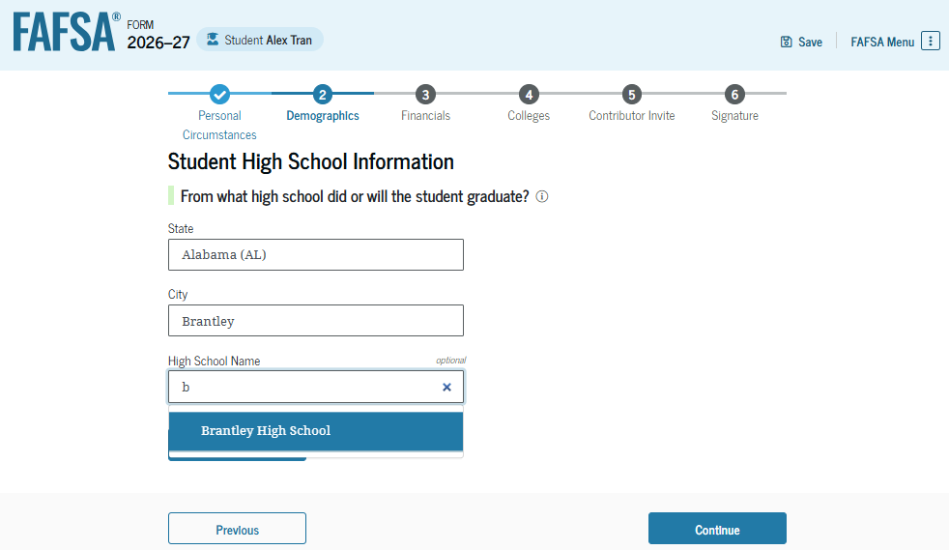
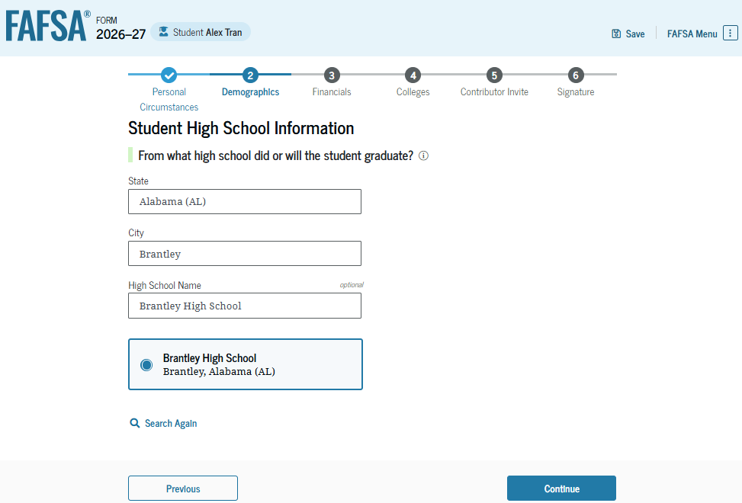
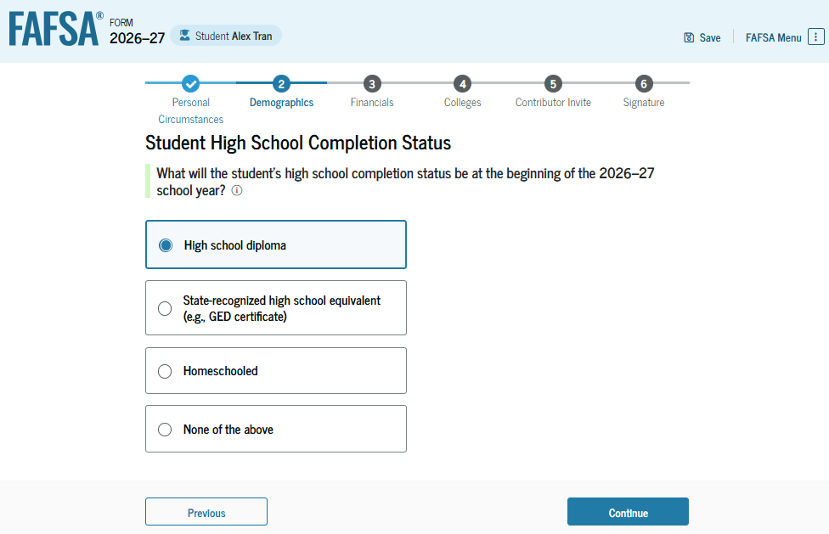
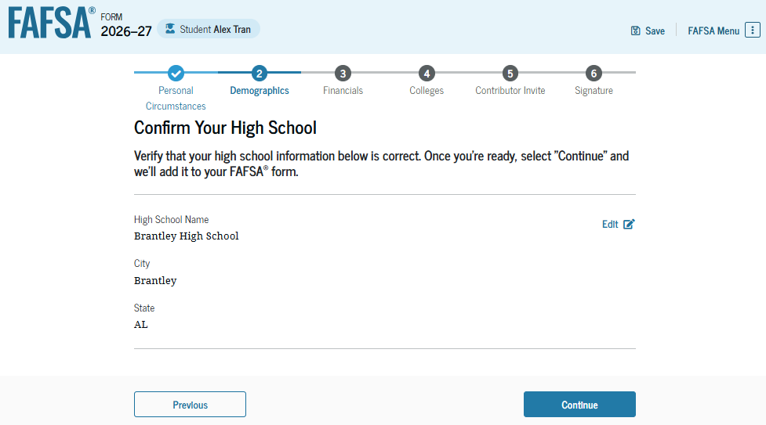
High school information

Slide 31
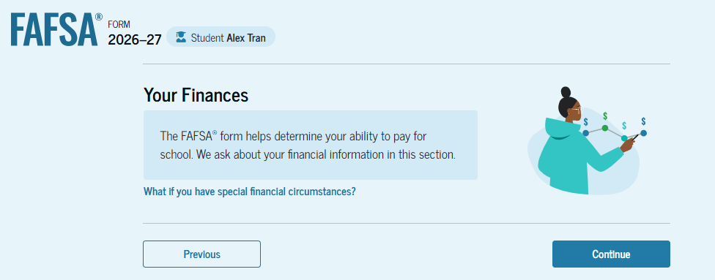
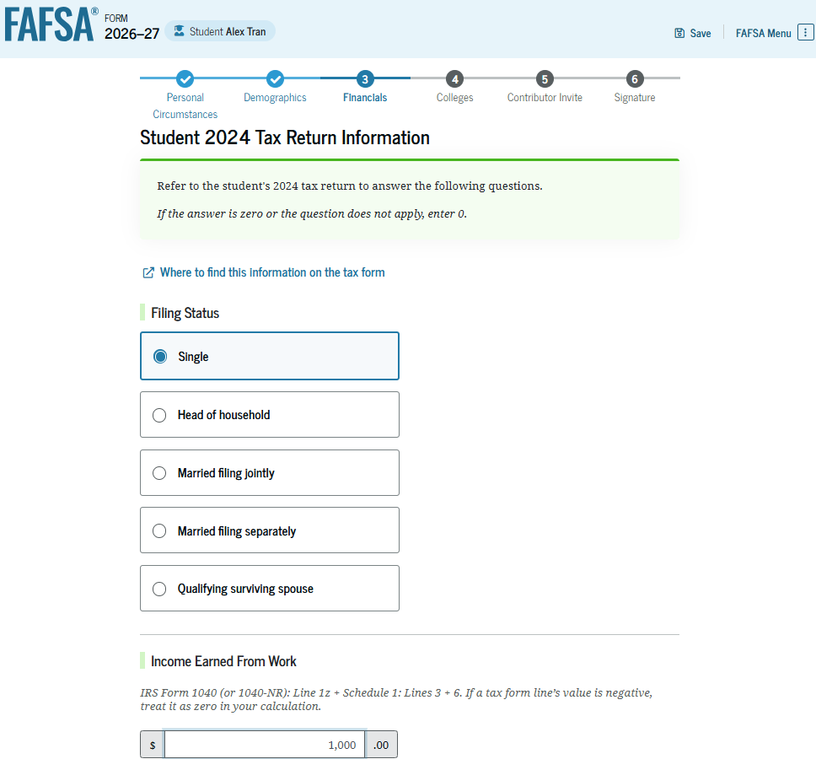
Student financial information
Once approval is granted, financial data is being transmitted behind the scenes
If the Direct Data Exchange (DDX) is not available to pull the tax information, a manual response to tax-related questions will be required.
  Once the DDX is available again, the FAFSA will be re-run and the student’s eligibility may change
Information transferred through the DDX will not display

Slide 32
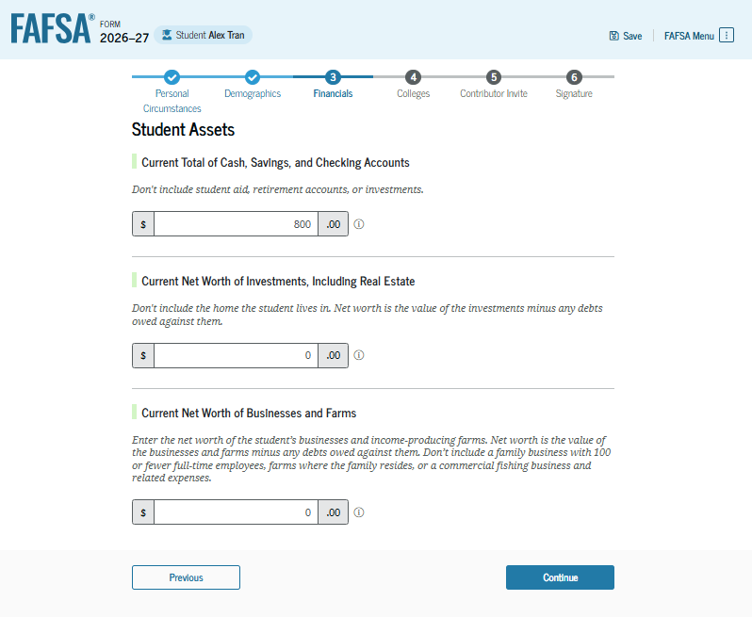
Student asset information
If the student starts the FAFSA, they will be asked the asset questions
If the parent starts the FAFSA and their adjusted gross income is less than $60,000, the asset information will not be asked
Notes:
If the student starts the FAFSA, they will be asked the asset questions.
If the parent starts the FAFSA and their income is less than $60,000, the asset information will not be asked either of the parent or the student.

Slide 33
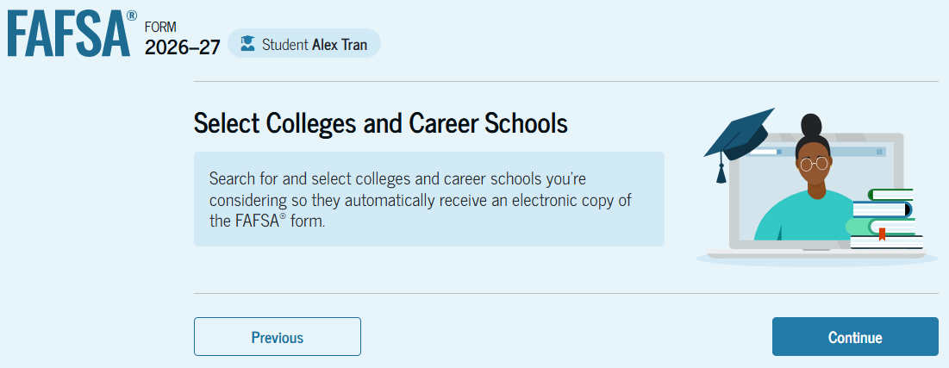
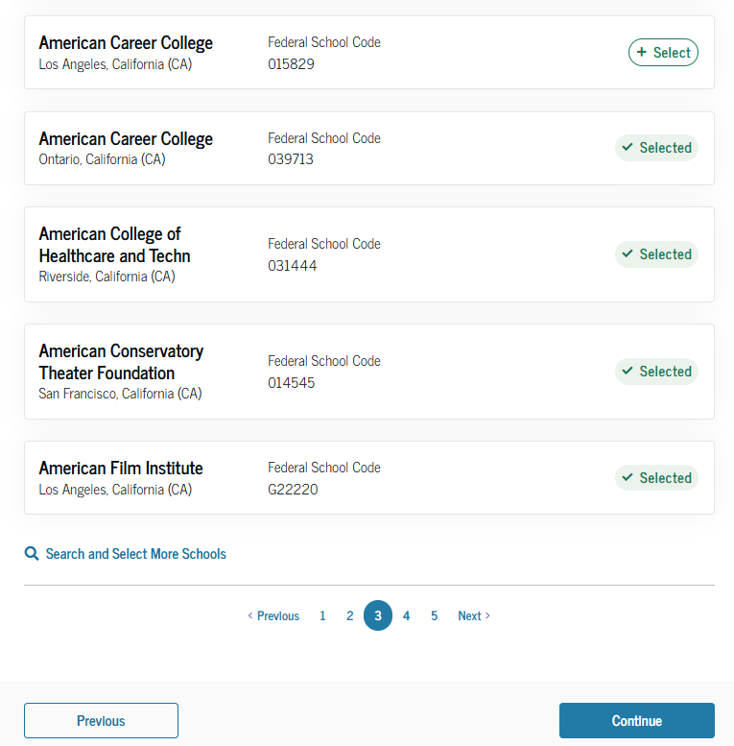
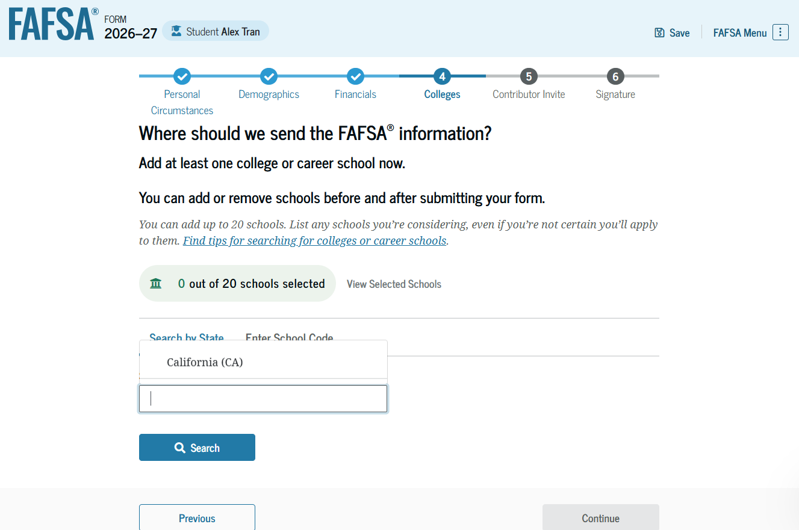
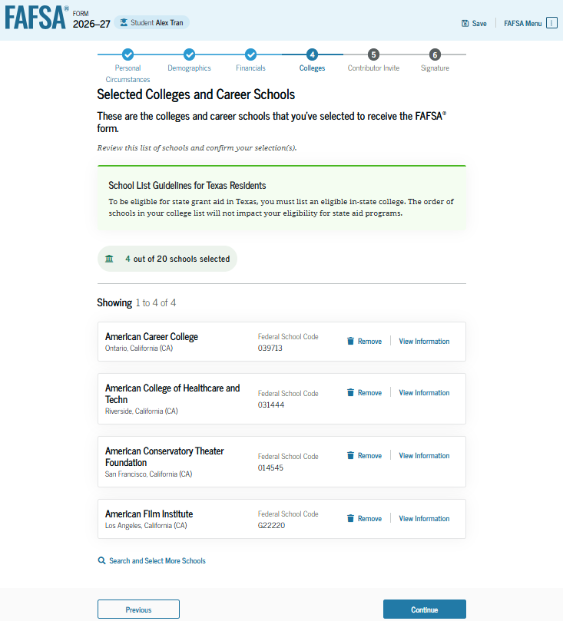
Select colleges
Select up to 20 schools to receive FAFSA information
Use Search or enter school’s Title IV code
33
Notes:
Select up to 20 schools to receive FAFSA information
Use Search or enter school’s Title IV code
Order does not matter in most states (Some states require students to list a state institution in their top three choices if they want state aid).

Slide 34
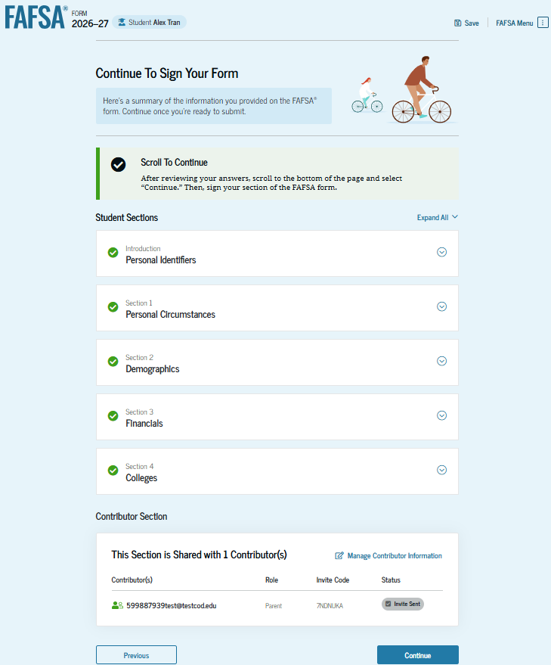
Student review page
Will list who was invited to contribute
Review information and make corrections, if needed
Can see status of parent contributors
34
Notes:
Will list who was invited to contribute
Review information and make corrections, if needed
Can see status of parent contributors

Slide 35
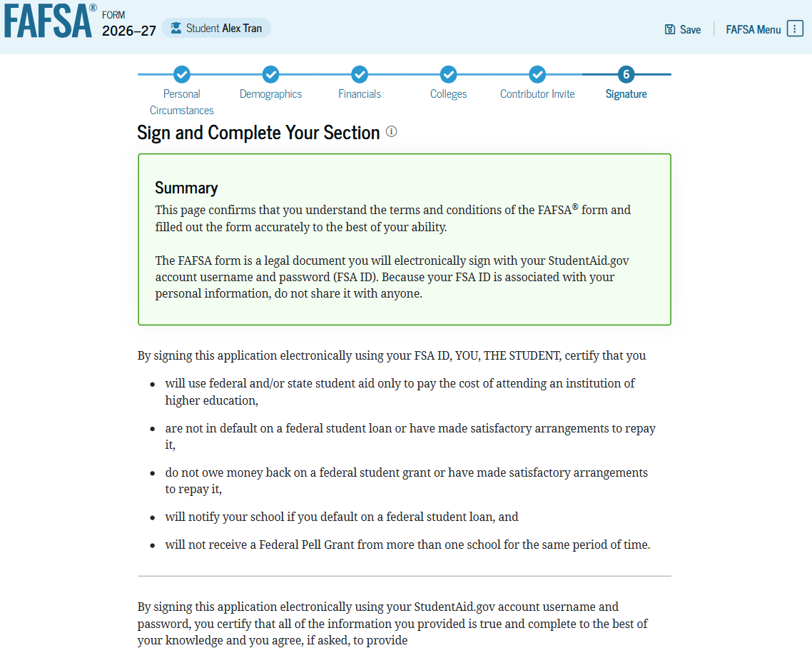
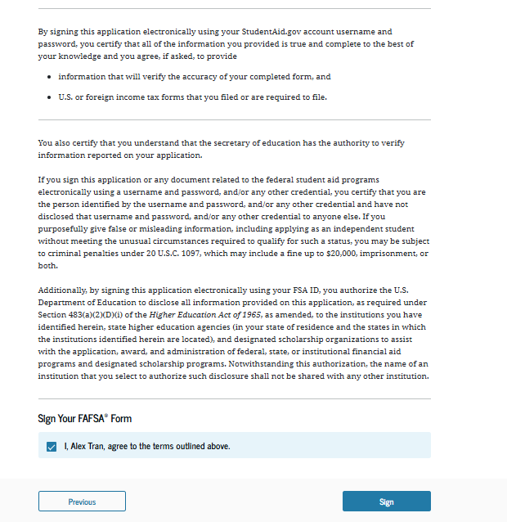
Dependent student signature

Slide 36
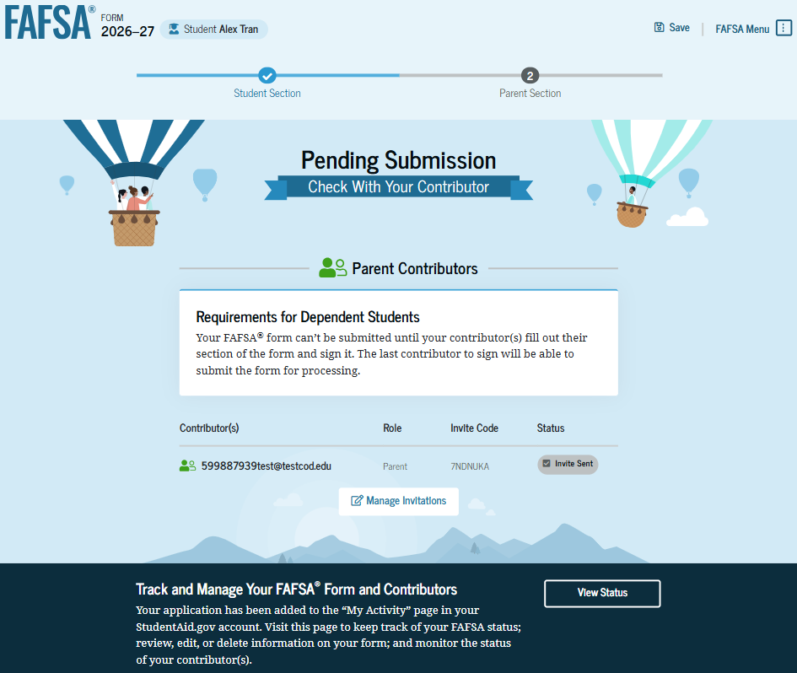
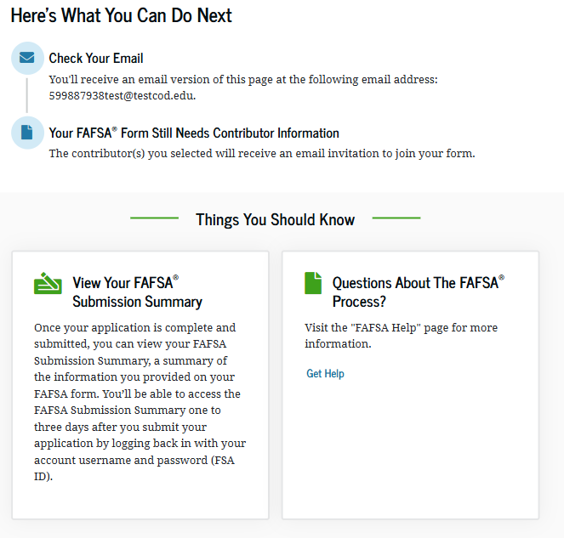
Student section complete
Notes:
Upon signing the student section, the student is presented the student section complete page. This page displays information for the student about the next steps, including tracking their FAFSA® form. The student. If dependent, is reminded that their form is not completed and can’t be submitted until the parent completes the contributor section of the form and signs it.

Slide 37
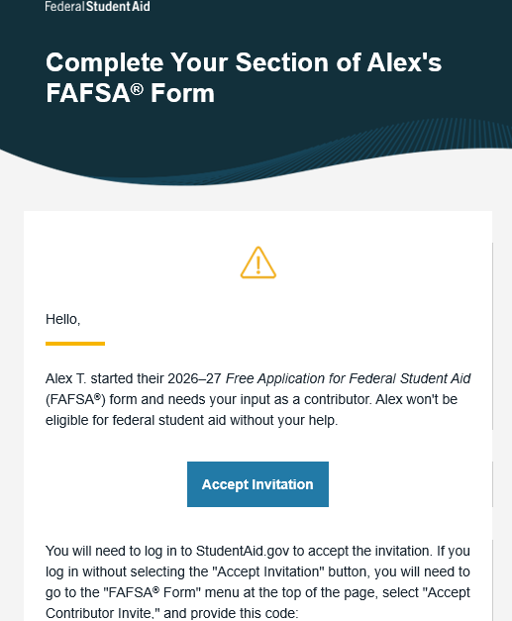
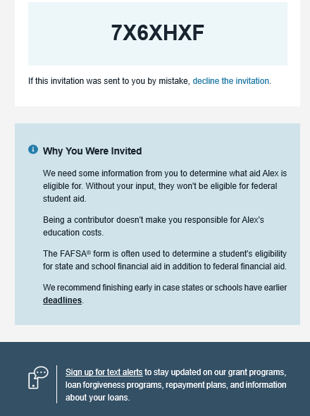
Parent e-mail
Parent is invited by e-mail to log in to StudentAid.gov to contribute to the student’s FAFSA.
37
Notes:
Parent is invited by e-mail to log in to StudentAid.gov to contribute to the student’s FAFSA.

Slide 38
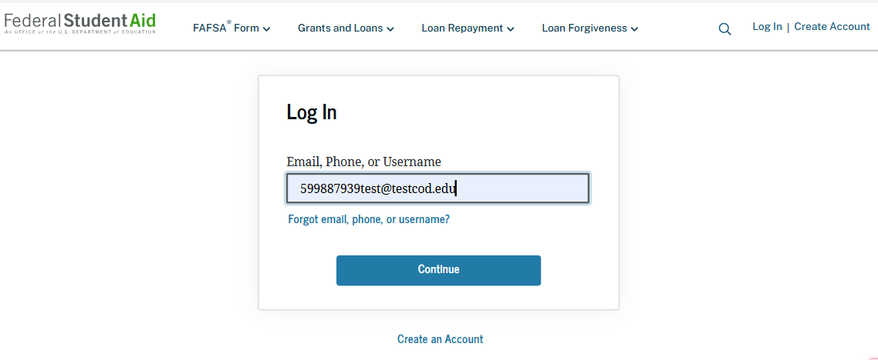


Parent log in
Notes:
Parent will log into their StudentAid.gov account using their FSA ID user name and password and hit “Get Started.”

Slide 39

Parent log in
Notes:
Parent will log into their StudentAid.gov account using their FSA ID user name and password and hit “Get Started.”

Slide 40




Parent’s onboarding

Slide 41


Parent identification information
Same process as for the student, can’t change name, date of birth, Social Security number or e-mail address
  Go to Account Settings on StudentAid.gov if e-mail address or phone number is incorrect
Can change mailing address
41

Slide 42



Parent approval screen

Slide 43



Parent demographics
Notes:
Collect marital status, state of legal residence, and number of college students in household. While the number in college is no longer a factor in determining need for federal financial aid, the information is used by some states and scholarship programs.

Slide 44



Parent financial information
Notes:
Financial questions.
If anyone in the family was eligible to receive the federal benefits listed, they will not be asked to provide assets.

Slide 45
Students with undocumented parents
Parents must still report information on the FAFSA
  Can get an FSA ID, even if don’t have a Social Security number
  May be authenticated against the credit bureau instead of the Social Security Administration
  May be asked to income earned from work instead of tax information

Slide 46

Family size
Can report if the number of dependents is different than the number of individuals claimed on 2024 tax return

Slide 47

Who is included in the number in college?
Dependent student
Student
NOT the parent(s)
Others attending at least half time in an approved program during 2026-27 that leads to a degree or certificate at a postsecondary school eligible to participate in any of the federal student aid programs
Does not factor into need analysis calculation

Slide 48


Tax return information
Income tax information will be pulled through the Direct Data Exchange (DDX)
Notes:
Parent may be asked to provide financial information from tax return.

Slide 49

Asset questions
Annual child support received
Cash, savings, and checking accounts
Businesses and investment farms
Investments, including real estate (not parents’ home)

Slide 50
Determining the value of assets
Market value
Debt owed
Net value

Slide 51

Other parent information
Could be a biological or adoptive parent or step-parent

Slide 52

Parent review page
52

Slide 53


Parent signature and abbreviated confirmation page

Slide 54



FAFSA Submission summary
54

Slide 55
FAFSA help options
Questions and answers at the beginning
Help “bubbles” on each FAFSA question
Federal Student Aid Information Center
800-433-3243
Mapping Your Future
800-374-4072
More online resources may be available when the FAFSA is finalized

Slide 56
Student Aid Index (SAI)
The amount a family can reasonably be expected to contribute
Calculated using data from the FAFSA and federal formula
  May be a negative number
Two components
  Parent contribution
  Student contribution
Stays the same regardless of college

Slide 57




Financial aid calculation
Cost of
Attendance
Student Aid Index
Other financial assistance
Need

Slide 58
Sample maximum federal financial aid amounts
Federal Pell Grant: up to $7,395*
Direct Loan: $5,500
  Up to $3,500 Subsidized
  Remaining $5,500 after subtracting Subsidized can be Unsubsidized
  6.39% interest rate for undergrads, 7.94% for graduate students*
Direct PLUS Loan: Parents can borrow up to the cost of attendance less financial aid
  8.94% interest rate*
  *For the 2025-26 academic year

Slide 59

Sample financial aid offer
Also referred to as award letter

Slide 60
South Dakota Opportunity Scholarship
Attend postsecondary school in SD
Starting Fall 2023, $1,500 for 3 years and $3,000 for final year
Must be SD resident
Eligibility requirements include minimum GPA, minimum ACT scores, curriculum requirements, etc.
Apply at https://sdos.sdbor.edu/ by September 1
Recommended that initial application and transcript be submitted by June 1
Programs may change – check website for the latest information

Slide 61
Dakota Corps Scholarship
  Tuition and applicable fees at participating SD schools
  Requirements include minimum grades and agreement to stay in state for work in specific critical need occupations
  Understand the scholarship will turn into a loan if requirements are not met
  Apply at https://tdx.sdbor.edu/TDClient/33/Portal/KB/ArticleDet?ID=278 by December 15
Programs may change – check website for the latest information

Slide 62
South Dakota Needs Based Grant Program (SDNBGP)
  Resident of SD
  Enrolled at least part time at a participating institution
  Completed FAFSA and requirements established by institution
  Information at https://tdx.sdbor.edu/TDClient/33/Portal/KB/ArticleDet?ID=311
Programs may change – check website for the latest information

Slide 63
Build Dakota Scholarship
Full-ride scholarship
For students enrolled in a high-need workforce area program at one of the four technical colleges
Work full-time in SD for a minimum of three years.
Next application cycle will be January 1, 2026 – March 31, 2026
Understand the scholarship will turn into a loan if requirements are not met
More information at www.builddakotascholarships.com or on the technical college’s website
Programs may change – check website for the latest information
Notes:
Tuition is based on public university tuition rates

Slide 64
Freedom Scholarship
New state-wide initiative to encourage South Dakota students of all economic backgrounds to live and work in South Dakota after graduation
Available to students with unmet financial need as determined through their submission of the FAFSA, in conjunction with the financial aid office at the respective university.
Understand the scholarship will turn into a loan if requirements are not met
More information at www.freedomscholarshipsd.com
Programs may change – check website for the latest information

Slide 65
Jump Start Scholarship
Students who graduate from a SD public high school in 3 years or less
Enroll in an accredited institution located in SD within 1 year of high school graduation.
For first year only and dollar amount varies
For SD residents
Apply at https://tdx.sdbor.edu/TDClient/33/Portal/KB/ArticleDet?ID=252 September 1
Programs may change – check website for the latest information

Slide 66
Critical Teaching Needs Scholarship
Agree to work in SD in a critical teaching need occupation for five years
Understand the scholarship will turn into a loan if requirements are not met
Attend a participating SD postsecondary institution
Application and more information online at https://tdx.sdbor.edu/TDClient/33/Portal/KB/?CategoryID=38
Programs may change – check website for the latest information

Slide 67
Scholarship tips
Develop a plan
Understanding the cost
Establish a scholarship goal
Conduct research
Research local, college, state, employer programs
Organizations/
employers that align with your career choice
Scholarship search
Prepare applications
Write the essay
Proof and edit, neatness counts
Stay organized
Use the scholarship tracking sheet
Follow deadlines, requirements
Have a dedicated
e-mail address

Slide 68


Slide 69

Resources
SouthDakota.MappingYourFuture.org
  https://southdakota.mappingyourfuture.org/college.cfm
  https://southdakota.mappingyourfuture.org/career-sort.cfm
MappingYourFuture.org
StudentAid.gov
  https://studentaid.gov/aid-estimator/
Scholarship tracking sheet: https://mappingyourfuture.org/wp-content/uploads/2024/08/MappingYourFuture_Scholarship_Tracking2024.xlsx
Scholarship searches
  FastWeb: www.fastweb.com/
  BigFuture: bigfuture.collegeboard.org/
  Scholarship Resources: https://mappingyourfuture.org/wp-content/uploads/2024/08/MappingYourFutureScholarshipTips.pdf
69

Slide 70

Questions
70
© Mapping Your Future 2024

Slide 71

Thank you for participating
Cathy Mueller
Marlene Seeklander
(800) 374-4072
feedback@mappingyourfuture.org
SouthDakota.MappingYourFuture.org

