Slide 1

2027-28
Financial Aid Event
High School
September 2026

Slide 2
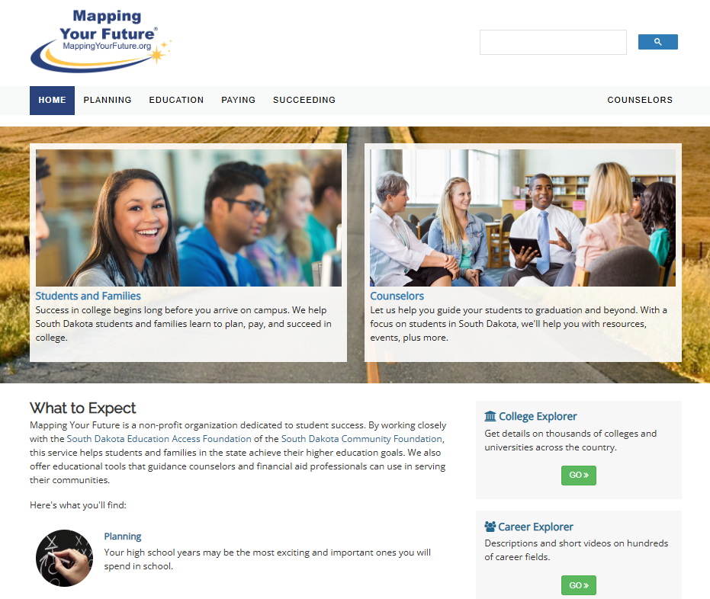
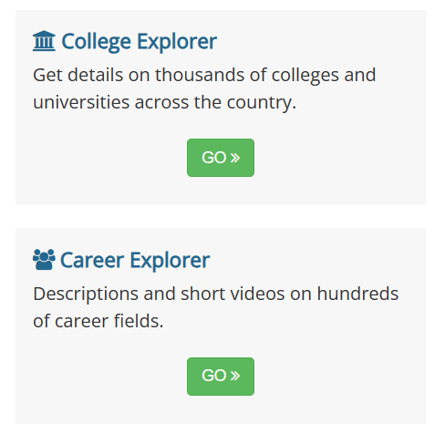
South Dakota Mapping Your Future website
Comprehensive website for students, parents, counselors, and other professionals at https://SouthDakota.MappingYourFuture.org

Slide 3

Agenda
Paying for College
Financial Aid
FAFSA
Scholarships
Resources

Slide 4

Planning for life after high school
Congressional changes to financial aid underscore the need for students and families to plan ahead to pay for college.
Parent borrowing is now limited
Part-time students can now only borrow based on enrollment
Pell Grant was expanded to cover short-term and credential programs
New loan limits for graduate and professional students
Asset exemptions
529 plans

Slide 5

New limits on what parents can borrow
Parent borrowing limited to $20,000 annually per student with a lifetime limit of $65,000.
Legacy provision for parents who borrowed before July 1, 2026.
Parents wanting to borrow more money may need to consider private loans or other financing options.
Parent PLUS loans disbursed after July 1, 2026, can only be repaid in the new tiered standard plan.

Slide 6
Paying for education
Savings
Earnings
Financial aid
Tax credits & deductions

Slide 7
Financial aid process
Complete
2
the Free Application for Federal Student Aid (FAFSA)
Receive
3
FAFSA Submission Summary
Receive
4
a financial aid offer from the school
Decide
5
which aid to accept and return the financial aid offer
Create
1
FSA ID on StudentAid.gov

Slide 8
Types of financial aid
Grants
Scholarships
Work-study programs
Loans
8

Slide 9
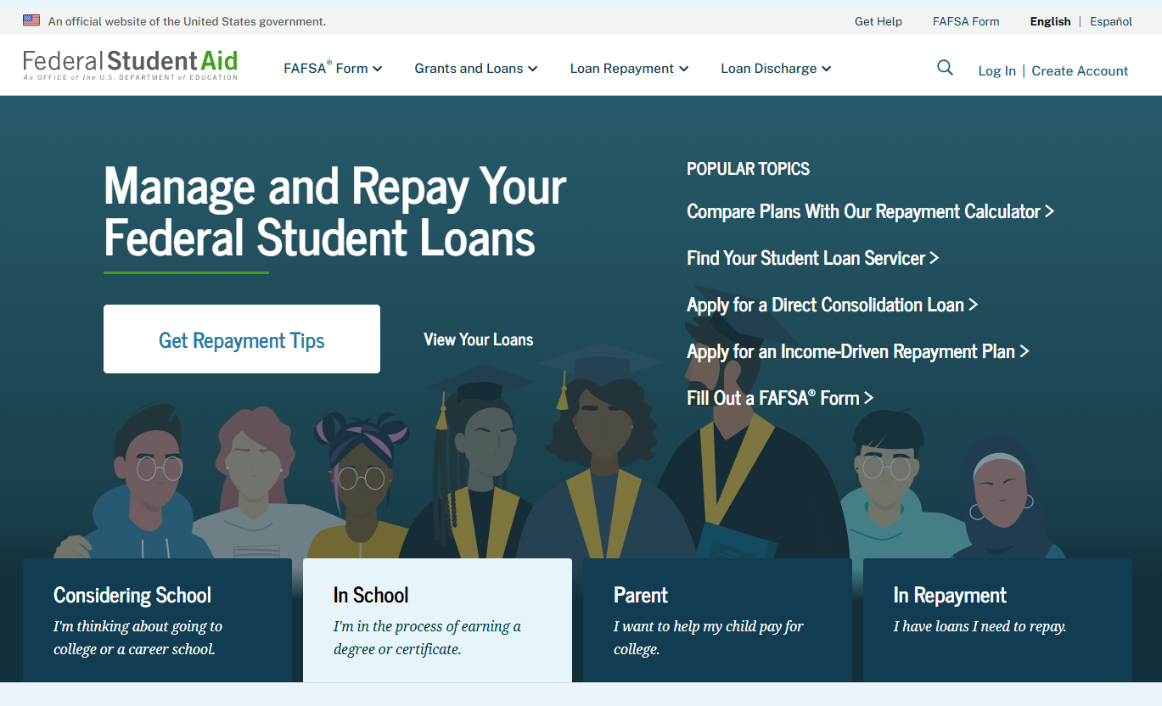
https://StudentAid.gov
Navigation tool for the applicant when accessing the FAFSA on the website
Includes Dashboard for the user
Provides options and messaging based on the status of the student’s FAFSA:
  Start a 2027-28 FAFSA
  View the FAFSA Submission Summary
  Make FAFSA corrections
  View correction history
  Complete and submit a Renewal FAFSA

Slide 10
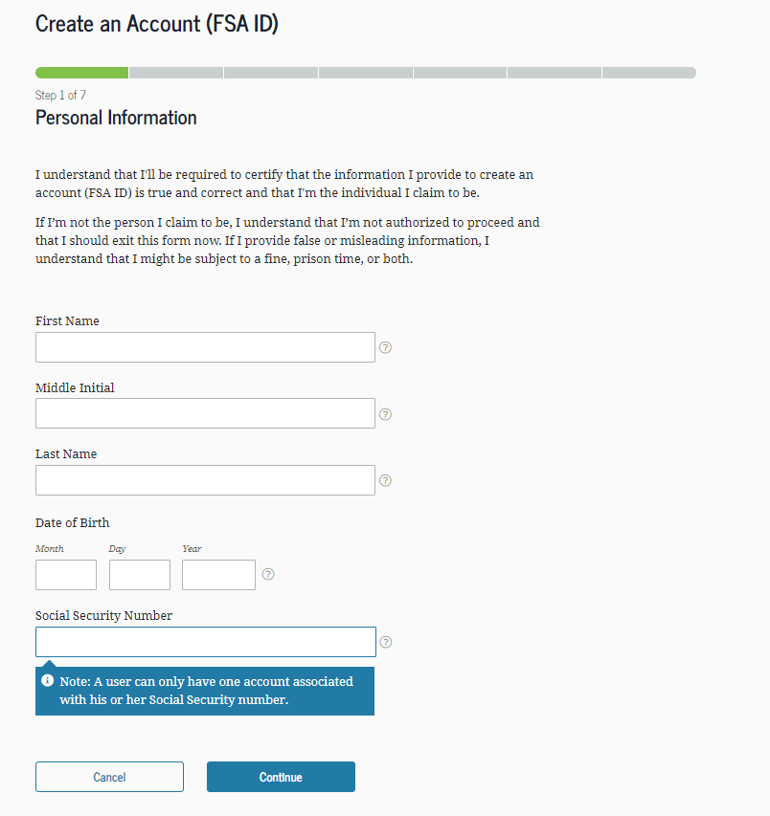
Create an StudentAid.gov account (FSA ID)
Key StudentAid.gov account (FSA ID points:
Students and at least one parent for FAFSA purposes need one (see parent wizard information)
Cannot share an e-mail address or phone number for FSA ID
Must be set up before completing the 2027-28 FAFSA
Identity verification is real-time
Go to StudentAid.gov, Create Account
Enter your personal information
Create your username and password
Enter your e-mail address
Create security questions
Submit your information

Slide 11
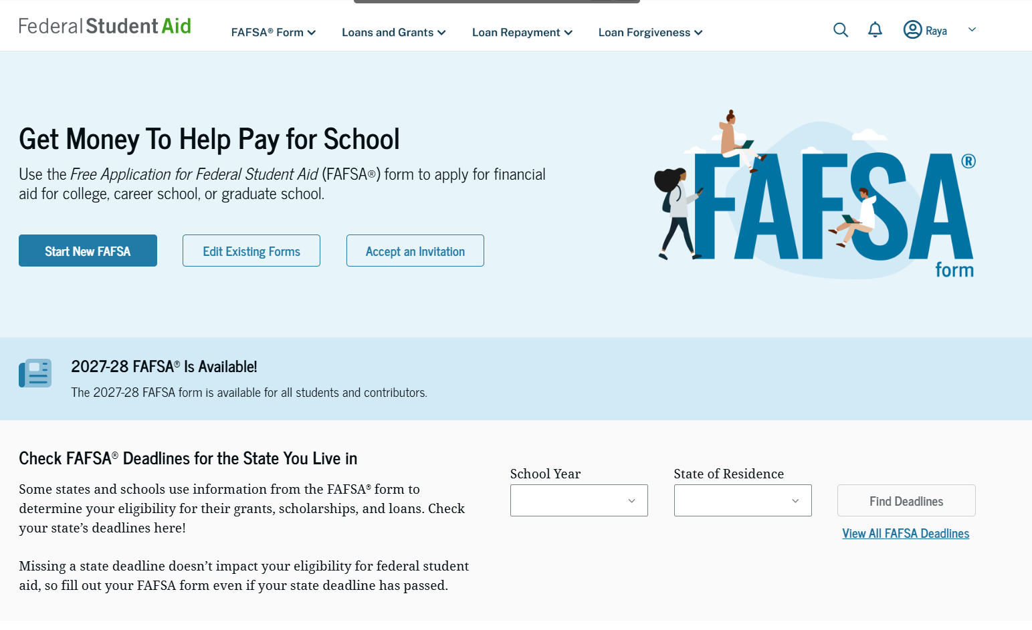

What is the FAFSA?
Free Application for Federal Student Aid
Base application for various forms of financial aid (need based and non-need based)
  Federal
  State
  Institutional
  Private
2027-28 FAFSA available by October 1 for the following academic year

Slide 12
Who is the parent for FAFSA purposes?
Your biological and/or adoptive parents are considered your legal parents.
  Must report information for both biological or adoptive parents if they are married or unmarried and living together
Grandparents, foster parents, legal guardians, older brothers or sisters, and aunts and uncles are not considered parents unless they have legally adopted you.
Parent wizard tool in the FAFSA helps determine which parent’s or parents’ information to include.
Department of Education has made the parent wizard tool available outside of the FAFSA to help students and parents prepare to complete the form. https://studentaid.gov/fafsa-apply/parents

Slide 13
Which parent provides information/needs a StudentAid.gov account (FSA ID)
Divorced or Separated
Parent who provided the most financial support reports information and needs an FSA ID.
Remarried
Parent who provided the most financial support reports information for parent and step-parent
  Only the biological parent needs an FSA ID if filed joint taxes.
  If filed separately, parent and step-parent needs an FSA ID.
Widowed
Surviving parent provides information and needs an FSA ID.
Married
Report information on both parents:
  Only one parent needs an FSA ID if filed joint taxes.
  If filed separately, both parents need an FSA ID.
Unmarried but living together
Report information on both parents and both parents need an FSA ID.
Never married and not living together
Parent who provided the most financial support reports information and needs an FSA ID.

Slide 14
Gathering documents needed
Government-issued ID
Your Social Security number
Your parents’ Social Security numbers
2025 federal tax information, tax returns, W-2’s for you and for your parents
Records of your 2025 untaxed income
Information on cash, savings and checking account balances, investments, businesses and farms

Slide 15
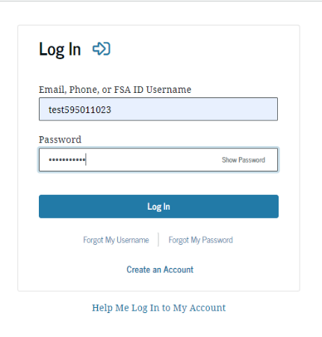
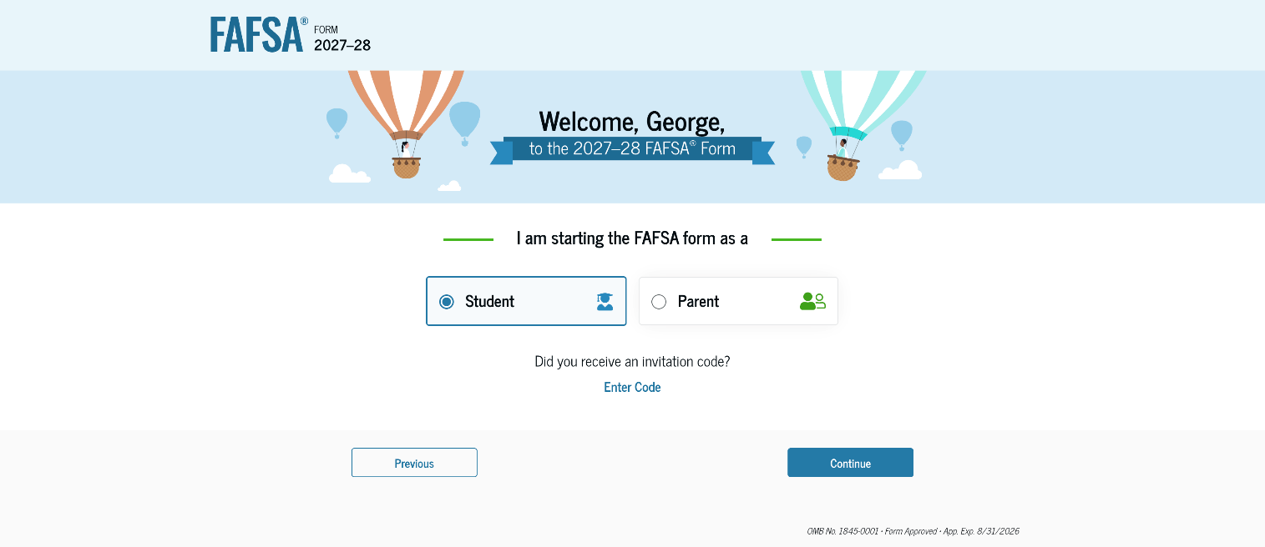
FAFSA log in

Slide 16
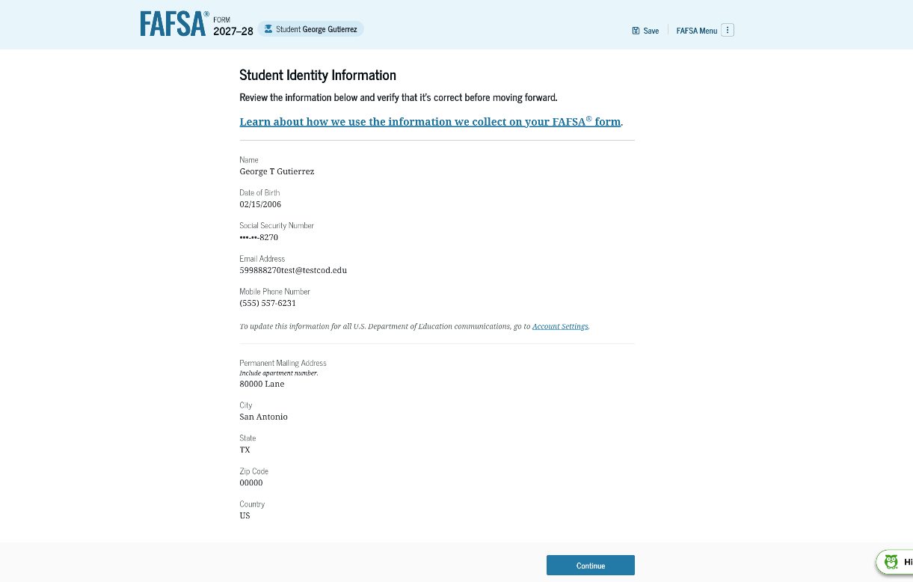
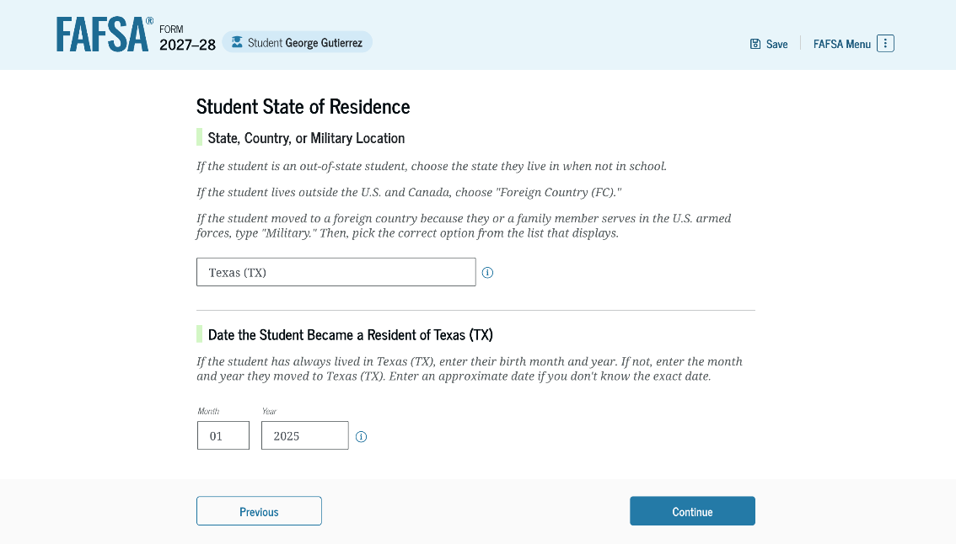
Student identifiers
Prefilled from the FSA ID information:
  Name
  Social Security Number
  Date of birth
  Email address
  Phone number
Mailing address
Residency

Slide 17
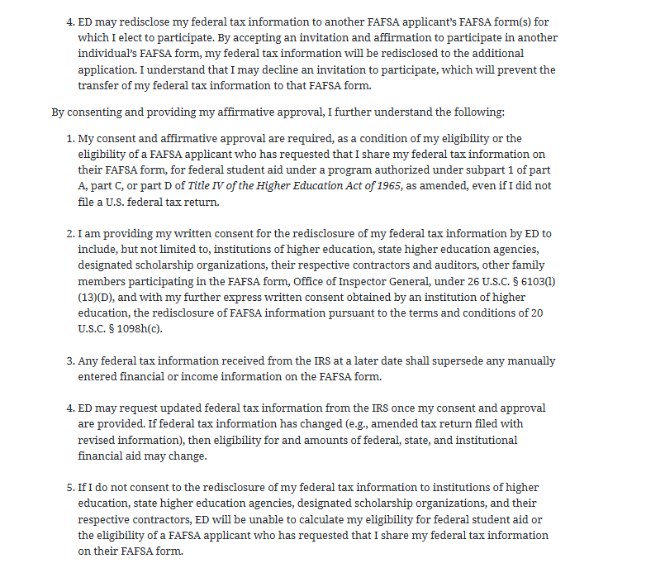
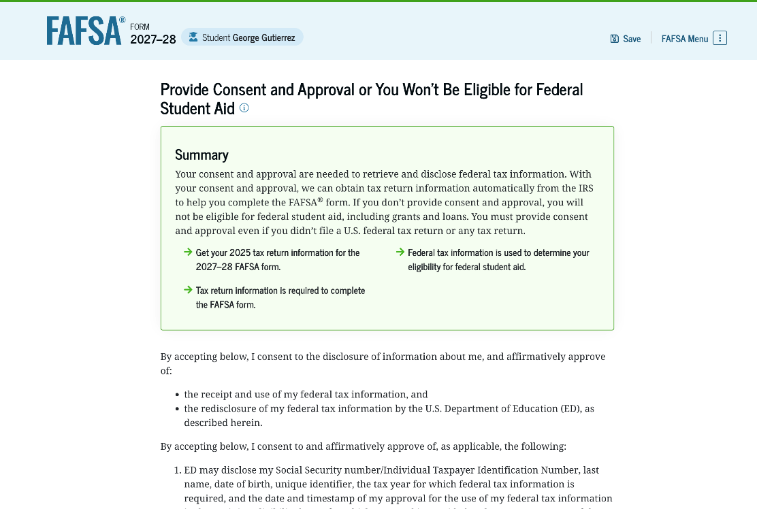
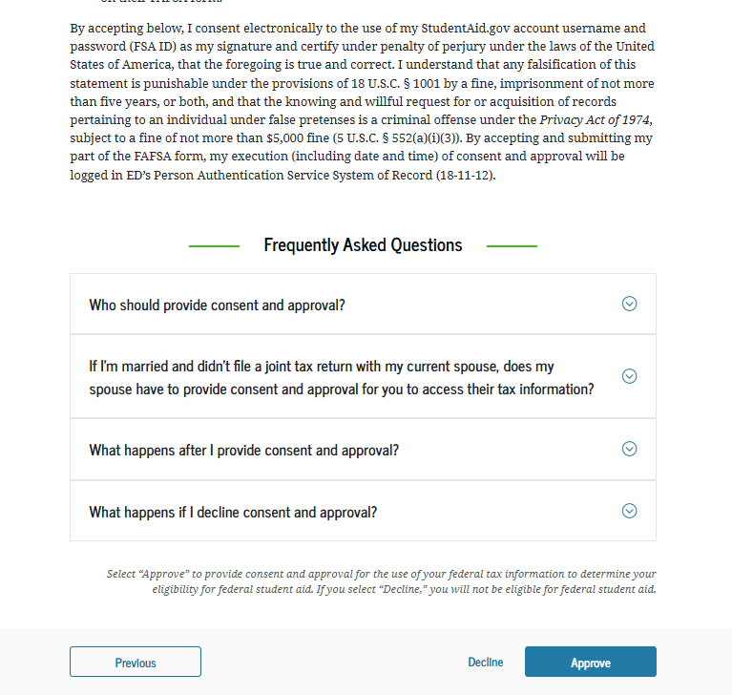
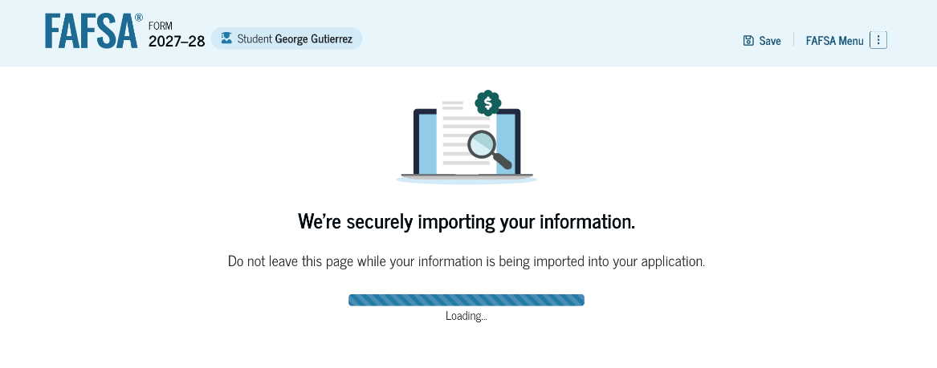
Direct Data Exchange (DDX)
Allows student and parents to transfer federal tax information directly from the IRS to the FAFSA
Requires consent of all FAFSA contributors
IRS transfers information for income questions on the FAFSA
Eliminates the need for manual entry of tax and income information
17

Slide 18
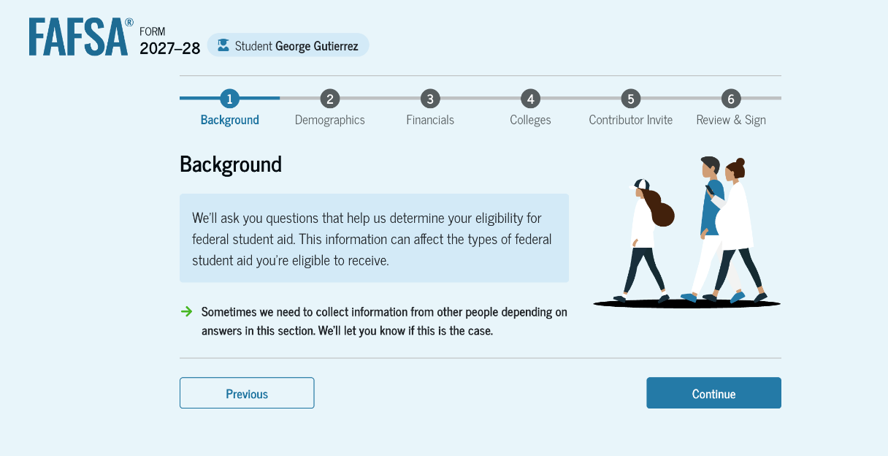
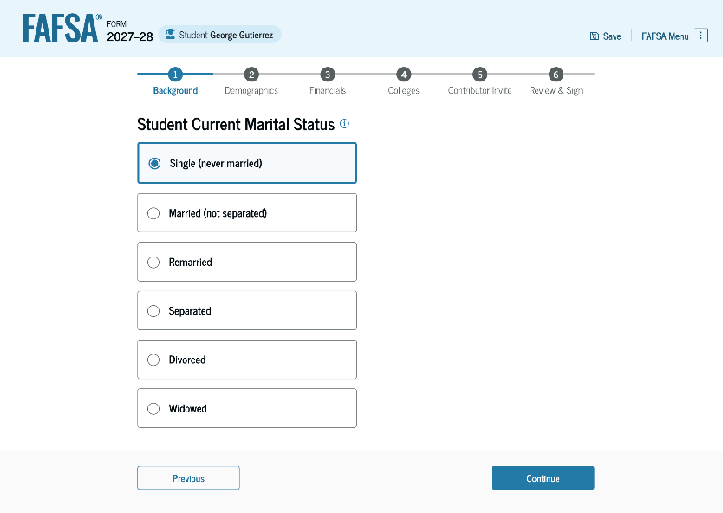
Background
Marital status
College or career school plans
Student personal circumstances
Homeless
Unusual circumstances

Slide 19
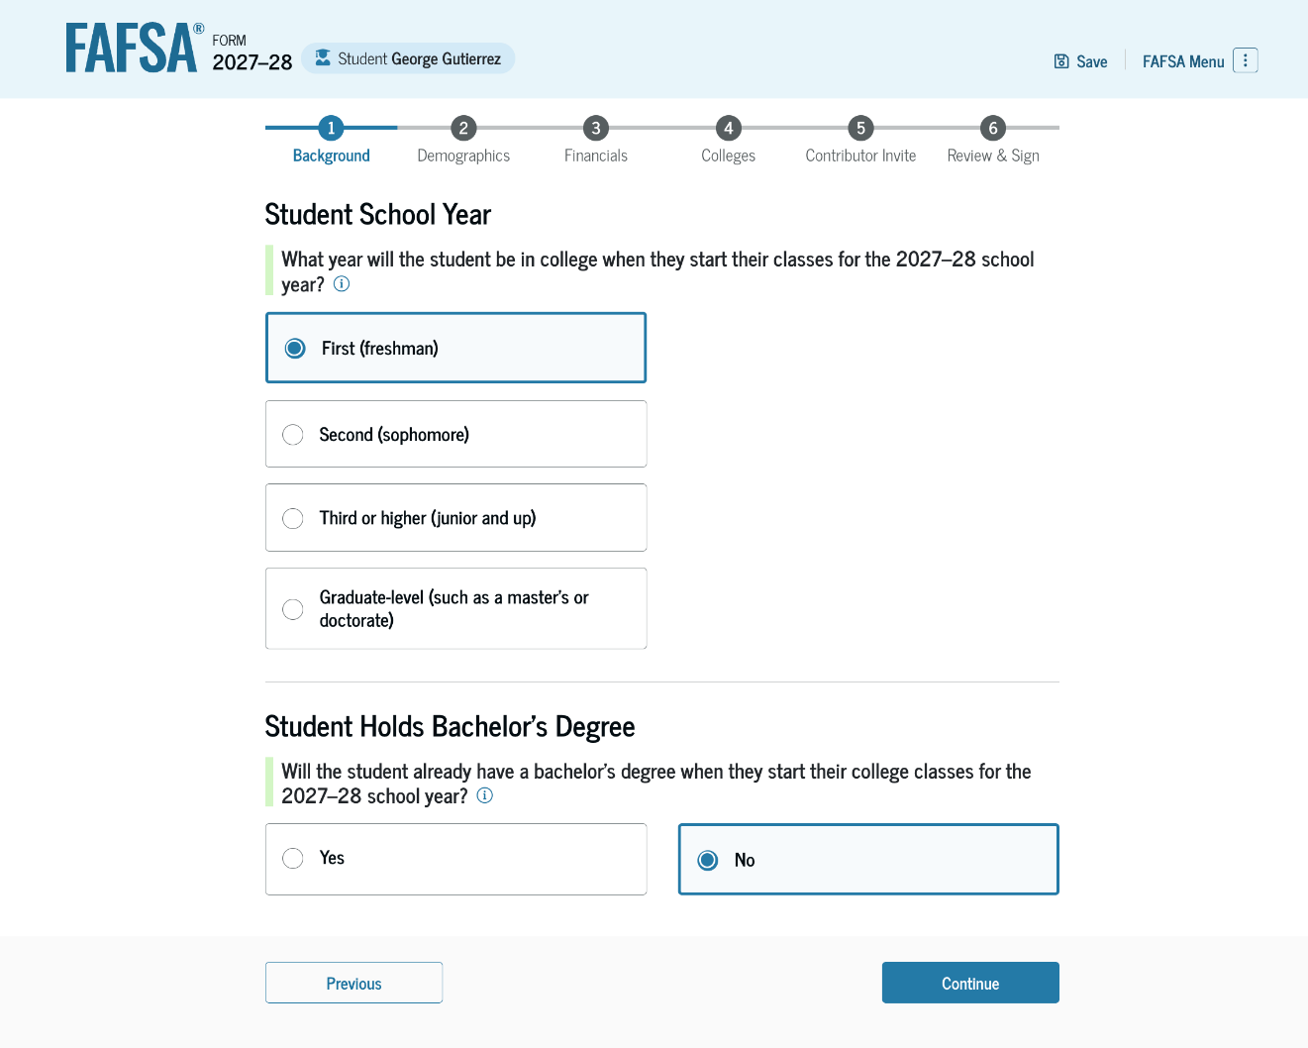
Student’s college or career plans

Slide 20
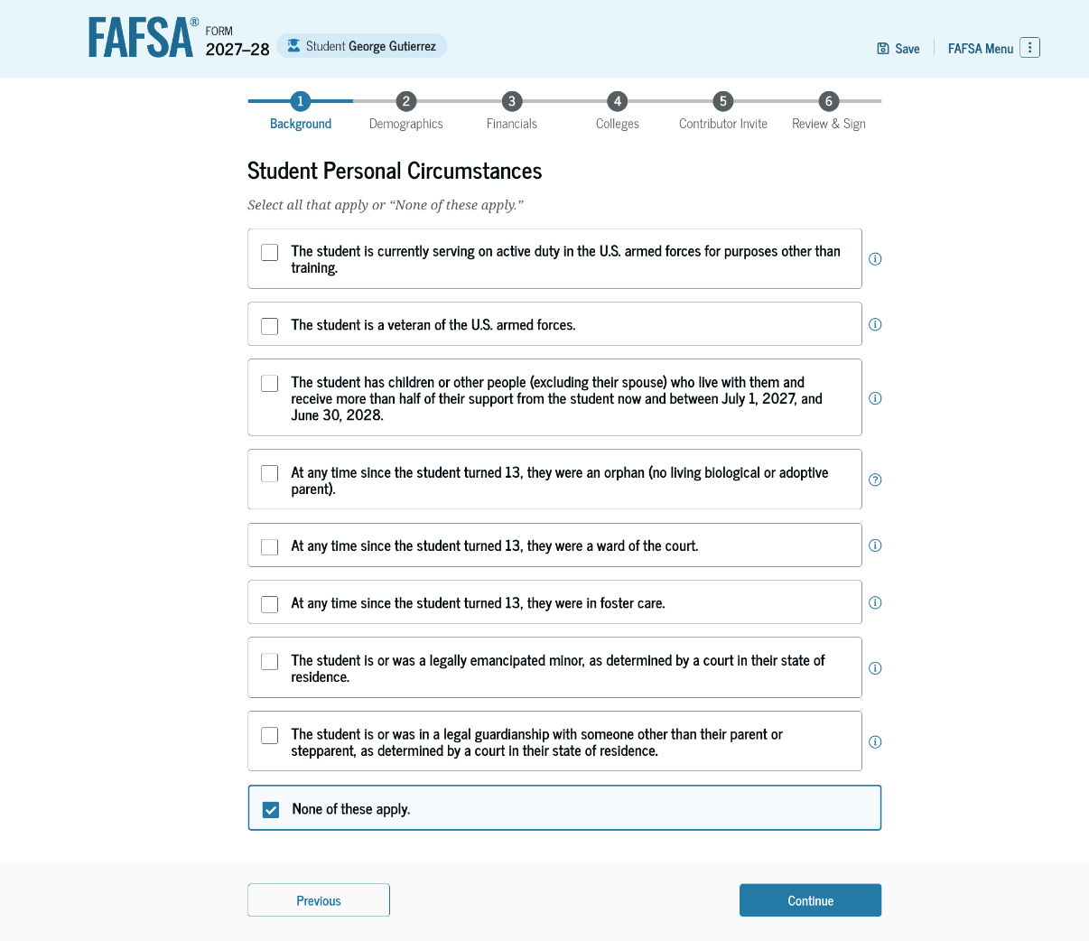
Student’s personal circumstances
24 years of age
Married
Master’s or doctorate program
Active-duty military
Veteran of the U.S. Armed Forces
Have children
Have dependents
Orphan, foster care or ward of the court
Emancipated minor
Legal guardianship
Homeless or self-supporting and at risk of being homeless
20

Slide 21
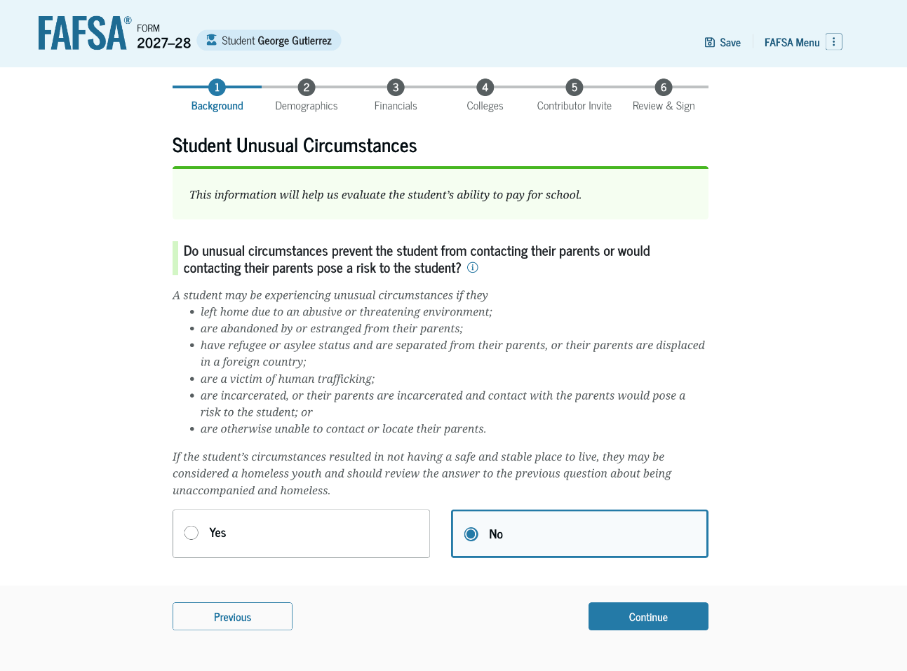
Unusual circumstances
Left home due to abusive or threatening environment
Been abandoned or estranged from parents, and have not been adopted
Been granted refugee or asylee status and are separated from parents
Been a victim of human trafficking
Been incarcerated, or parents are incarcerated and pose a risk to them
Been otherwise unable to contact or locate their parents, and have not been adopted

Slide 22
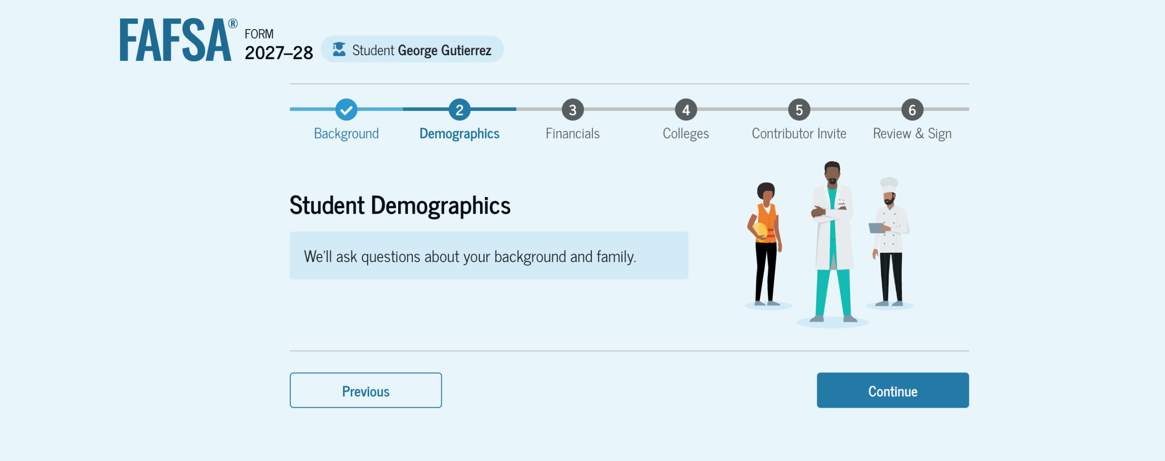
Student demographics
Notes:
Students must complete a demographic survey. The survey is mandatory (legislated by Congress), but the student can indicate they prefer not to answer. The information collected does not impact a student’s financial aid award.

Slide 23
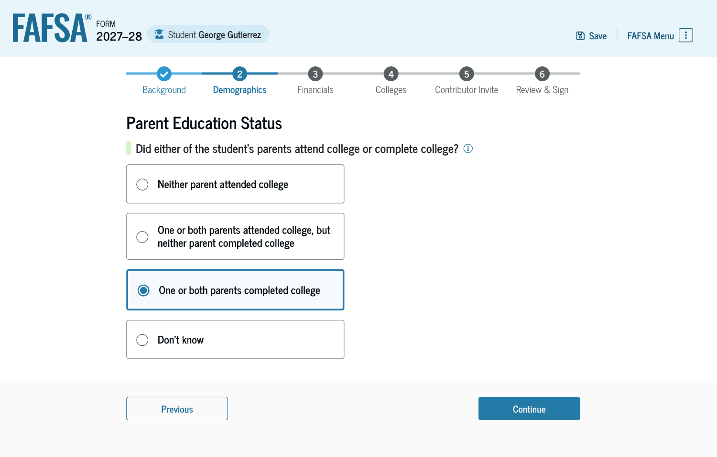
Parent’s education status
Question to identify possible first-generation college students
Notes:
The student is asked about their parents’ education status. This is to identify possible first-generation college students.

Slide 24
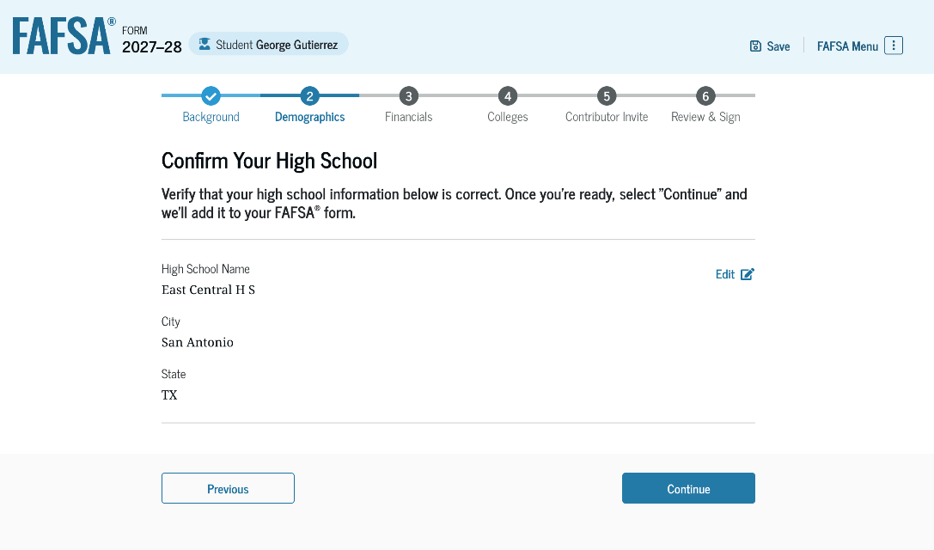
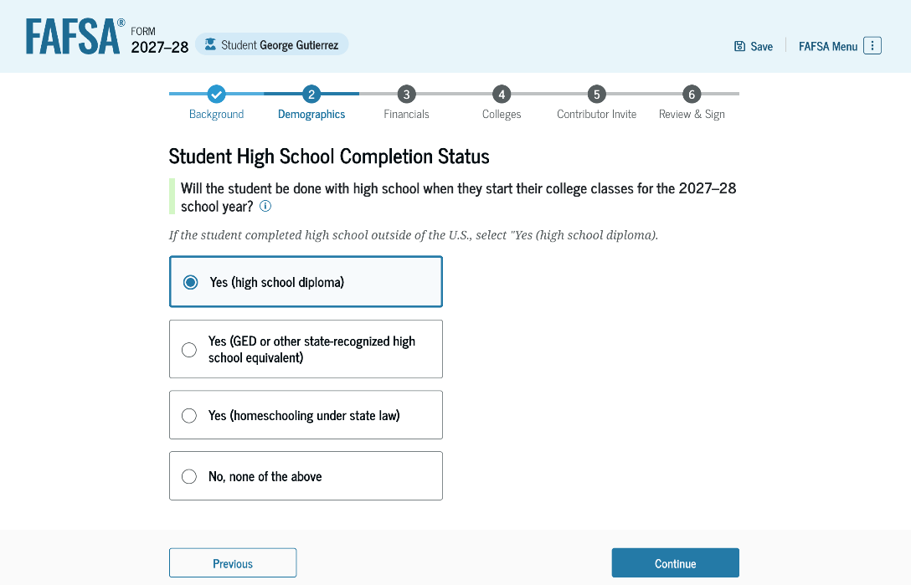
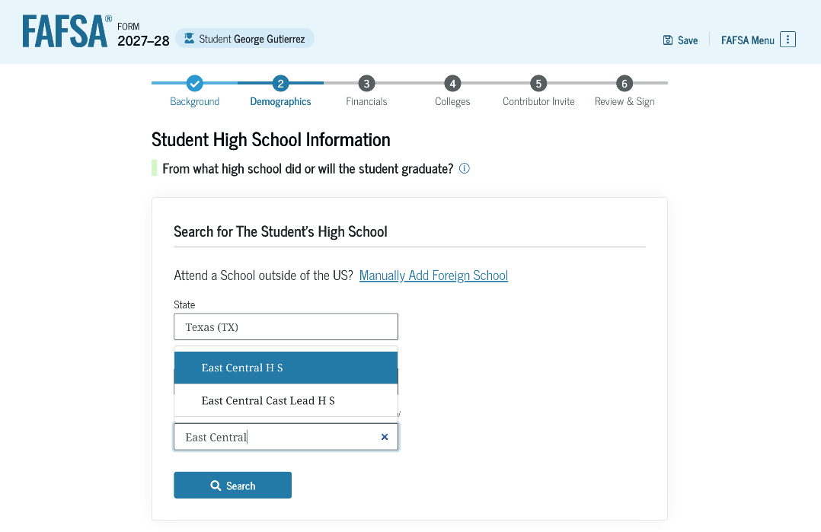
High school information

Slide 25
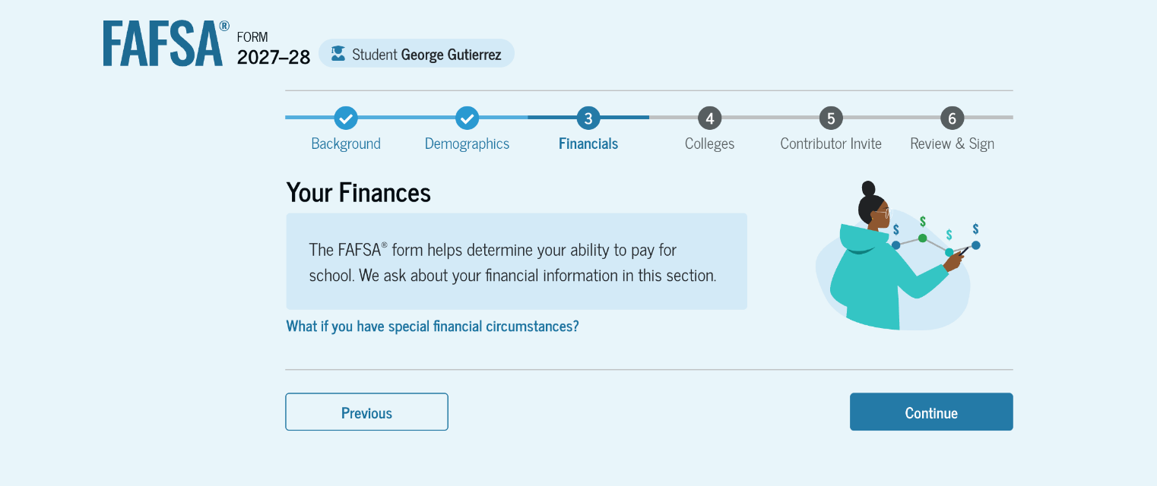
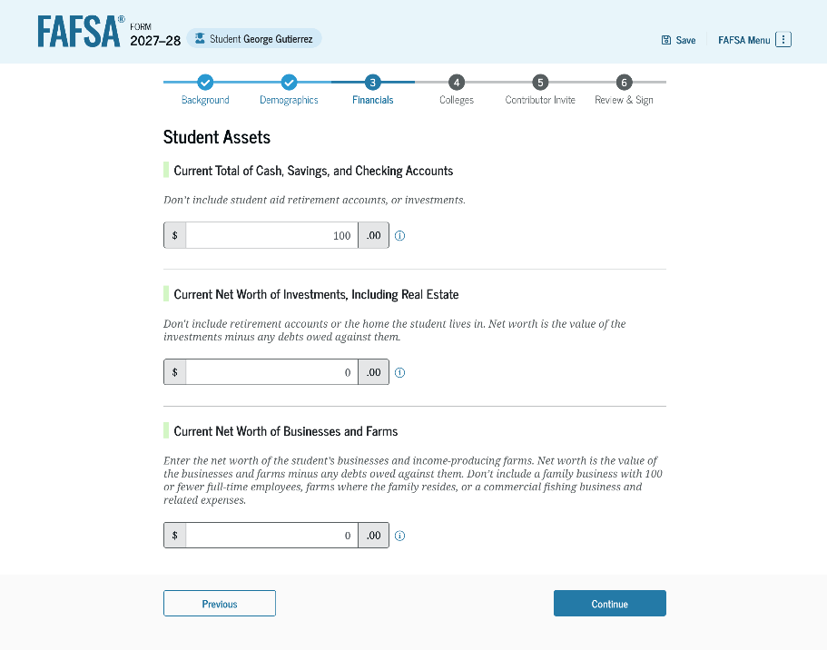
Student Financials
Notes:
Students must complete a demographic survey. The survey is mandatory (legislated by Congress), but the student can indicate they prefer not to answer. The information collected does not impact a student’s financial aid award.

Slide 26
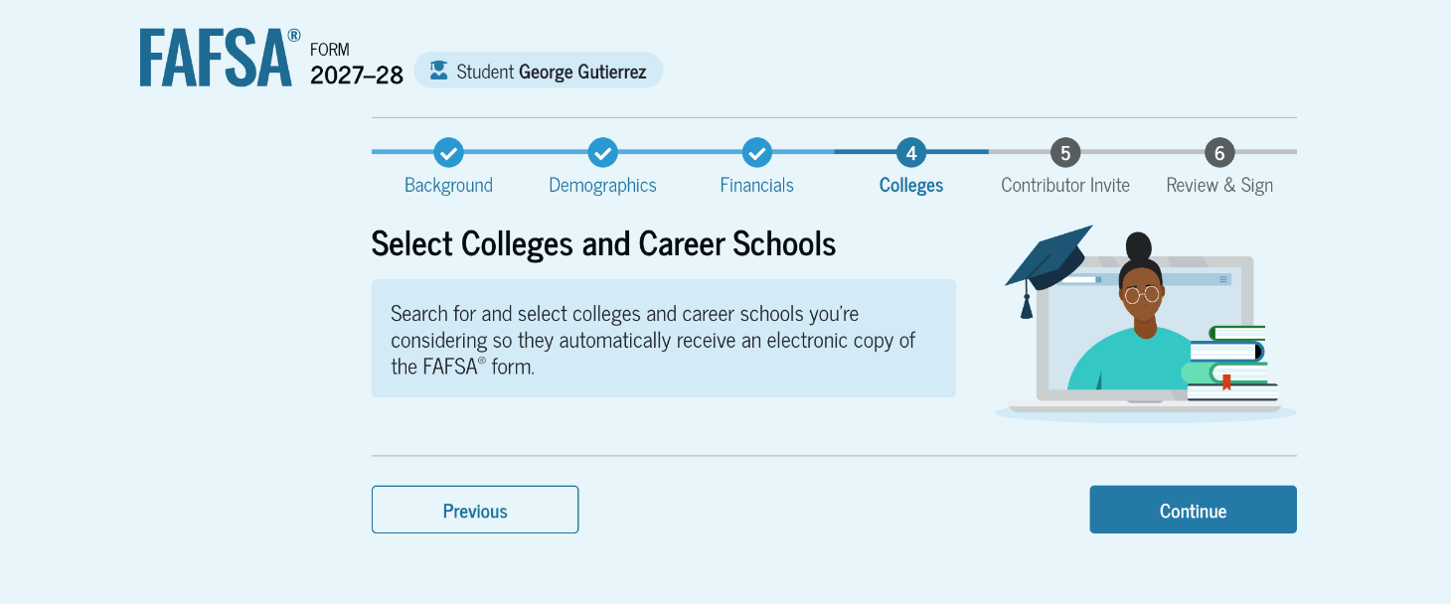
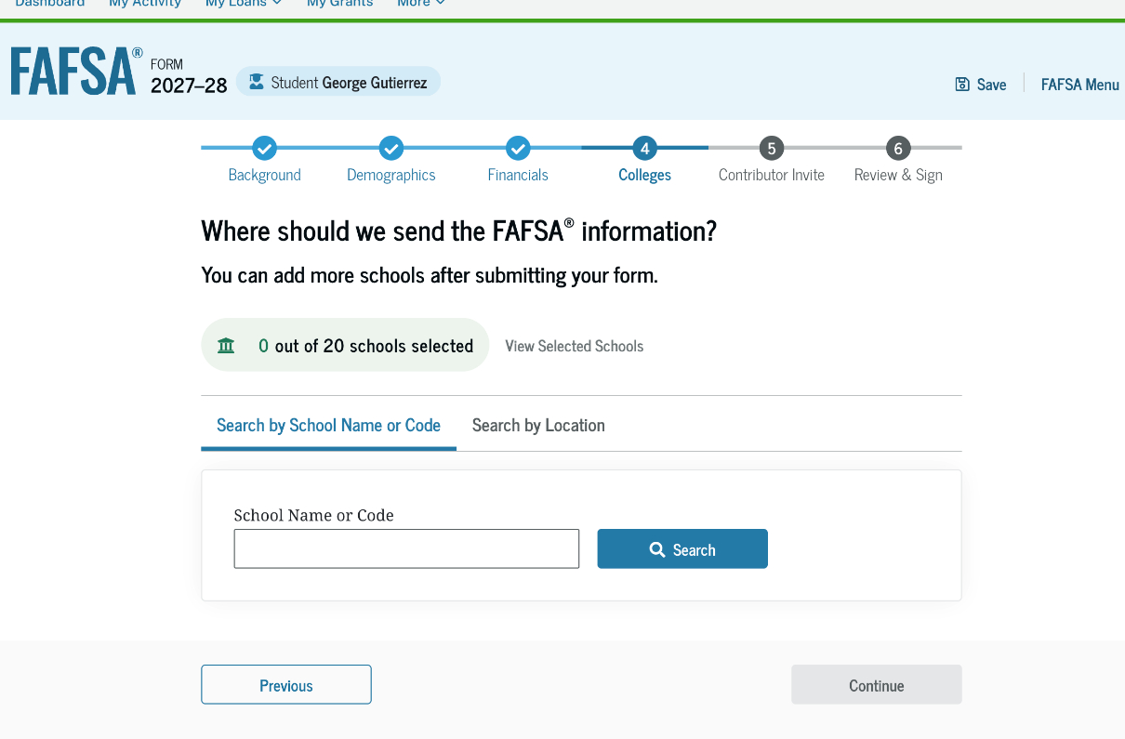
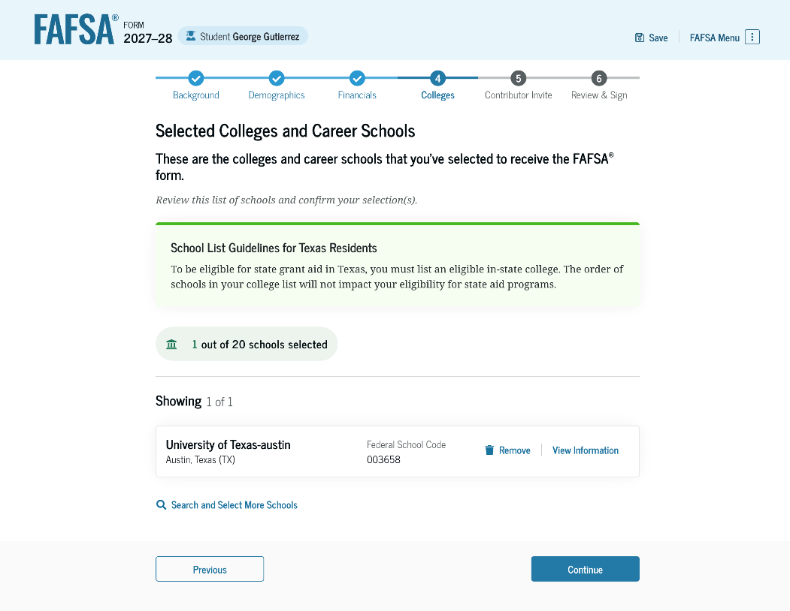
Select colleges
Select up to 20 schools to receive FAFSA information
Use Search or enter school’s Title IV code
26
Notes:
Select up to 20 schools to receive FAFSA information
Use Search or enter school’s Title IV code
Order does not matter in most states (Some states require students to list a state institution in their top three choices if they want state aid).

Slide 27
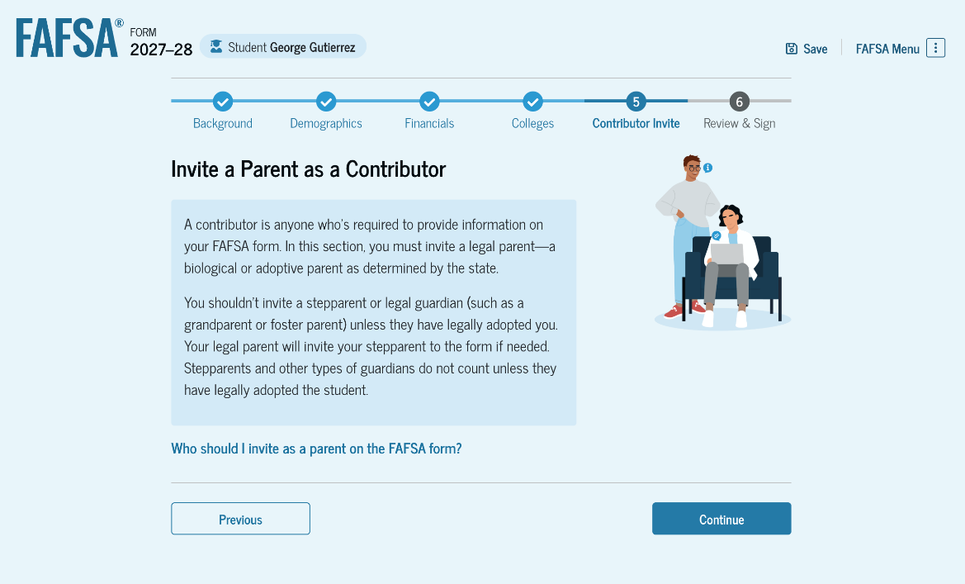
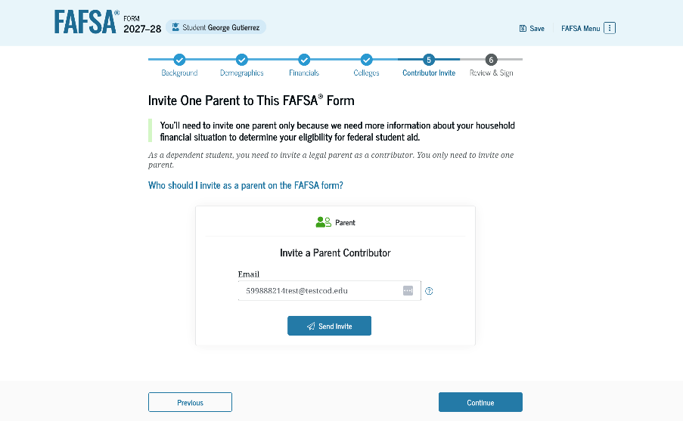
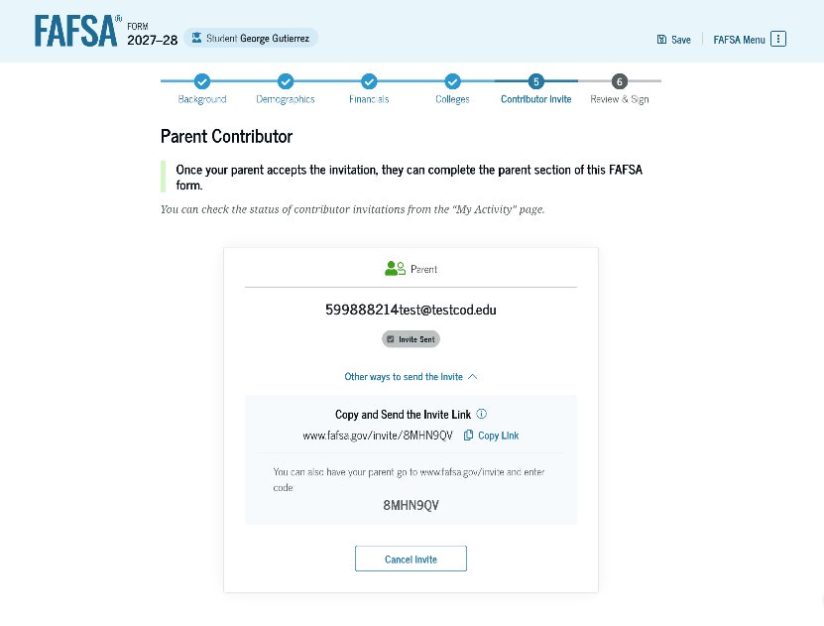
Inviting a parent as a contributor
Parent wizard to help determine the parent
Student invites the parent through the FAFSA by entering parent’s e-mail address
  The second parent may be invited to contribute later, especially if the parents did not file joint taxes.

Slide 28
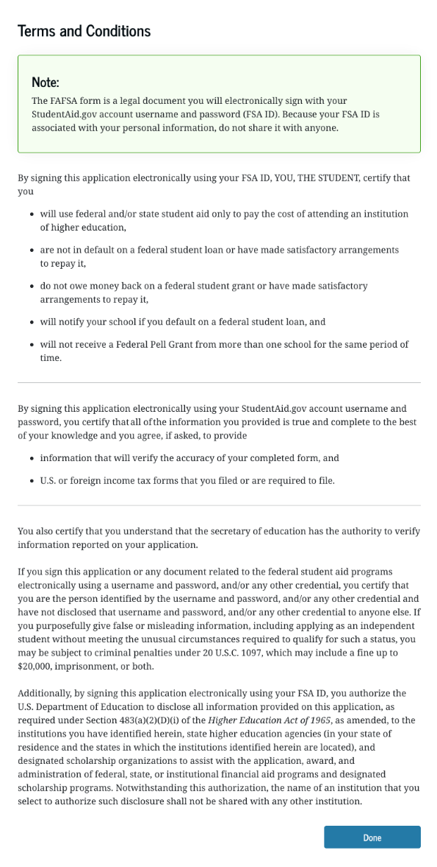
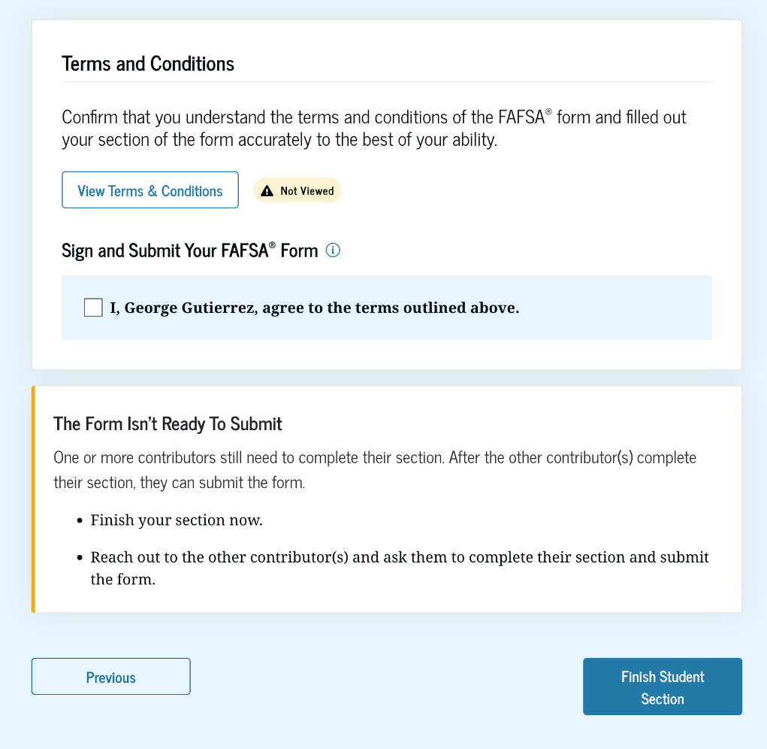
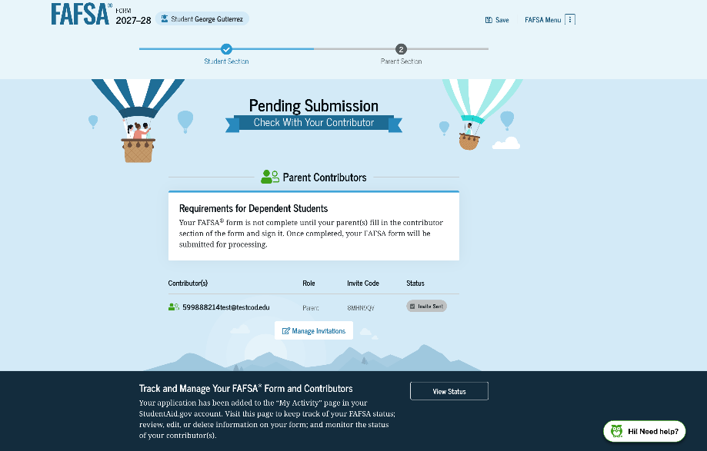
Dependent student review and signature

Slide 29
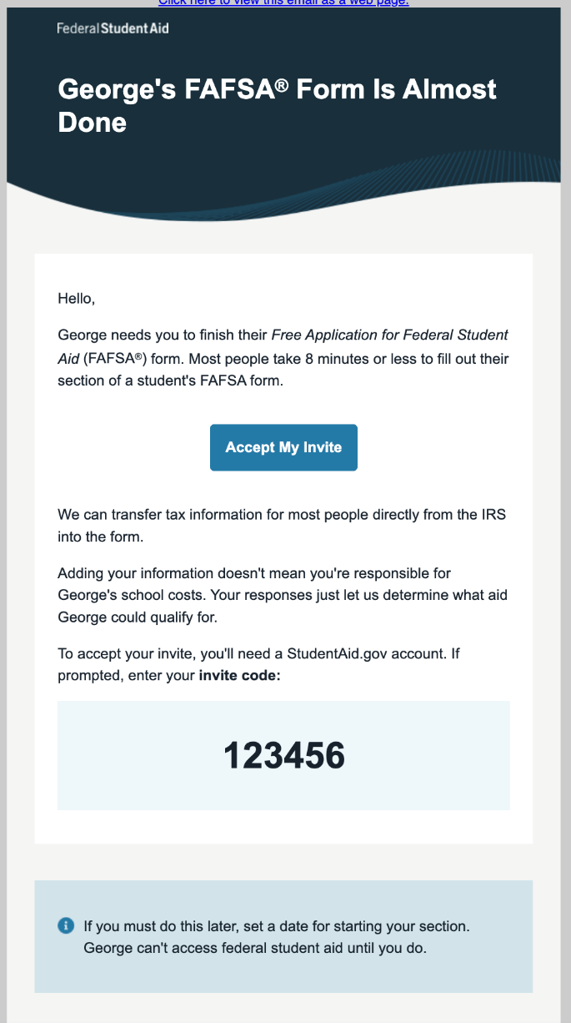
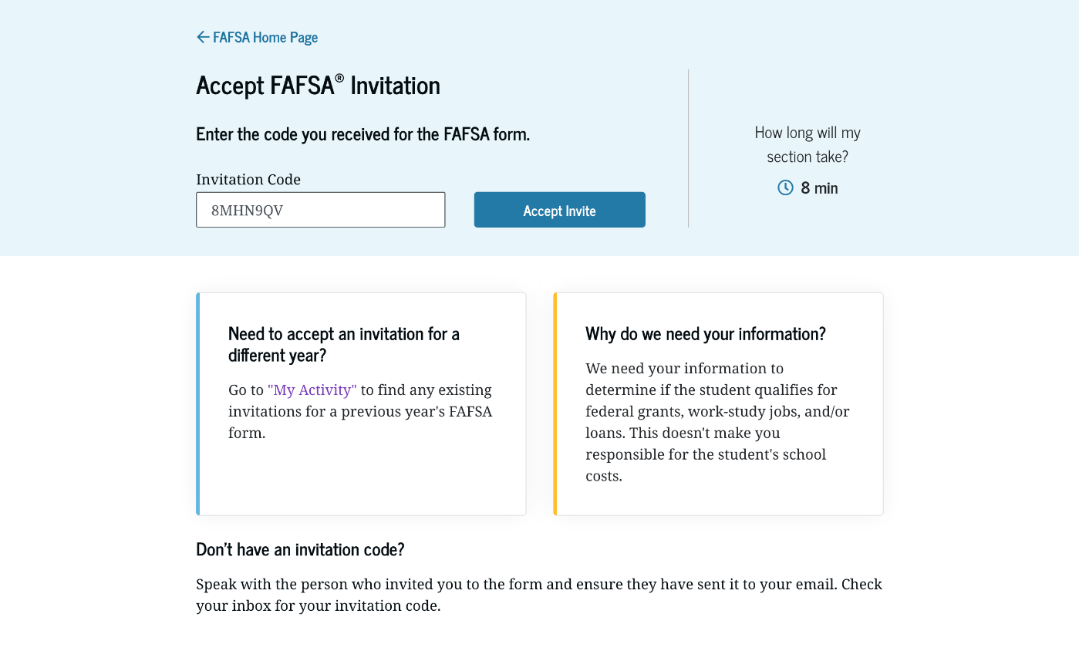
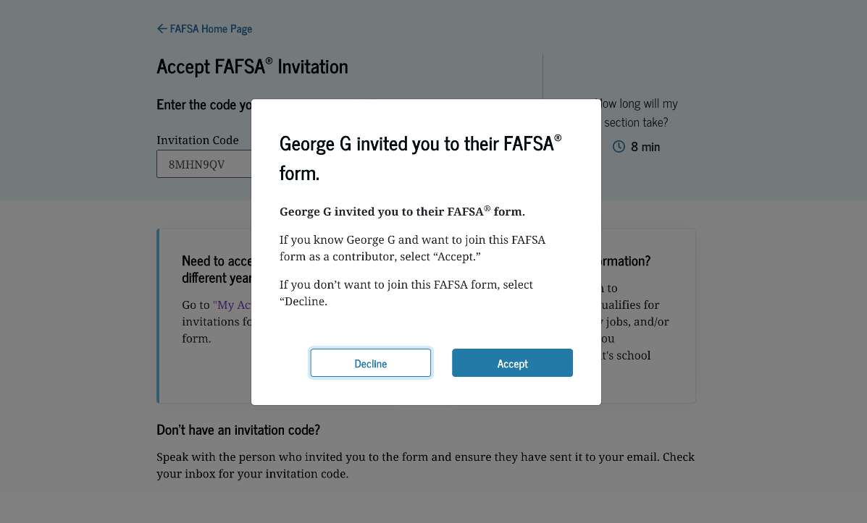
Parent accepts invitation
Parent receives email and clicks on “Accept my Invite.”
8MHN9QV
Notes:
Parent will log into their StudentAid.gov account using their FSA ID user name and password and hit “Get Started.”

Slide 30
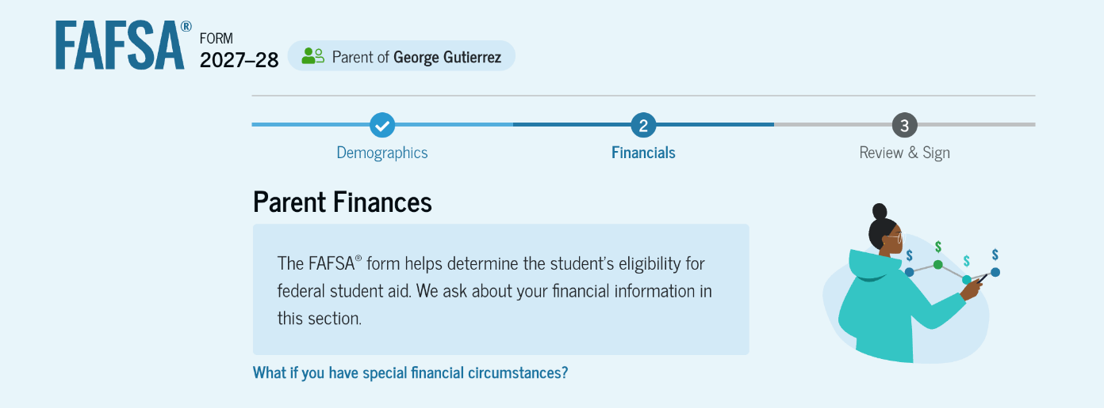
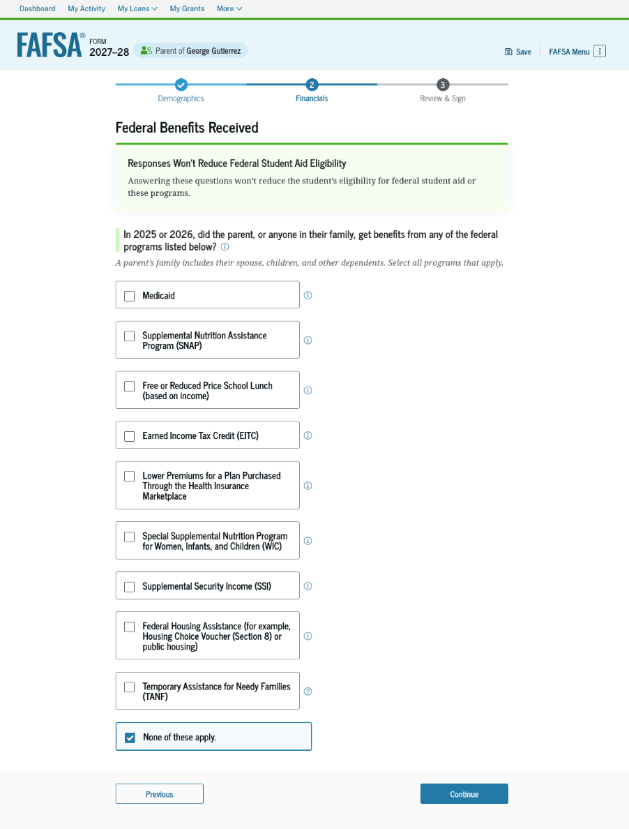
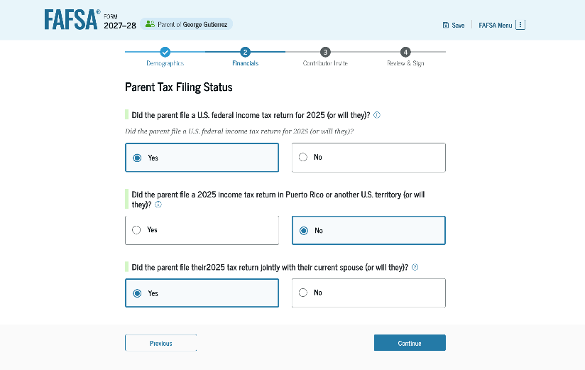
Parent financial information
Notes:
Financial questions.
If anyone in the family was eligible to receive the federal benefits listed, they will not be asked to provide assets.

Slide 31
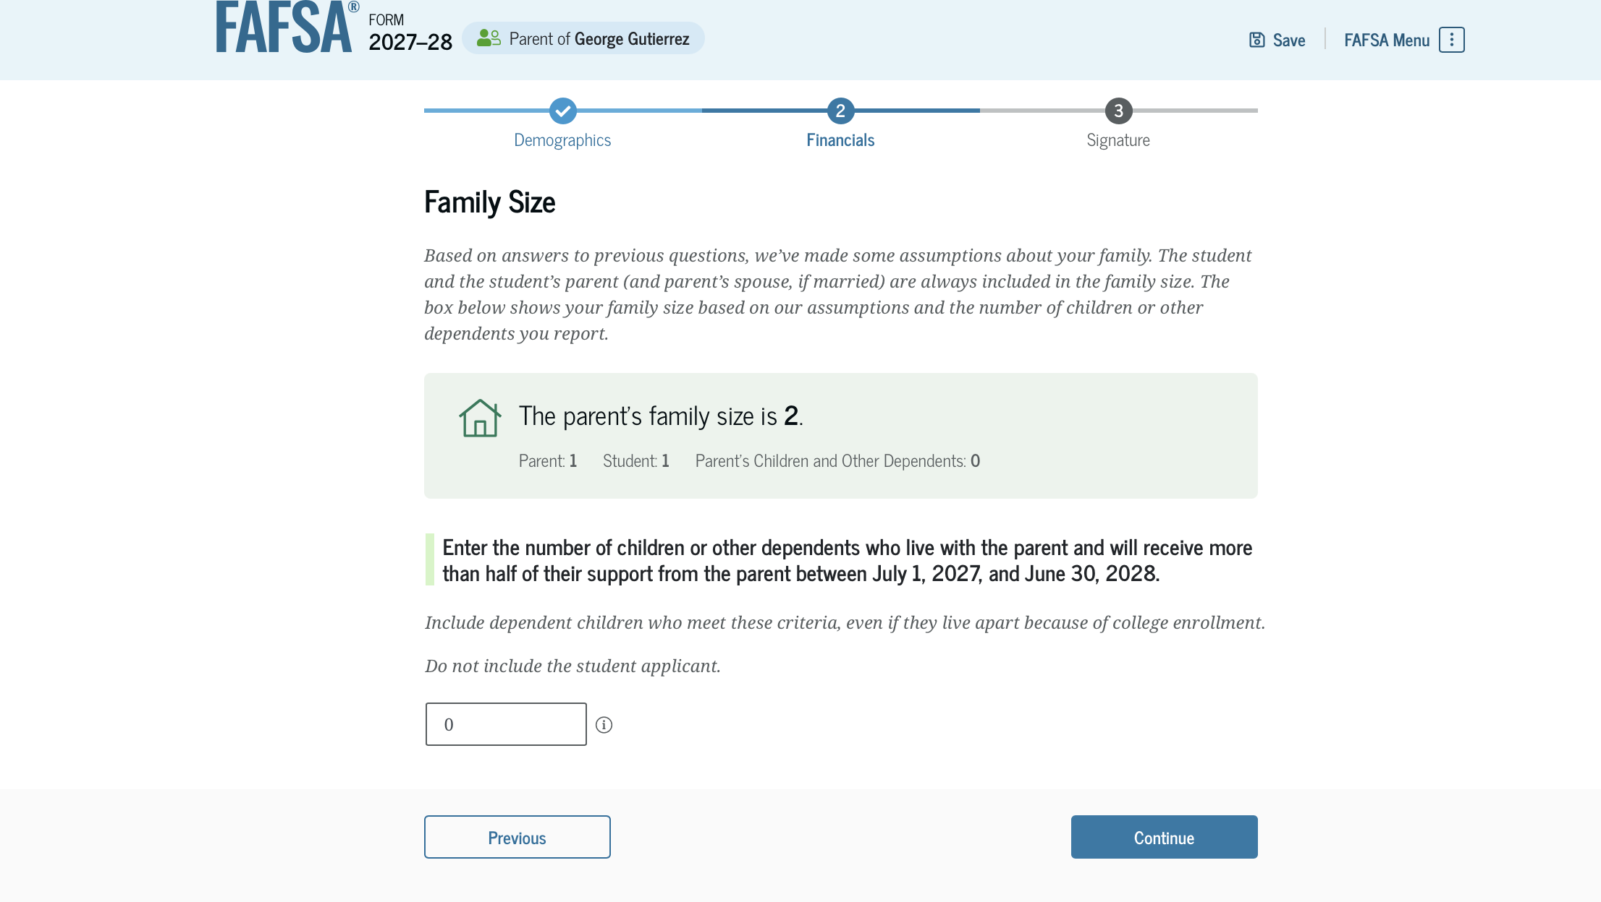
Family size
Can report if the number of dependents is different than the number of individuals claimed on 2025 tax return

Slide 32
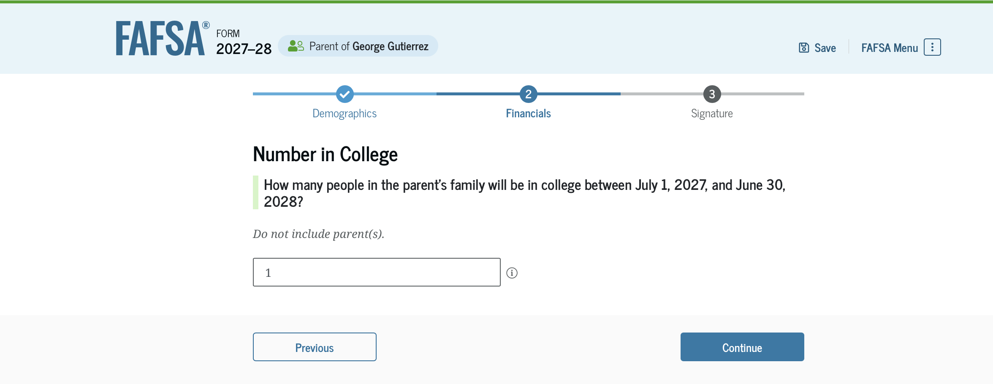
Who is included in the number in college?
Dependent student
Student
NOT the parent(s)
Others attending at least half time in an approved program during 2027-28 that leads to a degree or certificate at a postsecondary school eligible to participate in any of the federal student aid programs
Does not factor into need analysis calculation

Slide 33
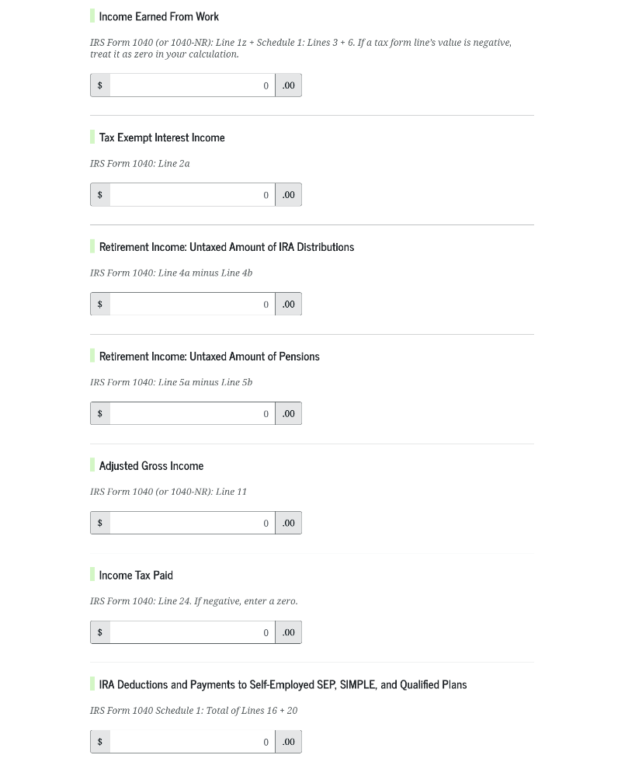
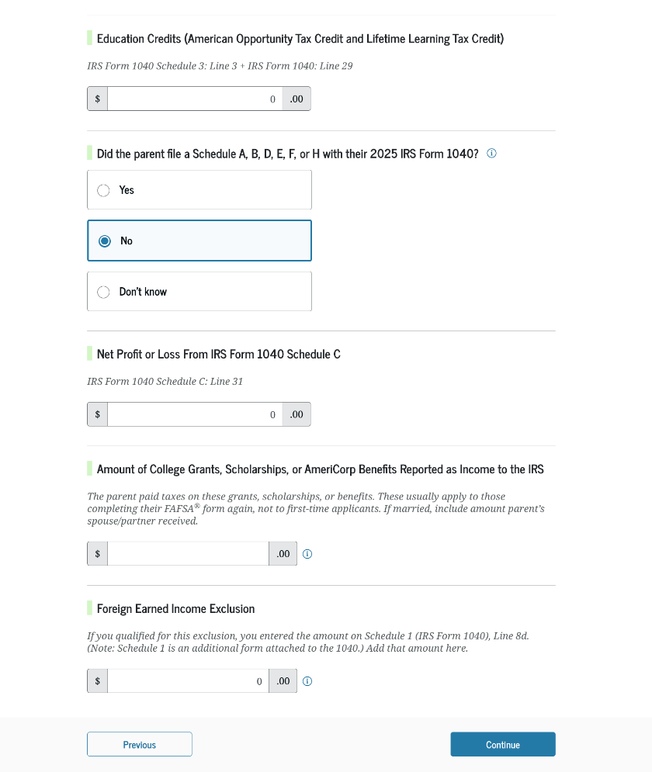
Parent financial questions
These questions are dependent on the information imported from the IRS.

Slide 34
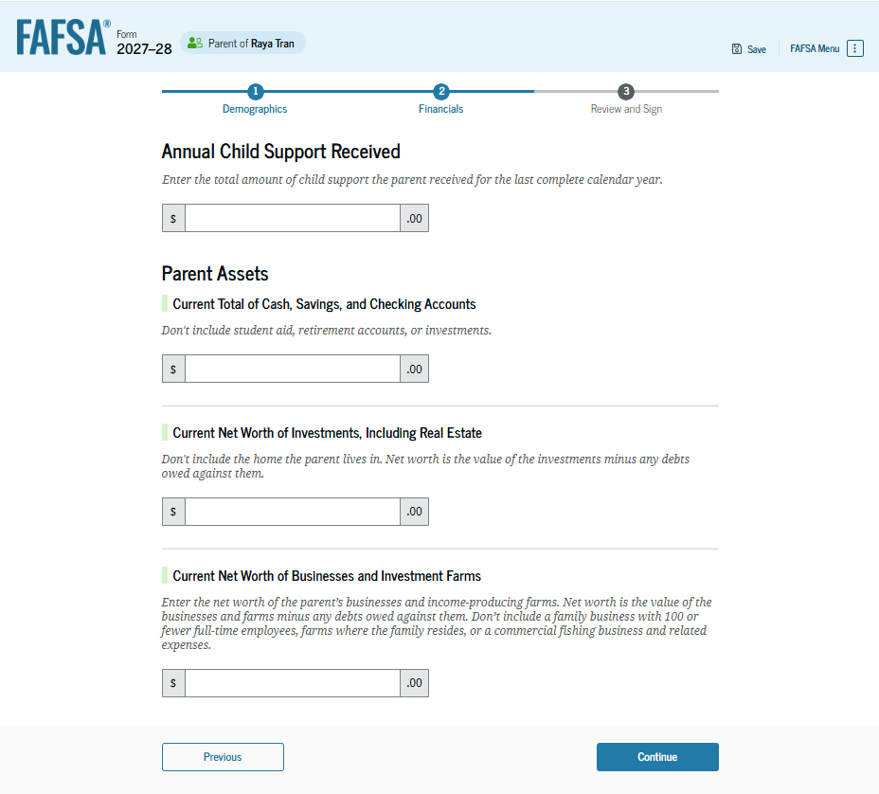
Asset questions
Annual child support received
Cash, savings, and checking accounts
Businesses and investment farms
Investments, including real estate (not parents’ home)

Slide 35
Determining the value of assets
Market value
Debt owed
Net value

Slide 36
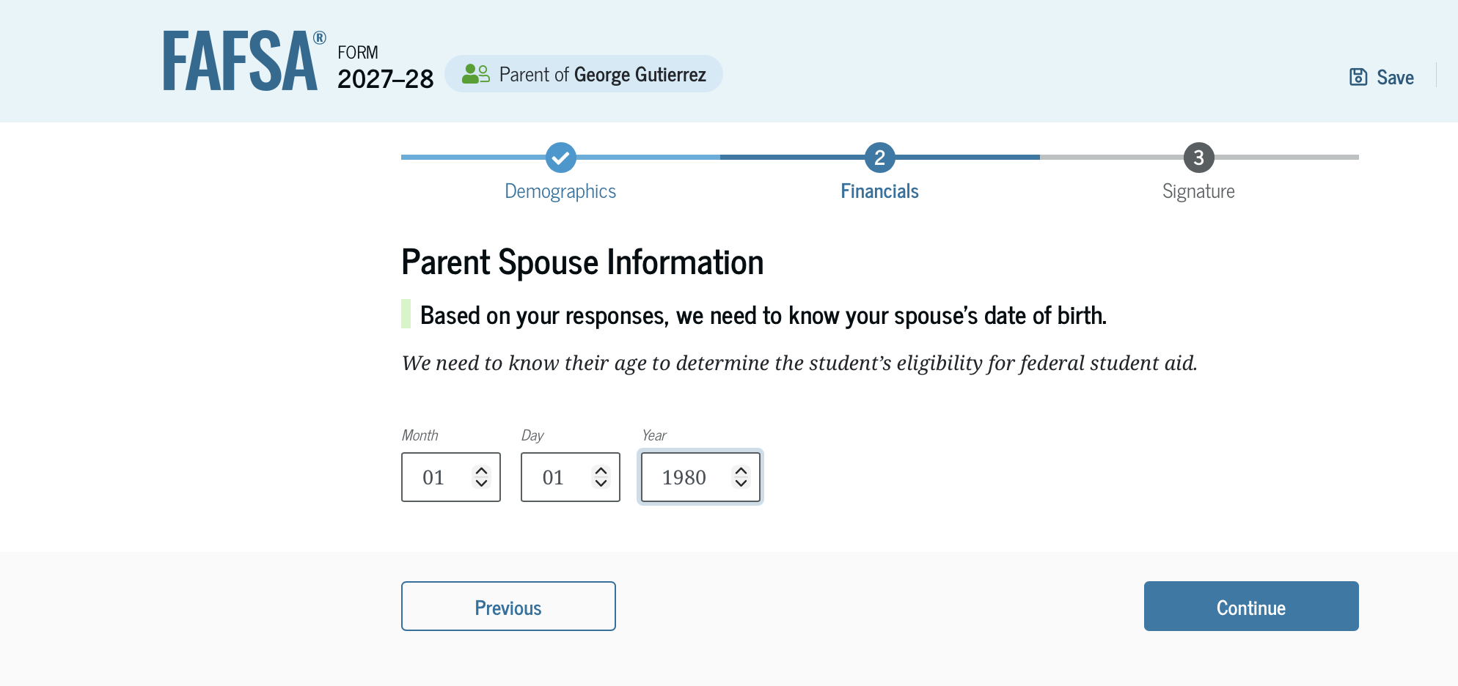
Other parent information
Could be a biological or adoptive parent or step-parent

Slide 37
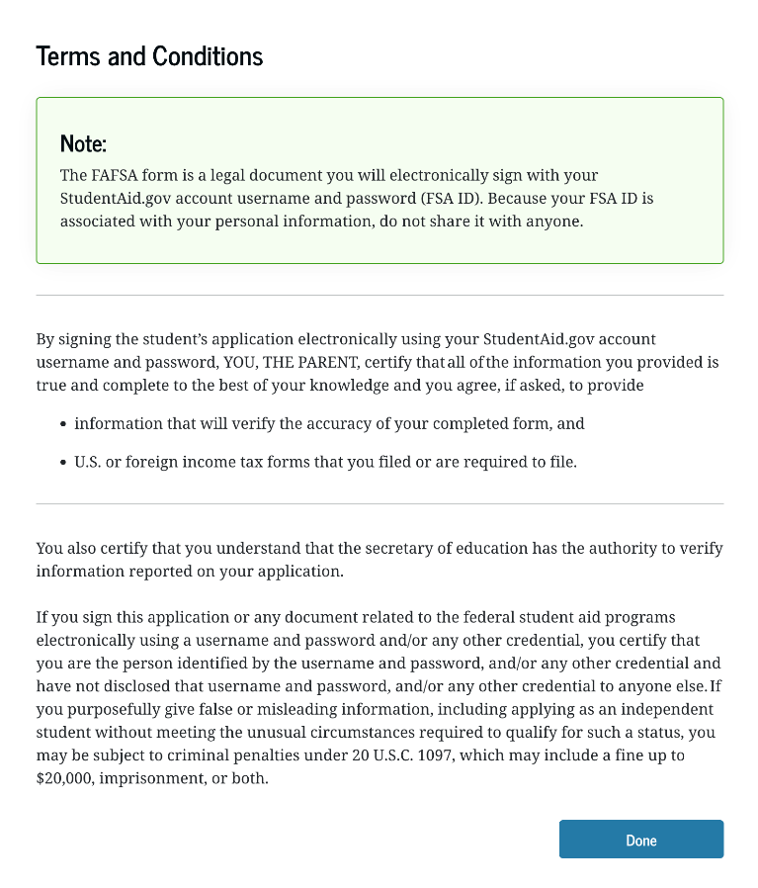
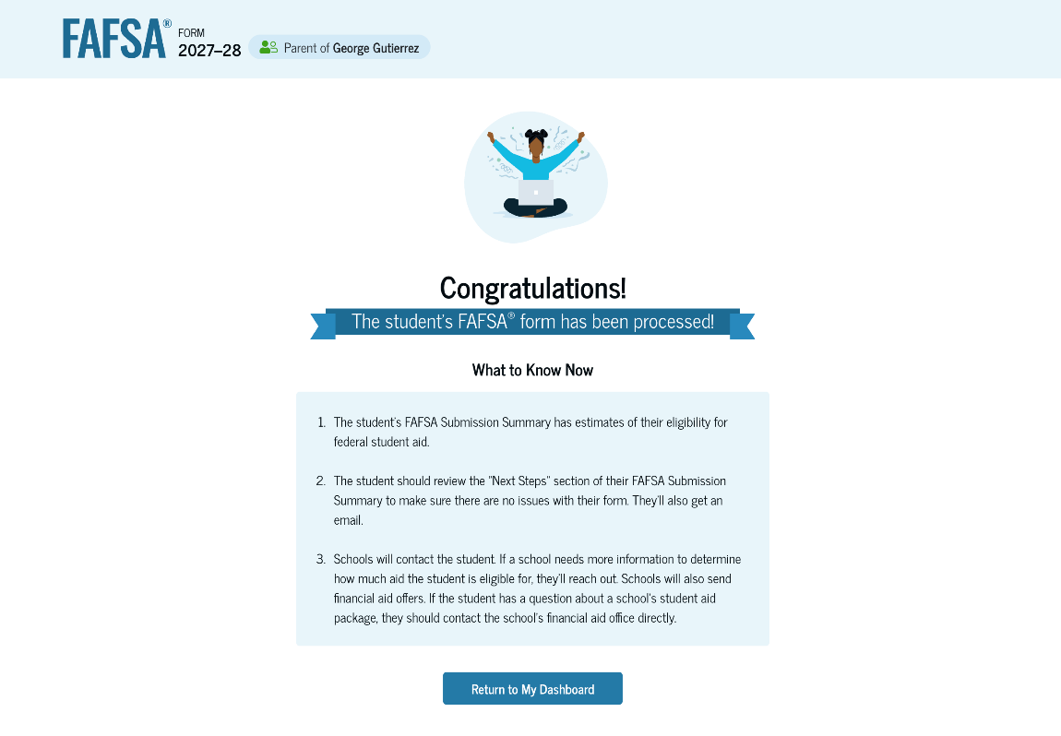
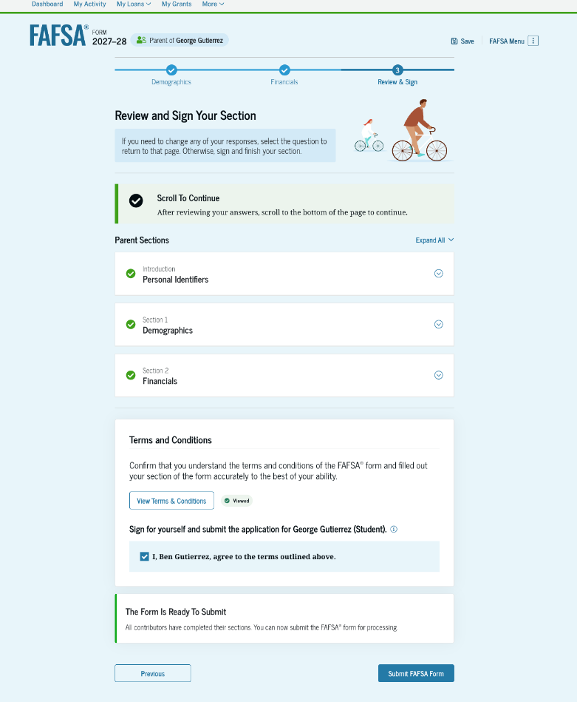
Parent review, signature and confirmation page

Slide 38
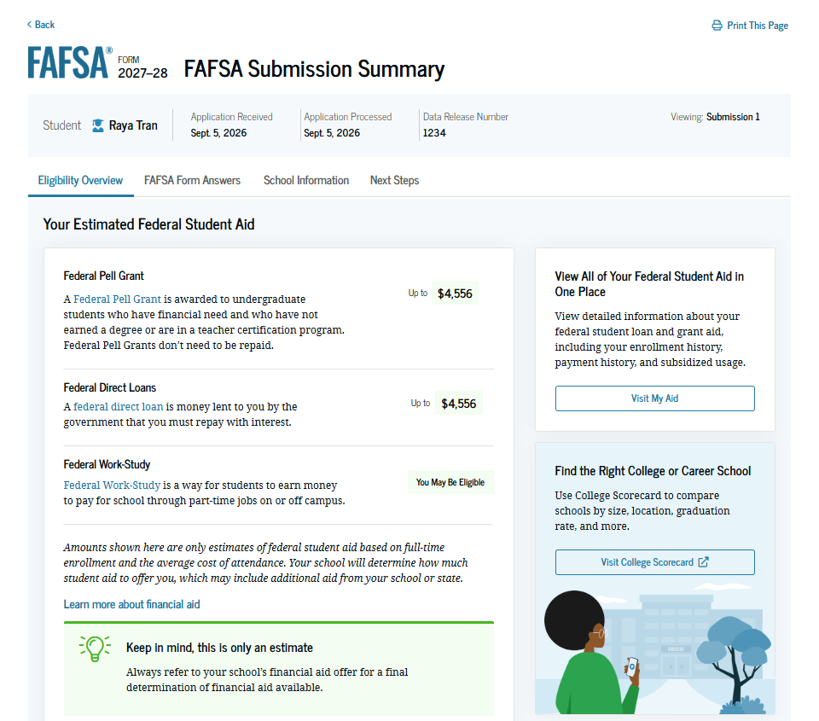
FAFSA Submission summary
FAFSA Submission Summary is now immediately available.
It is an estimate of federal financial aid.

Slide 39
Student Aid Index (SAI)
The amount a family can reasonably be expected to contribute
Calculated using data from the FAFSA and federal formula
  May be a negative number
Two components
  Parent contribution
  Student contribution
Stays the same regardless of college

Slide 40
Financial aid calculation
Cost of
Attendance
Student Aid Index
Other financial assistance
Need

Slide 41
Sample maximum federal financial aid amounts
Federal Pell Grant: up to $7,395*
Direct Loan: $5,500 for full-time undergraduates
  Up to $3,500 Subsidized with remaining amount Unsubsidized
  Part-time students borrowing based on enrollment.
Direct PLUS Loan: Parents can borrow up to $20,000 per year per student for a total of $65,000.
  9.07% interest rate*
  *For the 2026-27 academic year

Slide 42

Sample financial aid offer
Also referred to as award letter

Slide 43

State Scholarship programs
South Dakota Opportunity Scholarship
Dakota Corps Scholarship
South Dakota Need-based Grant Program
Build Dakota Scholarship
Freedom Scholarship
Jump Start Scholarship
Critical Teaching Needs Scholarship

Slide 44
Scholarship tips
Develop a plan
Understanding the cost
Establish a scholarship goal
Conduct research
Research local, college, state, employer programs
Organizations/
employers that align with your career choice
Scholarship search
Prepare applications
Write the essay
Proof and edit, neatness counts
Stay organized
Use the scholarship tracking sheet
Follow deadlines, requirements
Have a dedicated
e-mail address

Slide 45


Slide 46
Resources
SouthDakota.MappingYourFuture.org
  https://southdakota.mappingyourfuture.org/college.cfm
  https://southdakota.mappingyourfuture.org/career-sort.cfm
MappingYourFuture.org
StudentAid.gov
  https://studentaid.gov/aid-estimator/
  1-800-4-FEDAID
Scholarship tracking sheet: https://mappingyourfuture.org/wp-content/uploads/2026/01/MappingYourFuture_Scholarship_Tracking2026.xlsx
Scholarship searches
  FastWeb: www.fastweb.com/
  BigFuture: bigfuture.collegeboard.org/
  Scholarship Resources: https://mappingyourfuture.org/wp-content/uploads/2024/08/MappingYourFutureScholarshipTips.pdf
46

Slide 47

Questions
47
© Mapping Your Future 2026

Slide 48

Thank you for participating
Cathy Mueller
Marlene Seeklander
(800) 374-4072
feedback@mappingyourfuture.org
SouthDakota.MappingYourFuture.org

